Slide 1

Local Work Group Meeting
Introduction for Conservation District Board Members

Slide 2
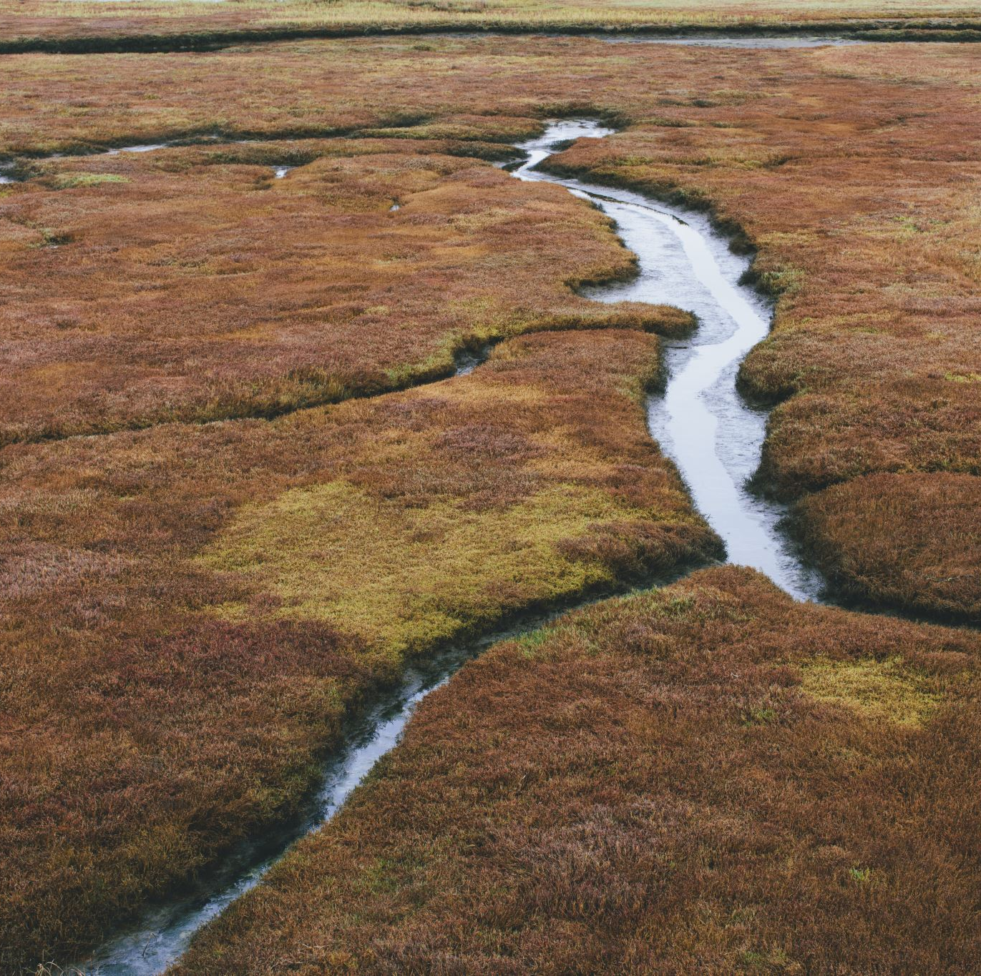
Locally Lead Conservation
I consider the soil conservation districts movement one of the most important developments in the whole history of agriculture. – Hugh Hammond Bennett

Slide 3
Local Work Group Meeting Purpose
Collect feedback from conservation partners and producers for local priorities, information, and concerns for NRCS financial and technical assistance administration and implementation.
  Adjust priority resource concerns,
  Change allocation distributions,
  Create new fund pools for priority/ specialized projects,
  Request changes in payment schedules,
  Inform technical decisions and state level implementation requirements,
  Identify barriers in local and state level program participation,
  Adopt/identify new technologies and practices that have proven successful locally,
  Collect local success stories,
  Understanding training needs for producers, partners, and staff

Slide 4
General Guidance
Responsibility of the local Conservation District to advertise and host the meeting.
Invite other conservation partners and producers to attend the meeting for input
Meeting to be held by July 15, 2023
Can be done in any format ( in person meeting, virtual meeting, or teleconference)
Complete and return Local Working Group Task Worksheet by July 31, 2023 to Amber Freouf amber.Freouf@usda.gov

Slide 5


Slide 6
Generational Differences in Communication
Age 58-75 (Baby Boomers)
Preferred communication is face to face or telephone over email and text.
Age 40-57 (Generation X)
Preferred communication is email and cell phone over face to face.
Age 25-39 (Millennials)
Preferred communication is email and text over face to face and telephone.
Age 24 and younger (Generation Z)
Preferred communication is face to face over email or other written communication.

Slide 7
New Support Packet

Slide 8
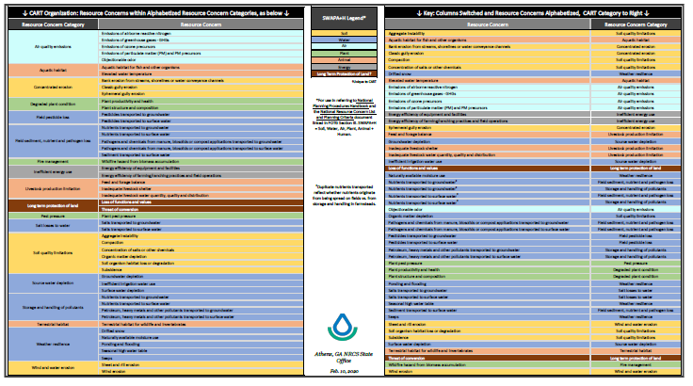

Slide 9
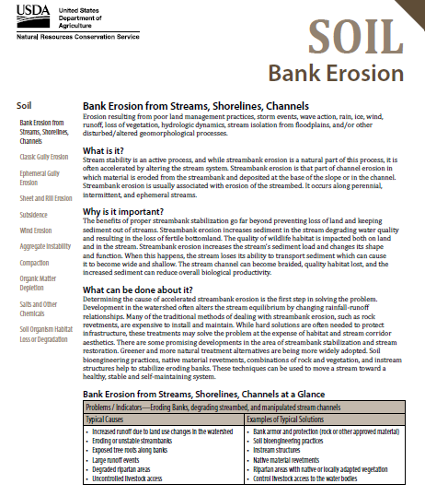
Detailed summary of each resource concern explaining:
  What the Resource Concern is
  Why it is important
  How to improve upon it
  Quick Glace of cause and solution

Slide 10
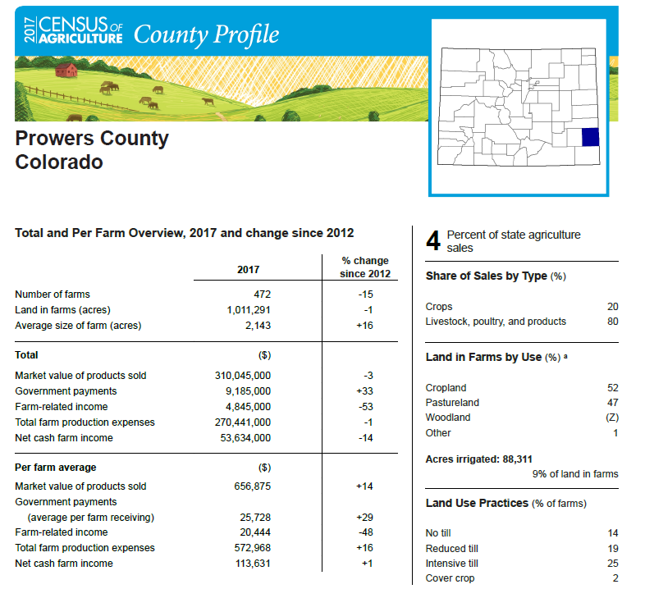
Summary breakdown of types of operations, ag products produced, and demographics of producers
Top agricultural products produced in the county
Types of tillage operations done in county
Percent of operators with internet access

Slide 11
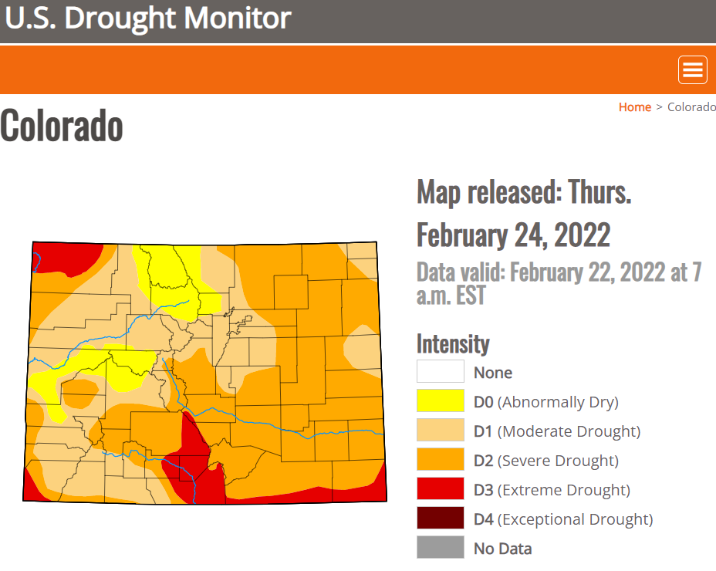
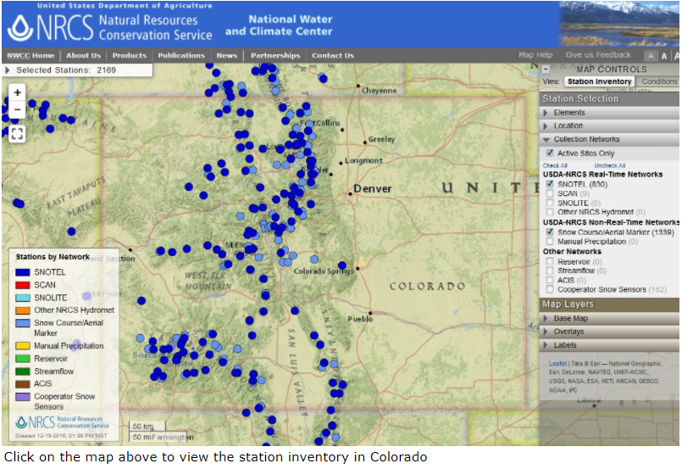
Other Resources Available
Current Drought Monitor Map
Interactive Snow Survey Map

Slide 12

Optional Survey
Google based or can be printed out email amber.Freouf@usda.gov for template
Overview of questions located on Local Work Group Meeting Task Worksheet
Conservation districts responsibility to compile results- google auto generates responses

Slide 13
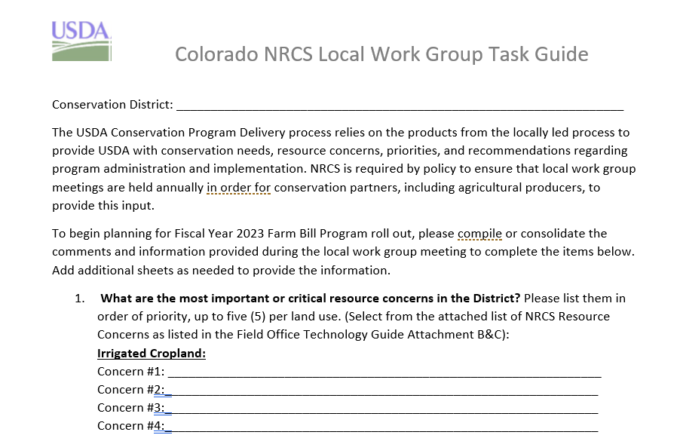
Local Work Group Meeting Task Worksheet
Completed after meeting is held
Summary of input from the meeting
Comments received affected changes for FY23 program administration and delivery
Used for future considerations for FY24 program administration and delivery
Email back to Amber Freouf amber.freouf@usda.gov by July 31, 2023

Slide 14
New to the task guide
Information gathered from FY22 LWG showed strong interest in locally lead conservation projects to be completed within conservation districts.
For FY23 NRCS developed Locally Lead fund pools in EQIP across all 21 Resource Team areas
Information was used from the past year’s LWG meeting to develop ranking questions and criteria
Help NRCS improve upon this effort: What is your locally lead conservation project, area of interest, resource concerns to be treated, and what conservation practices are needed.

Slide 15
Local Work Group Guidebook
Developed by National Conservation Planning Partnership
Optional for Conservation District use
Includes:
  Defining Membership for LWG
  Defining LWG Responsibilities
  Example of Meeting Checklist and other documents to host LWG meeting
  Frequently Asked Questions
  Template to help develop and refine any locally lead projects in your conservation district area to be used in Locally Lead EQIP fund pools

Slide 16

Thank you for your support

Slide 17
USDA Non-Discrimination Statement
In accordance with Federal Civil Rights law and U.S. Department of Agriculture (USDA) Civil Rights regulations and policies, the USDA, its agencies, offices, and employees, and institutions participating in or administering USDA programs are prohibited from discriminating based on race, color, national origin, religion, sex, gender identity (including gender expression), sexual orientation, disability, age, marital status, family/parental status, income derived from a public assistance program, political beliefs, or reprisal or retaliation for prior credible activity, in any program or activity conducted or funded by USDA (not all bases apply to all programs). Remedies and complaint filing deadlines vary by program or incident.
Persons with disabilities who require alternative means of communication for program information (e.g., Braille, large print, audiotape, American Sign Language, etc.) should contact the responsible Agency or USDA's TARGET Center at (202) 720-2600 (voice and TTY) or contact USDA through the Federal Relay Service at (800) 877-8339. Additionally, program information may be made available in languages other than English.
To file a program discrimination complaint, complete the USDA Program Discrimination Complaint Form, AD-3027, found online at How to File a Program Discrimination Complaint and at any USDA office or write a letter addressed to USDA and provide in the letter all of the information requested in the form. To request a copy of the complaint form, call (866) 632-9992. Submit your completed form or letter to USDA by: (1) mail: U.S. Department of Agriculture, Office of the Assistant Secretary for Civil Rights, 1400 Independence Avenue, SW, Washington, D.C. 20250-9410; (2) fax: (202) 690-7442; or (3) email: program.intake@usda.gov.
USDA is an equal opportunity provider, employer, and lender.

