Slide 1
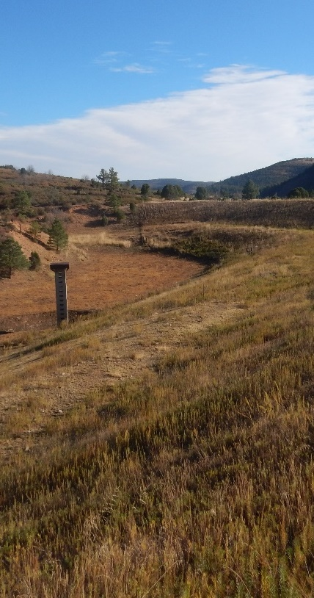
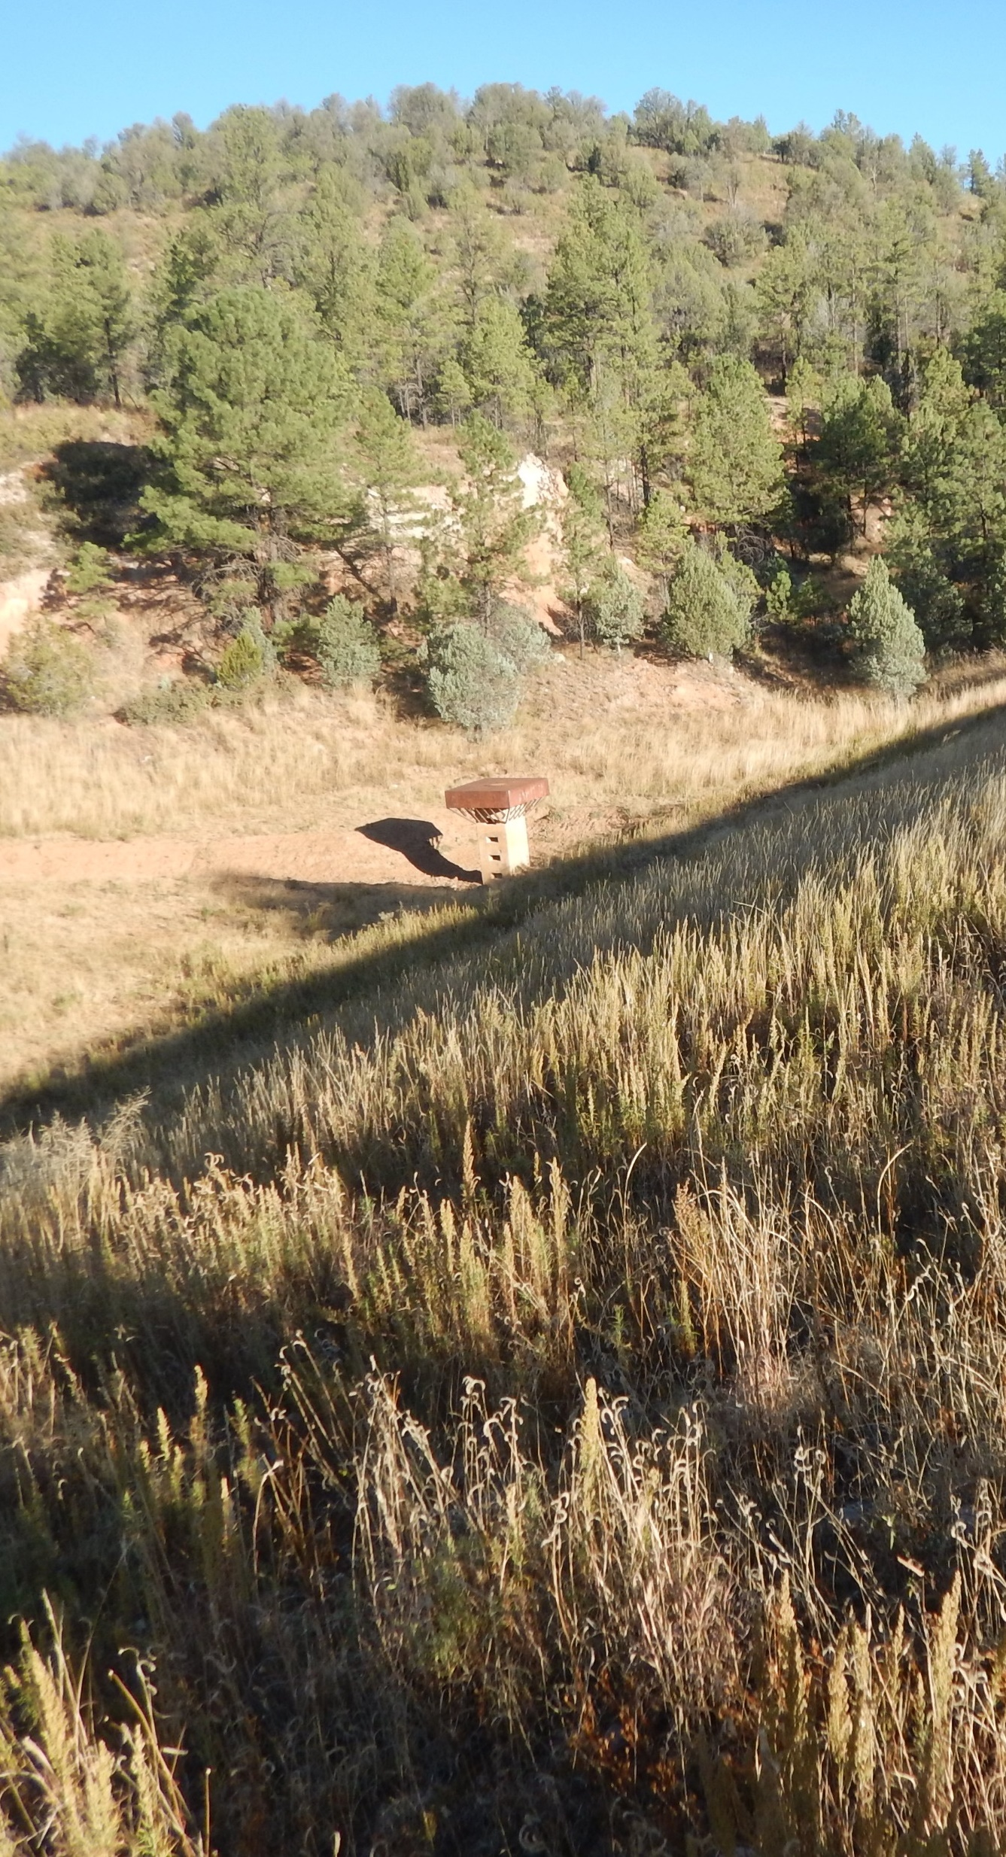
Supplemental Watershed Plan-Environmental Assessment for the Upper Rio Penasco Sites 1, 2, & 3A Dam Rehabilitation Project
Public Scoping Meeting
January 28, 2025, 6:30-8:00 PM
Mayhill Community Center
15 Civic Center Dr.
Mayhill, NM 88339

Slide 2
Meeting Agenda
Logistics and Introduction
Project Location and Background
NRCS Watershed Rehabilitation Program and NEPA Process
What Will the Supplemental Watershed Plan-EA include?
Purpose and Need
Overview of Scope of Work
Agency/Public Input and Comments
Discussion

Slide 3
Meeting Logistics
Instructions to Meeting Attendees
Instructions to Online Attendees
Muted and unable to speak.
Chat function is enabled and being monitored.
Add name, address, and email/phone number to the meeting chat.

Slide 4
Introductions
Lead Federal Agency
USDA Natural Resources
Conservation Service (NRCS)
Project Sponsor
Otero Soil and Water Conservation District
Elias Gnann, P.E. | State Conservation Engineer
Merceidez Fabok | Watershed Program Manager
Vicky Milne | District Manager
Bob Nichols and Jeff Rabon | Chairman
Consultant Lead
RJH Consultants, Inc.
Cooperating Agencies
U.S. Army Corps of Engineers
Justin Riggs
U.S. Forest Service – Lincoln National Forest
Amanda Ginithan and Titus Braboy
Robert Huzjak, P.E. | Project Manager
Ezra Stockton, P.E. | Project Engineer
Environmental Consultant
Pinyon Environmental, Inc.
Katie Evans, PMP | Project Manager

Slide 5
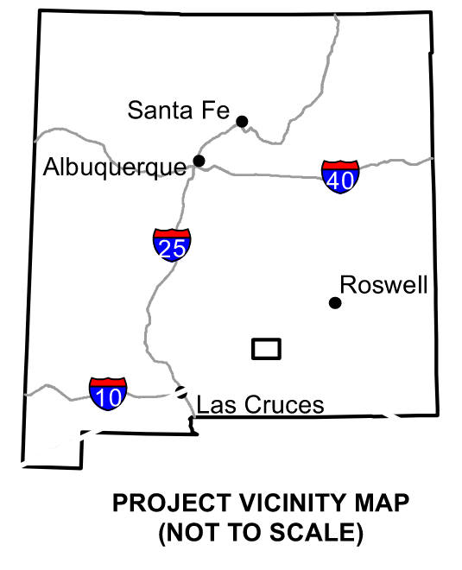
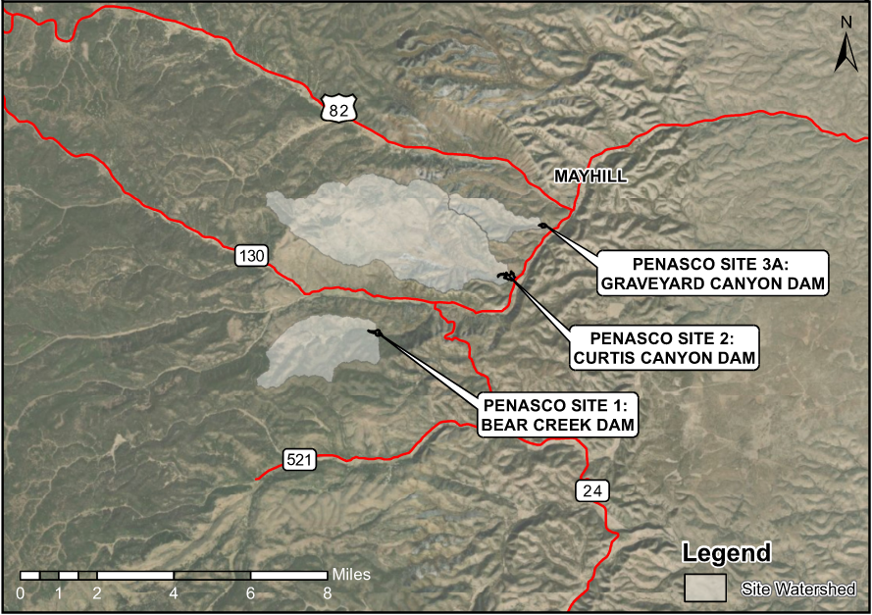
Project Location
Rio Penasco

Slide 6
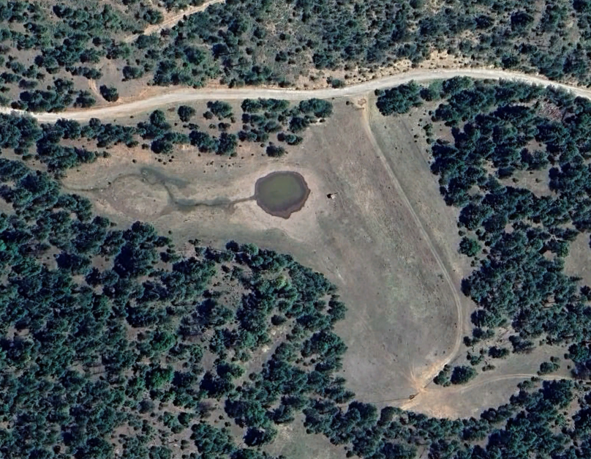
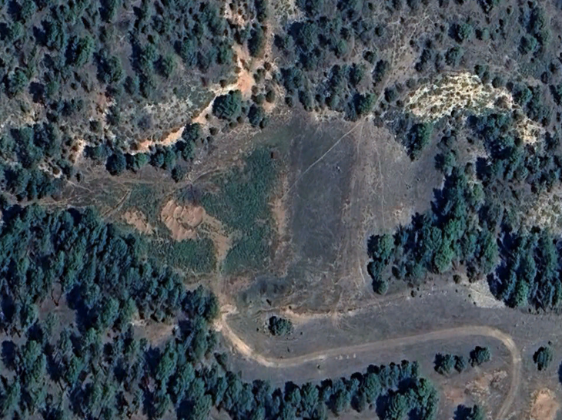
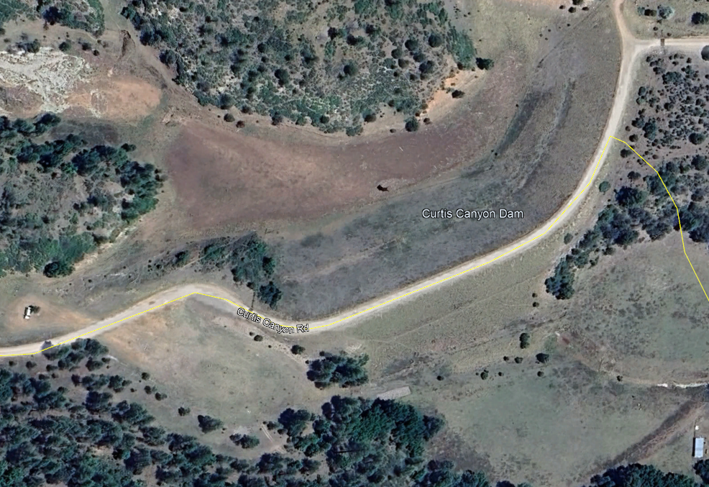
Project Location
Bear Creek Dam – Site 1
Graveyard Canyon Dam – Site 3A
N
Curtis Canyon Dam – Site 2

Slide 7
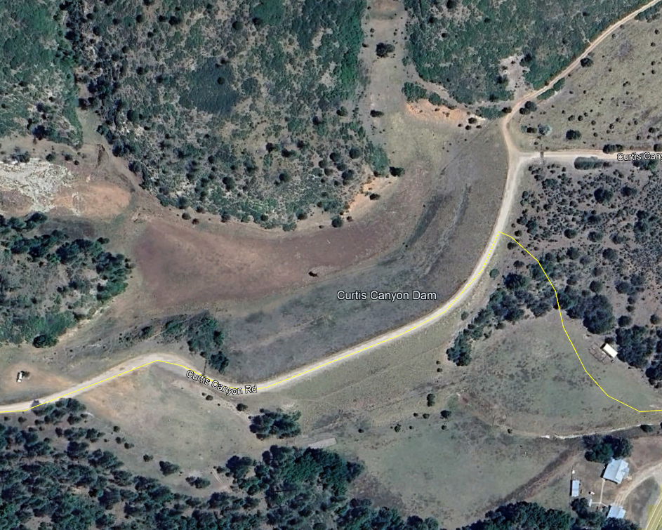
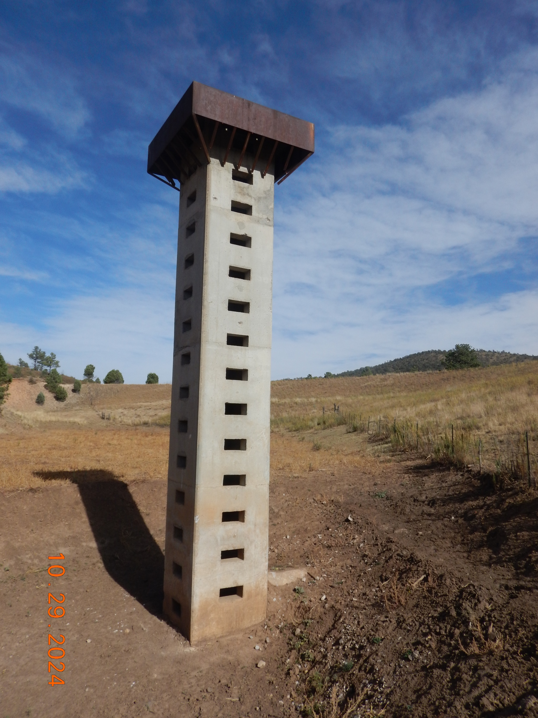
Dam Components
Riser Structure
Principal Spillway
Auxiliary Spillway
Dam (Embankment) Crest
N
Riser Structure
Reservoir
Dam Crest
Principal Spillway Conduit
Auxiliary Spillway

Slide 8
Background
Dams constructed between 1959 and 1960 for the purpose of flood protection.
Dams originally built as low hazard potential but are now rated as high hazard potential.
2023 condition assessment found that the dams do not meet current design and safety standards with the following deficiencies:
Inadequate principal and/or auxiliary spillways
Insufficient embankment crest width
No embankment filters for drainage and seepage management
Other deficiencies may still be identified
Notes:
Bear Creek Dam
PSH engages the auxiliary spillway (not meet NRCS criteria)
ASH and FBH overtop the dam
Assessment report includes 184’ wide labyrinth weir spillway and raising the dam 5.3 feet with a downstream raise.
Designed to contain a short duration 25-year storm
The 100-year storm has ~550 acre-ft runoff. The dam only has 95 ac-ft of storage between the sediment pool and the crest of the auxiliary spillway.
Curtis Canyon Dam
PSH engages the auxiliary spillway (not meet NRCS criteria)
ASH and FBH overtop the dam
400-foot wide labyrinth weir would work with existing dam crest elevation
The 100-year storm has ~1700 ac-ft runoff. The dam only has 173 ac-ft of storage if full sediment load (272 ac-ft with sediment in 2023).
Graveyard Canyon Dam
PSH engages the auxiliary spillway (not meet NRCS criteria)
ASH and FBH overtop the dam
A concrete lined auxiliary spillway is needed that is 2.6 ft higher and the dam crest would be raised 6.7 feet.
The 100-year storm has ~202 ac-ft runoff. The dam only has 45 ac-ft of storage between the sediment pool and crest of the auxiliary spillway.

Slide 9
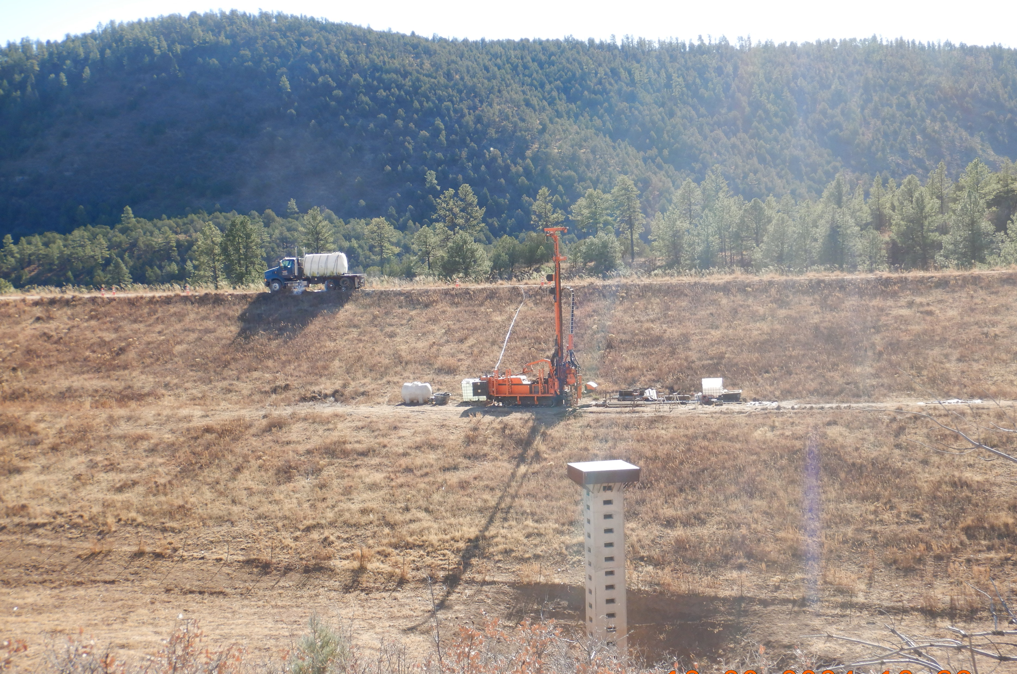
Benefits
Sediment retention
Flood protection for minor events
Could be modified to provide protection for the larger design storm events.

Slide 10
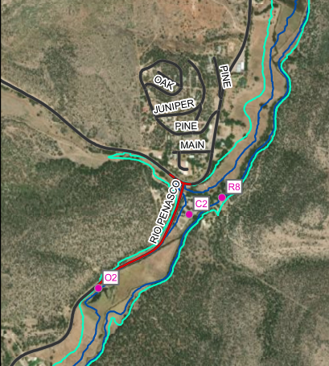
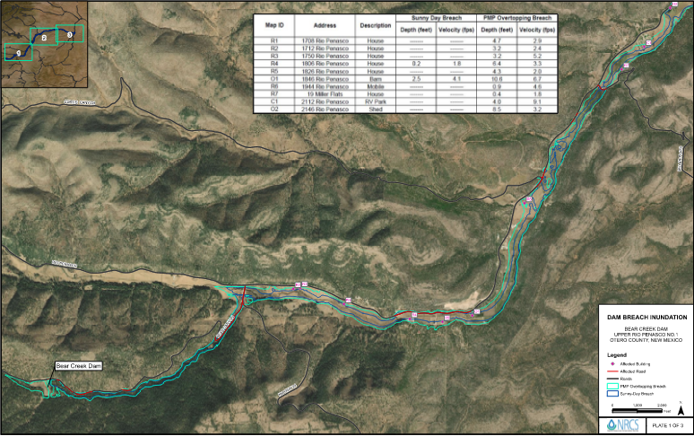
Dam Breach Inundation – Bear Creek
Mayhill
Impacted Structures
10 homes
2 RV Parks (92 Sites)
4 Outbuildings
N
Bear Creek

Slide 11
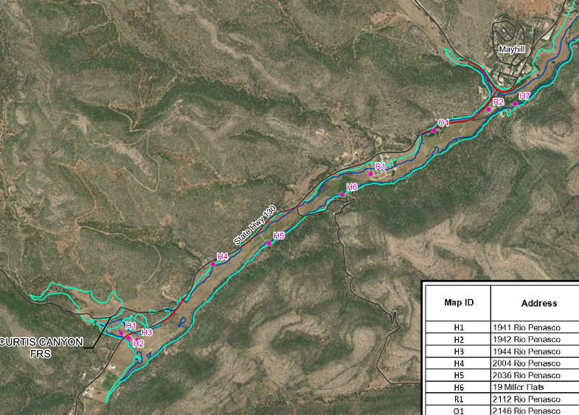
Dam Breach Inundation – Curtis Canyon
Impacted Structures
11 homes
2 RV Parks (92 Sites)
3 Outbuildings
Mayhill
N
Curtis Canyon

Slide 12
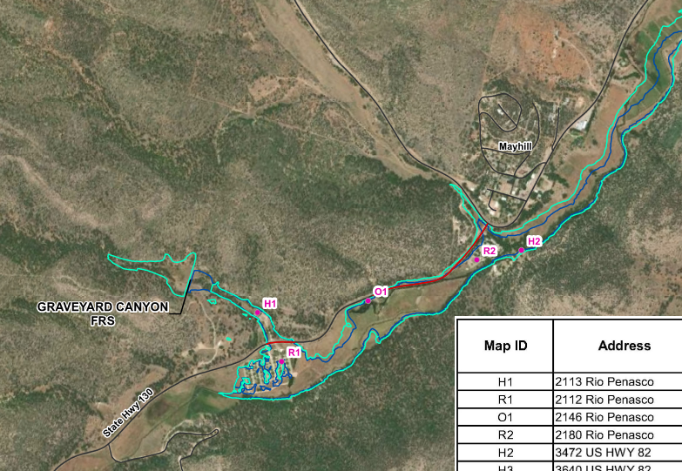
Dam Breach Inundation – Graveyard Canyon
Impacted Structures
5 homes
2 RV Parks (92 Sites)
3 Outbuildings
N
Mayhill
Graveyard Canyon

Slide 13
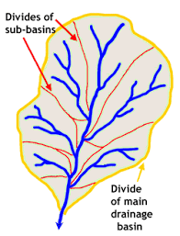
What is a watershed?
Watershed = the land that drains to one stream, lake, or river; includes surface water and underlying groundwater
Hydrologic Unit Codes - Used nationwide to describe drainage areas labelled with a series of numbers
Different numbers represent different scales
The smaller the number the LARGER the area
HUC-12 drainage basin will represent a smaller area than a HUC-8 drainage basin

Slide 14
The “NRCS Watershed Umbrella”
WFPO
Rehab
EWP
Watershed & Flood Prevention Operations Program
Helps units of federal, state, local and federally recognized tribal governments (project sponsors) protect and restore watersheds.
Rehabilitation Program
Helps project sponsors rehabilitate aging dams that are reaching the end of their design life and/or no longer meet federal or state safety criteria or performance standards
Emergency Watershed Protection Program
Helps people reduce imminent hazards to life and property threatened by excessive erosion and flooding caused by a natural disaster

Slide 15
Program Requirements
Rehab Program work may include any of the following:
Protecting the integrity of the dam or extending the useful life of the dam beyond the original evaluated life expectancy.
Repairing damage to the dam from a catastrophic event.
Repairing structural components that are deteriorating at an abnormal rate.
Upgrading the structural works of improvement to meet changed land use conditions in the watershed served by the structural works of improvement or changed safety criteria applicable to the structural measure.
Decommissioning (removing) the structure and stabilizing the site, if requested by the sponsoring local organization (SLO).

Slide 16
Rehab Program Cost Share
65% Federal / 35% Sponsor
Specific rate established in the statute
Cost share revolves around the total eligible project cost, not to exceed 100% of the actual construction cost
Project cost includes items like construction, in-kind services (planning, engineering, project administration), required replacement in-kind, required decent/safe/sanitary facilities, etc.

Slide 17
Rehab Program Steps
1. Dam Assessment
Typically funded by NRCS, and completed by NRCS or Contractor
Duration to complete is approx. 12 months
2. Rehab Planning
Normally fully funded by NRCS
Multiple options for who completes / creates the Watershed Plan
Federal Contract
Local-Led Agreement
Duration to complete is approx. 18-24 months (+ or -)
3. Rehab Design
Normally fully funded by NRCS
Multiple options for who completes the design(s)
Duration is approx. 1-2 years
4. Rehab Construction
Funded at 65% Federal / 35% Sponsor for total construction costs
Duration ranges from 2 years to 5 years due to:
Acquisition of easements and or land rights
Permits
Notes:
These steps of the Watershed Planning process cannot be skipped or combined.

Slide 18
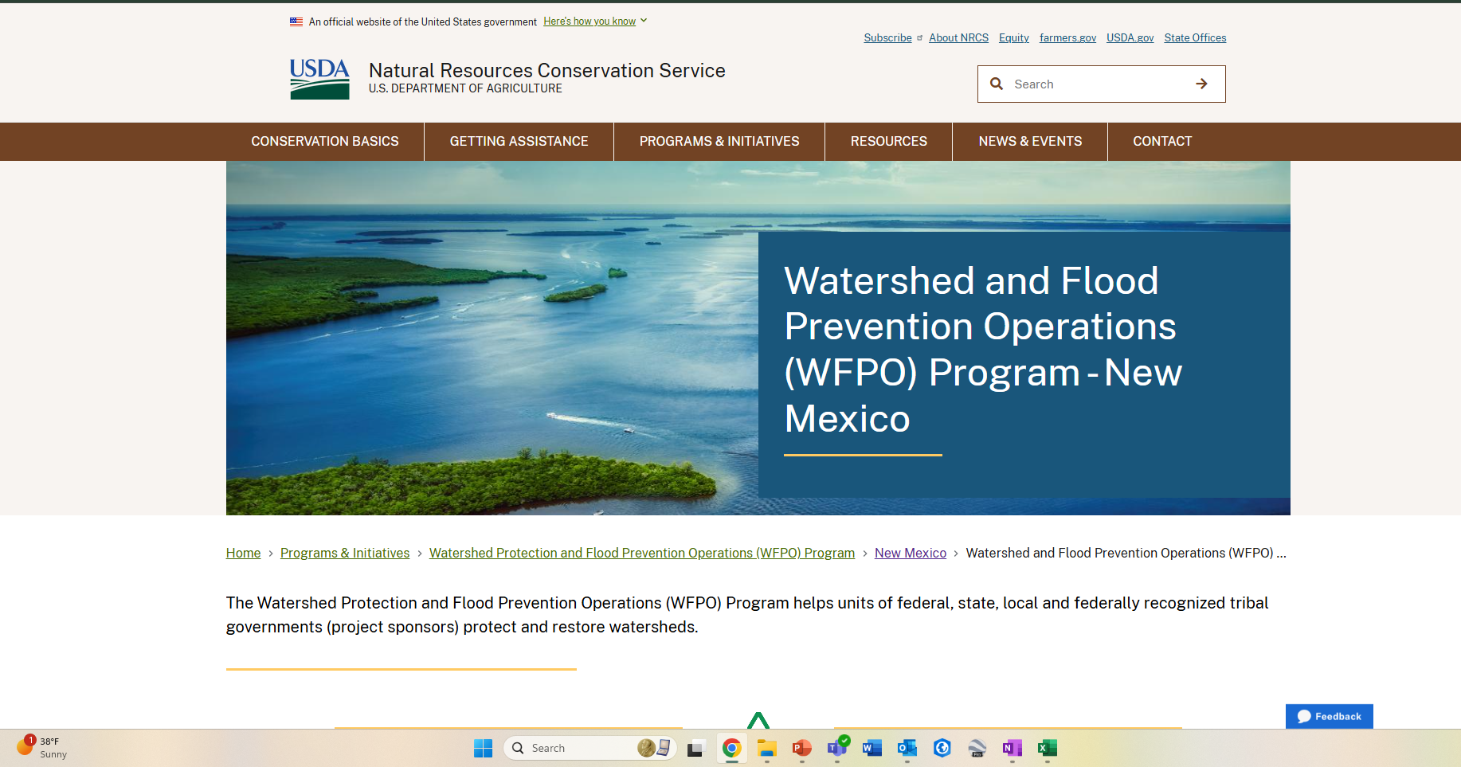
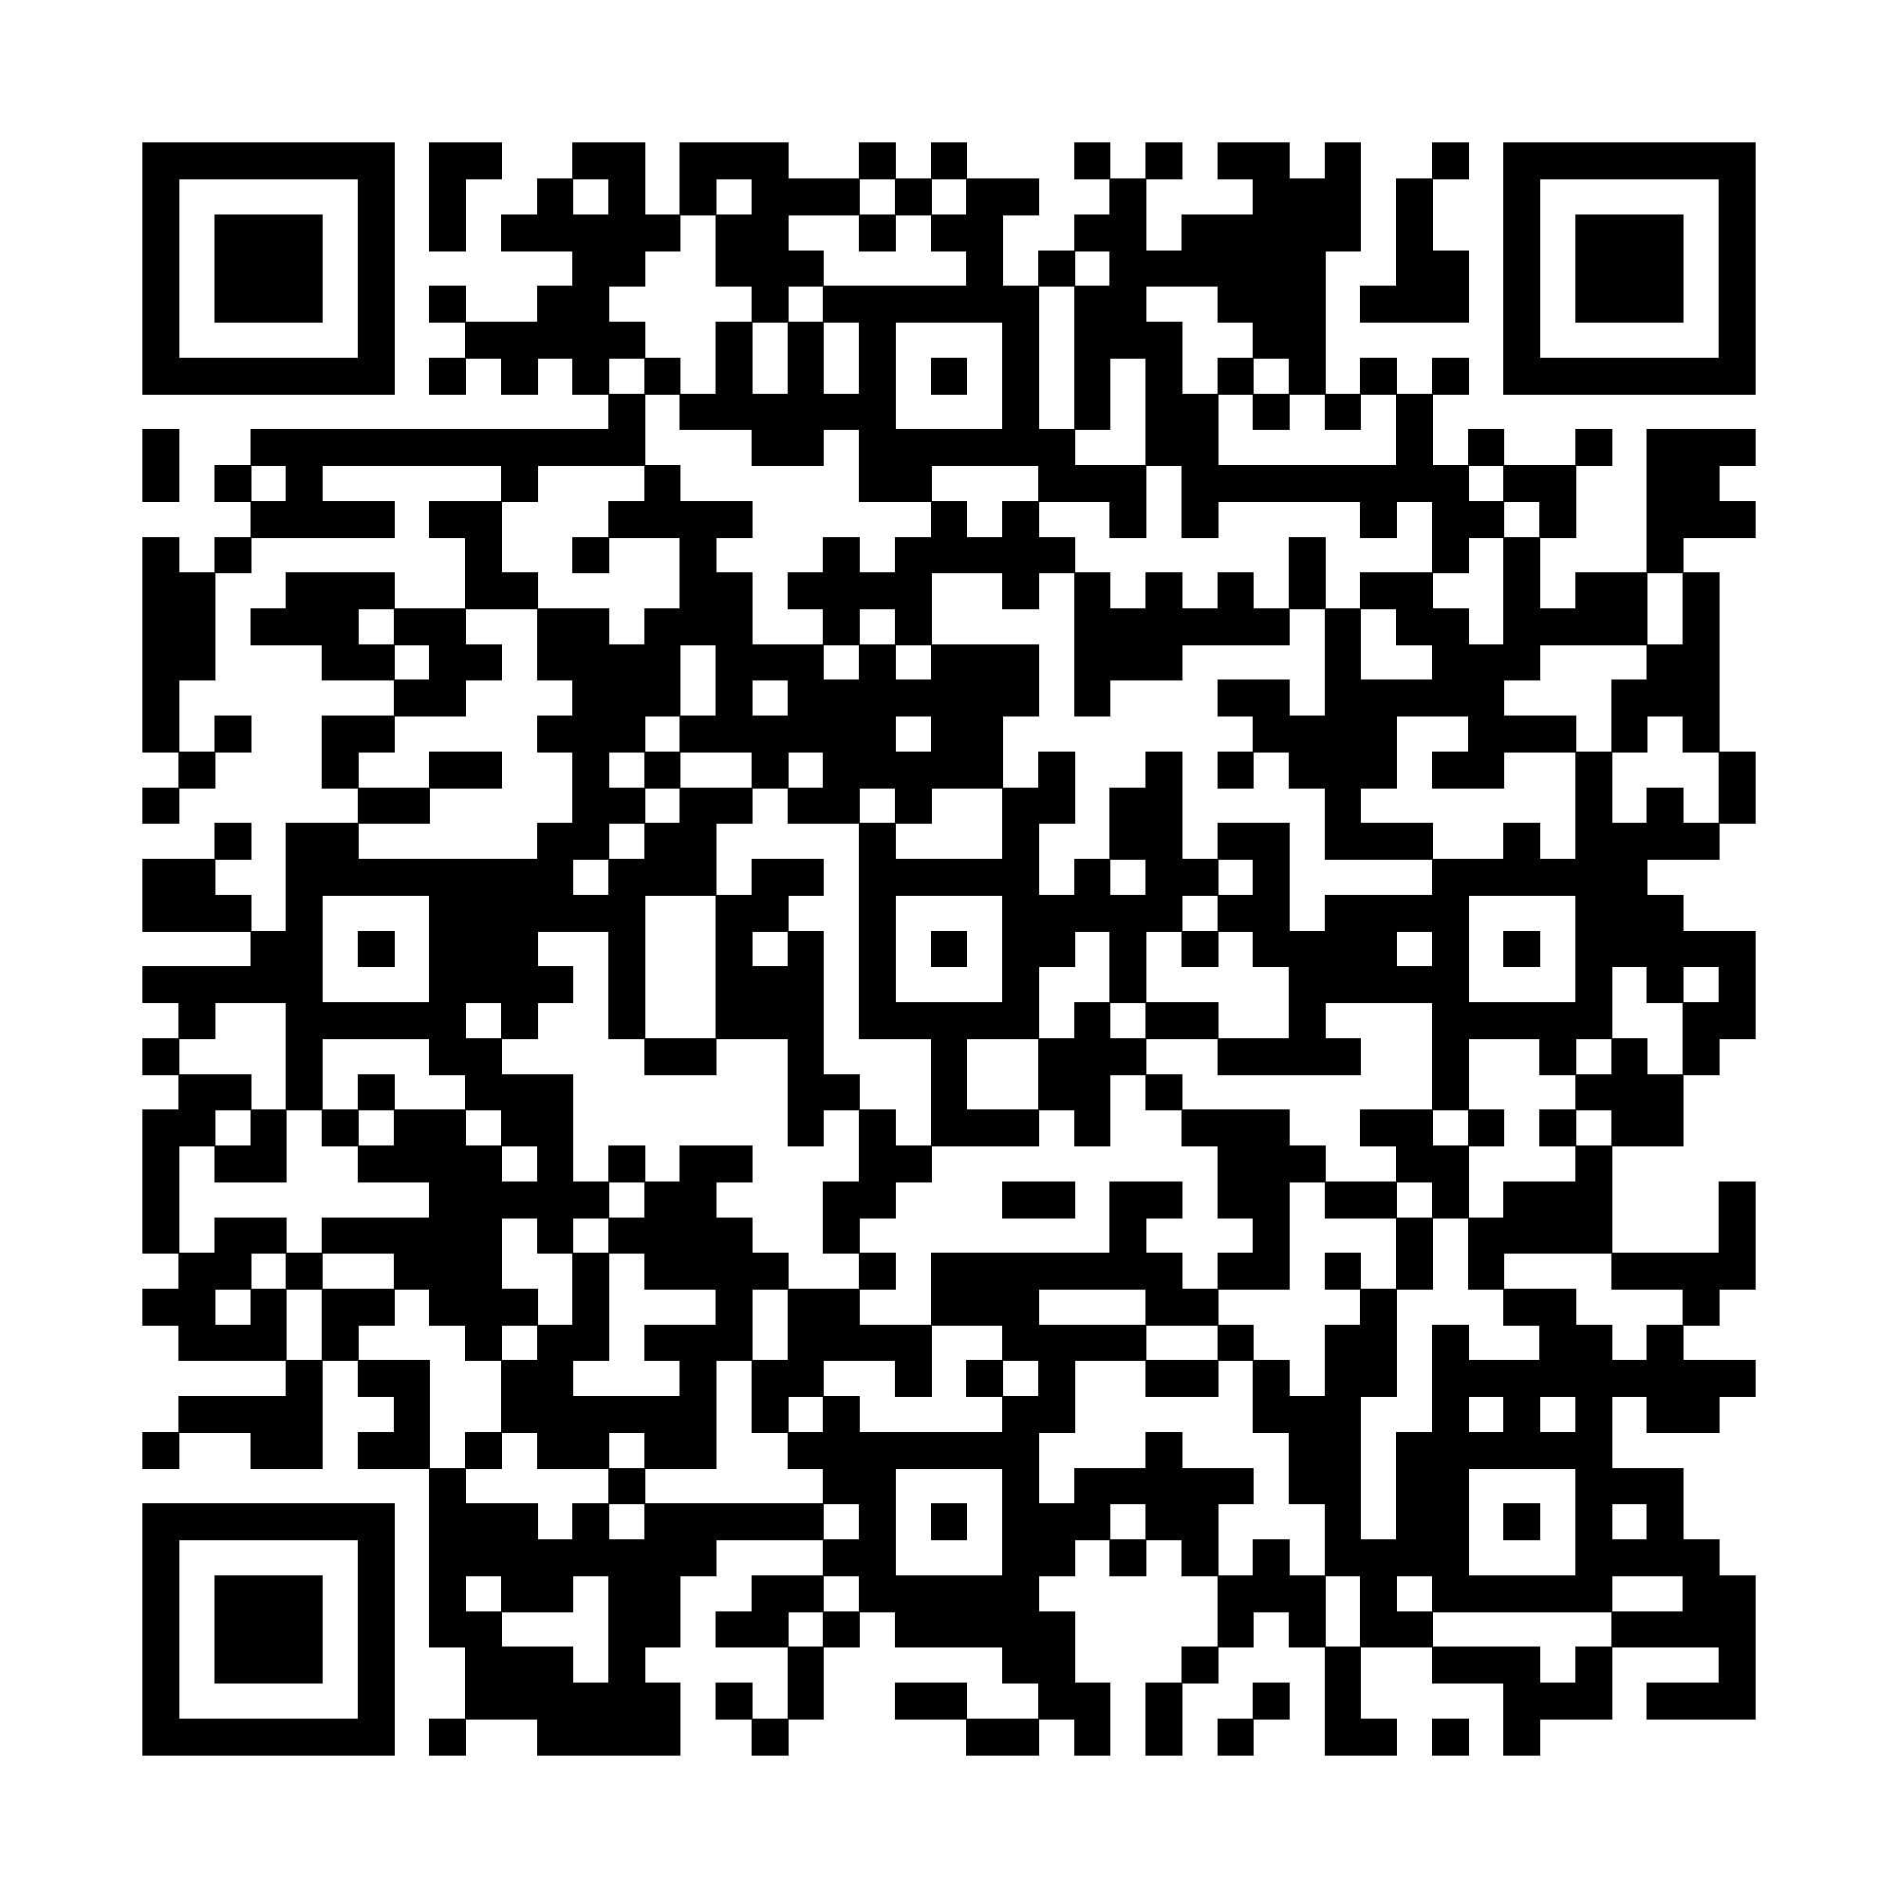
Link to NRCS WFPO Program Web Page:
https://www.nrcs.usda.gov/programs-initiatives/watershed-and-flood-prevention-operations-wfpo-program/new-mexico/watershed

Slide 19
National Environmental Policy Act (NEPA) Process
NEPA ensures that federal actions comply with federal, state, and local laws and regulations and that federal agencies consider the environment in decision-making
NRCS funding or approval of a watershed project plan is a federal action subject to NEPA
An EA will be part of the watershed plan to assess the environmental, social, and economic impacts of the identified alternatives

Slide 20
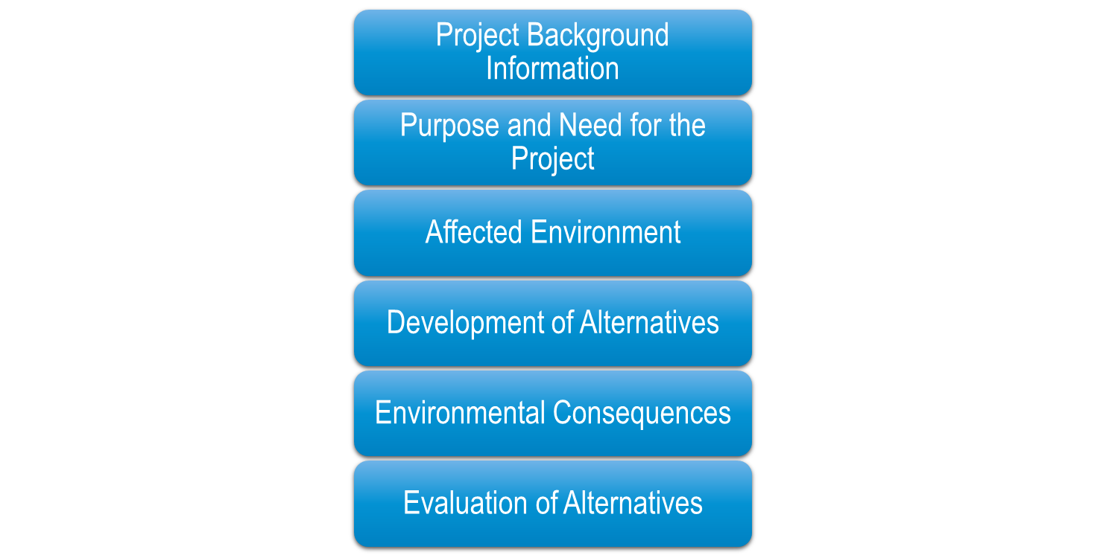
What will the Watershed Plan-EA include?
Soil Resources
Prime and Unique Farmland
Water Resources
Sole Source Aquifers
Water Quality
Floodplain Management
Wetlands
Wild and Scenic Rivers
Threatened and Endangered Species
Migratory Birds
Invasive Species
Fish and Wildlife
Cultural Resources
Historic Properties
Environmental Justice
Public Health and Safety
Economic and Social Conditions
Scenic Beauty
Land Use
Air Quality
Noise

Slide 21
Purpose and Need
Purpose
Maintain flood protection
Reduce sediment deposition
Need
Address dam safety and performance deficiencies
Improve public safety

Slide 22
Scope of Work
Project Planning Phases
Phase 1: Goals, Objectives, Purpose and Need
Phase 2: Inventory and Analyze Resources
Phase 3: Alternatives Formulation
Phase 4: Prepare Final Plan-Environmental Document

Slide 23
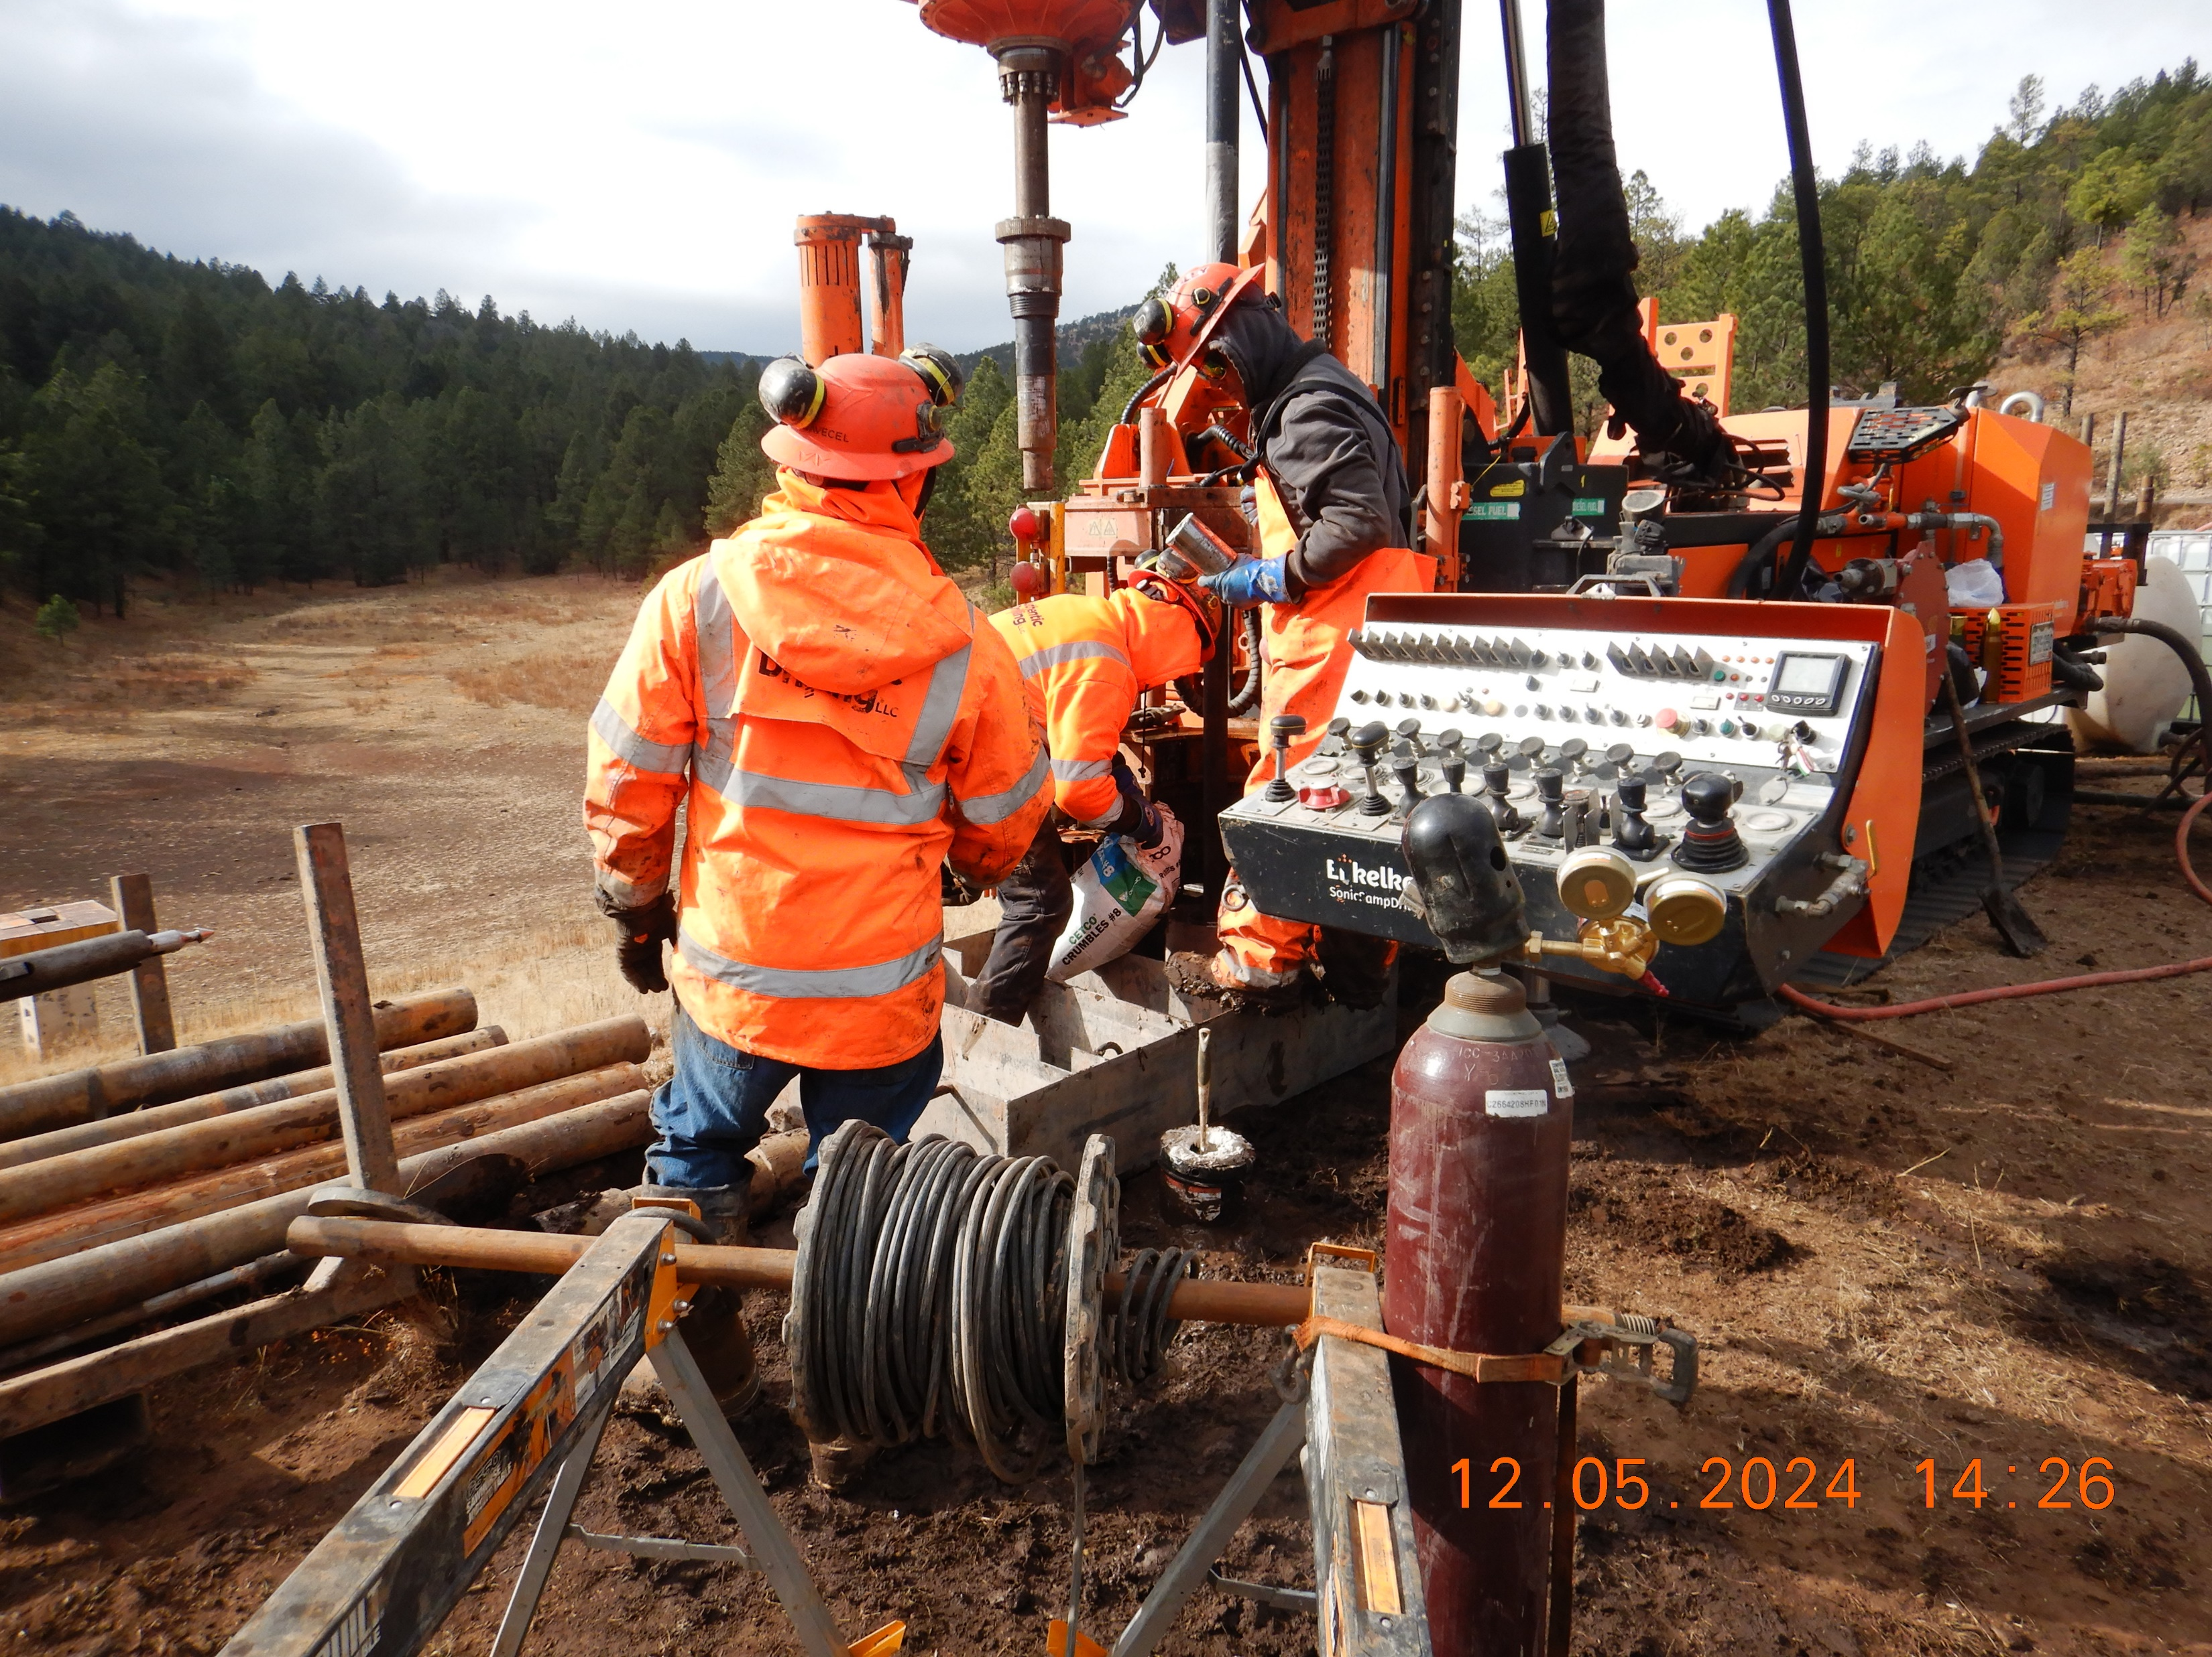
Phase 1: Goals, Objectives, Purpose and Need
Compile and Review Existing Data
Collect Additional Data
Subsurface investigation - complete
Topographic Survey - complete
Sediment Survey – in progress
Flooding Evaluations – in progress
Public Participation – in progress
Define Purpose and Need

Slide 24
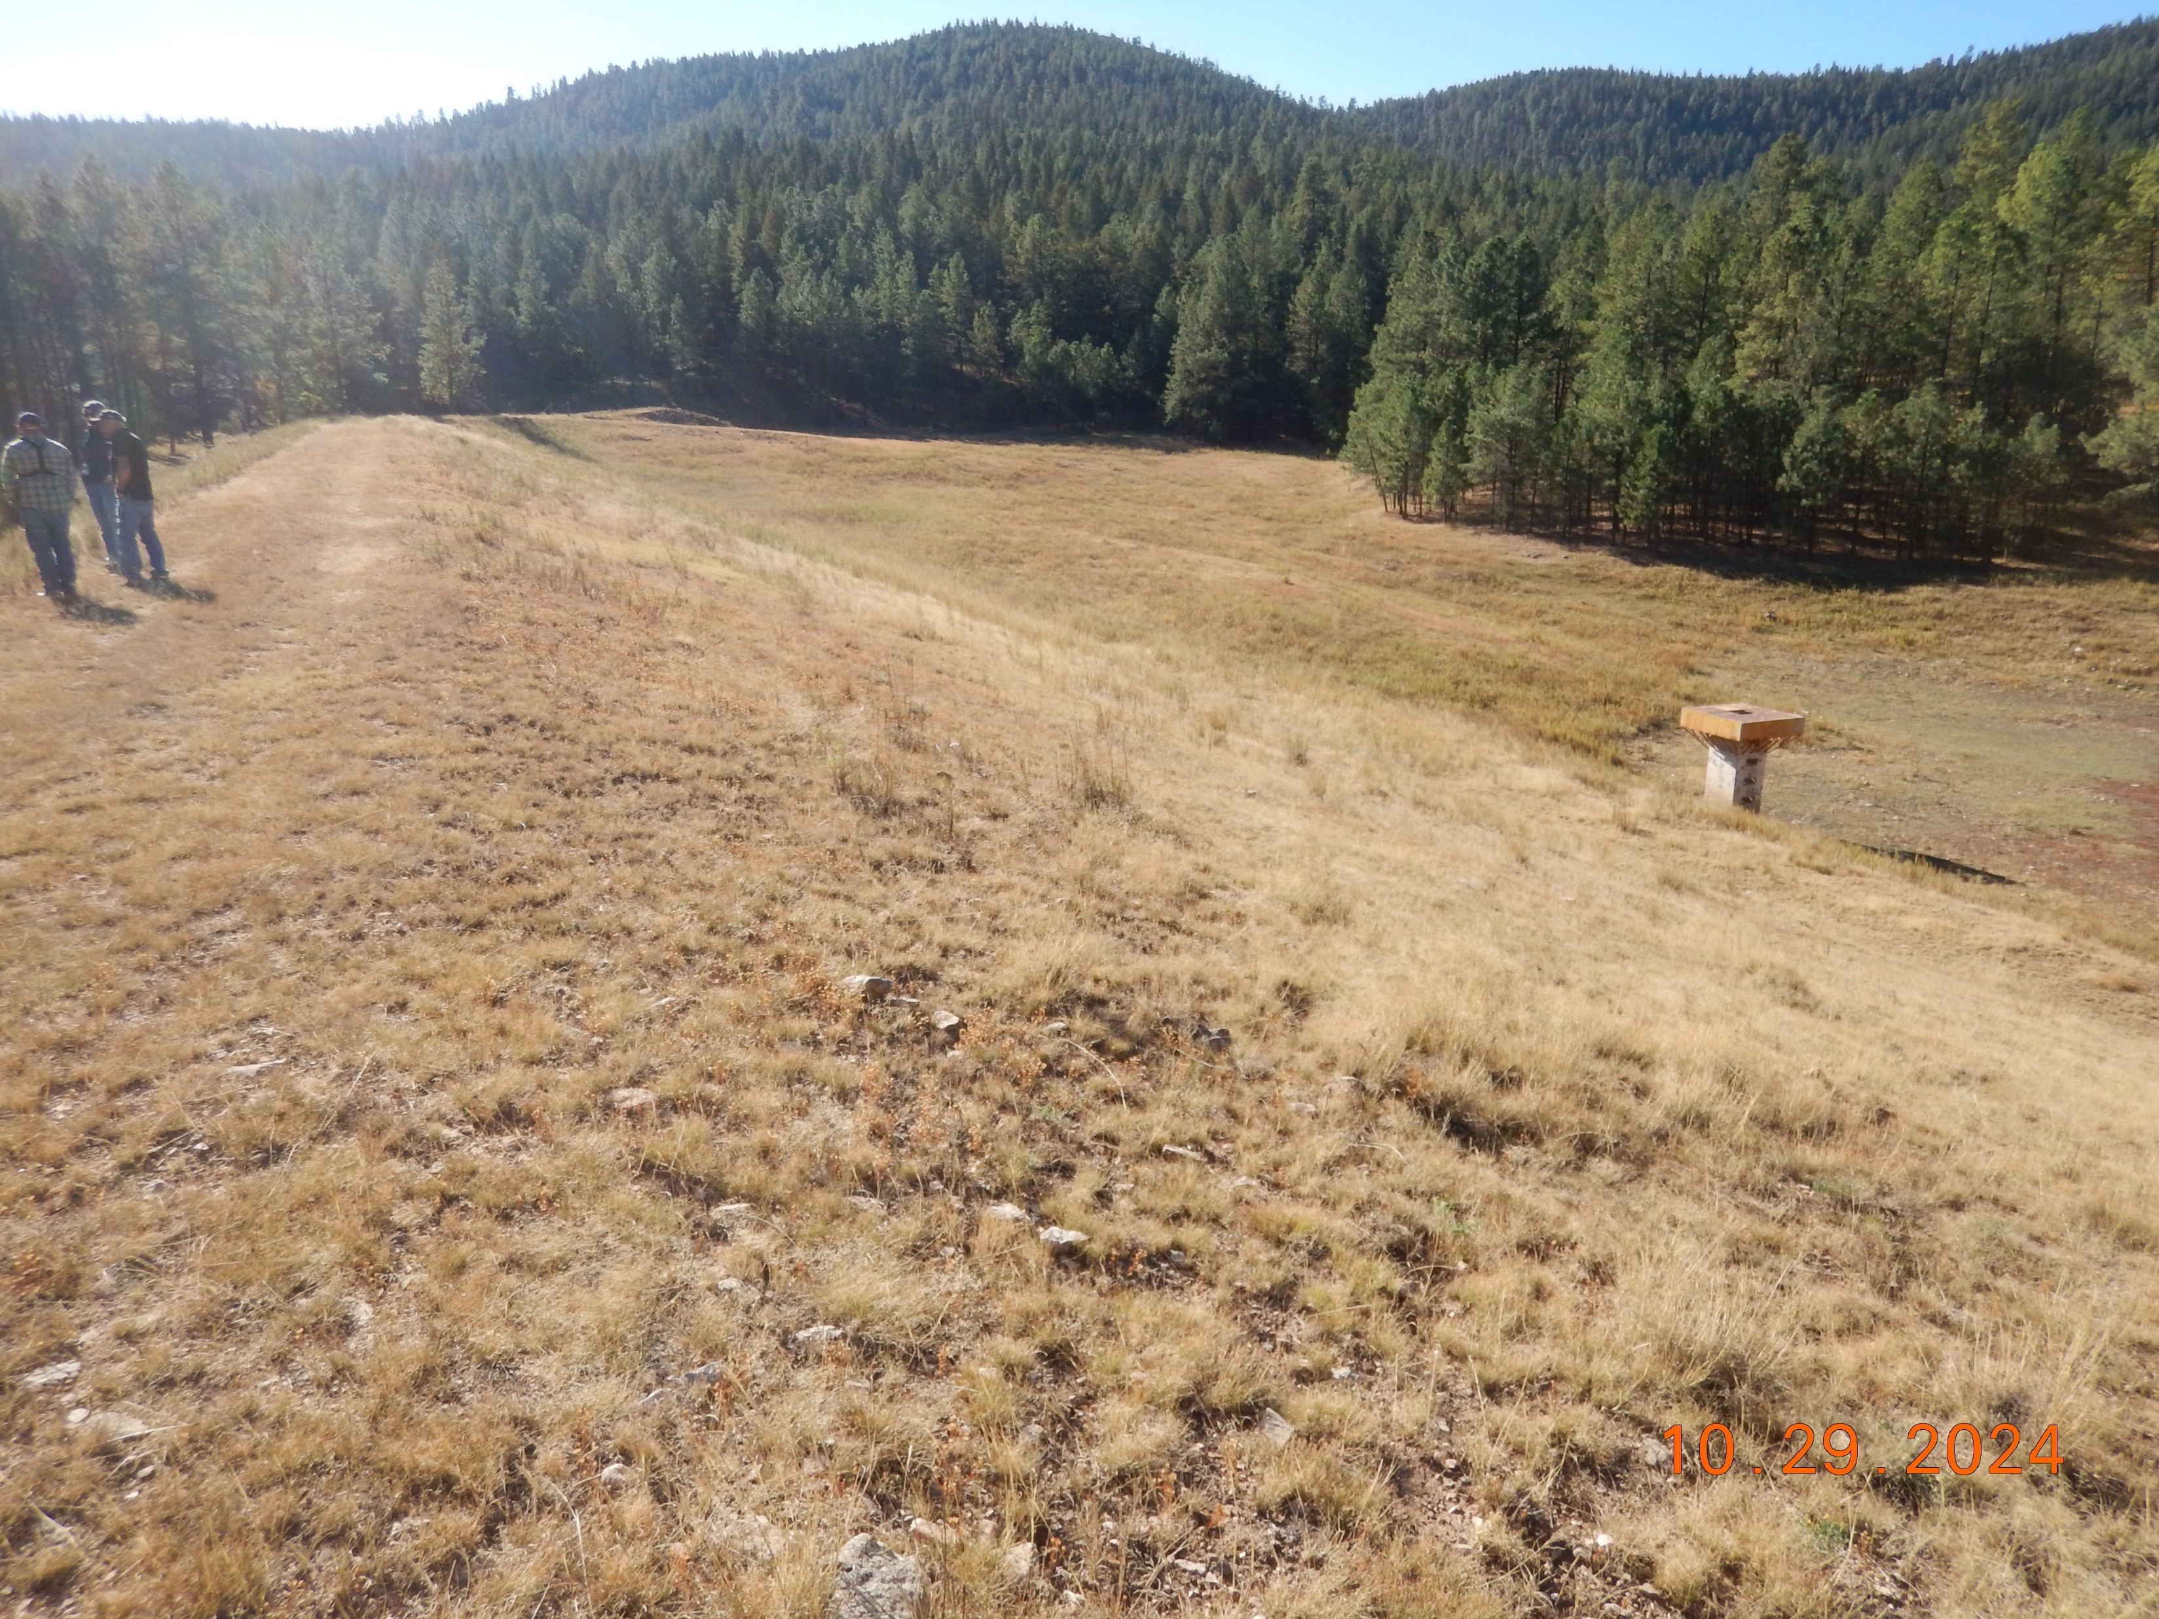
Phase 2: Inventory and Analyze Resources
Inventory Resources
Environmental
Economic
Cultural
Social
Analyze Identified Resources
Field Investigations
Local Research
Desktop Analysis
Evaluate Potential Impacts

Slide 25
Environmental Resources
Desktop analyses will provide a baseline to inform alternatives development and publicly available data will be reviewed to identify:
Soil types
Historic and current land use
Water resources and wetlands
Floodplains
Fish and wildlife
Federally and state-listed threatened or endangered species
Vegetation and invasive species
Riparian and natural areas

Slide 26
Social and Economic Resources
Social resources to be identified with publicly available sources include:
Population, income, poverty data
Public health and safety concerns
Transportation networks and conditions
Population centers
Economic conditions will be identified using:
Demographic economic drivers
Land use and property values
Number and characteristics of structures at risk in the 500-year floodplain
Historical information on how floods have impacted communities in study area
Notes:
WSP

Slide 27
Cultural Resources
Desktop survey/literature review will identify:
Location of any previous archaeological surveys or previously recorded archaeological sites within or around the study area
Sites listed on the National Register of Historic Places
Sites listed on the State Register of Cultural Properties
Notes:
WSP

Slide 28
Phase 3: Alternatives Formulation
Identify and formulate reasonable alternatives
Evaluate impacts to resources
Cost Estimates
No-action
Decommission
Structural
Non-structural
Identify the preferred alternative

Slide 29
Phase 4: Prepare Plan-Environmental Assessment
Compile collected data for existing structures
Identify and evaluate alternatives
Identify and evaluate impacts of alternatives
Select preferred alternative with public input
iStock

Slide 30
Agency and Public Input
Three scheduled opportunities for public and agency input:
Initial Public/Agency Scoping Meeting - today
Provided: Project introduction
Requested: Input on objectives, alternatives, and prioritization
Alternatives Meeting
Provided: Report on how input was incorporated and presentation of alternatives
Requested: Input on selected alternative
Plan-Environmental Assessment Review
Provided: Draft Plan-Environmental Assessment
Requested: Comments on the Plan-Environmental Assessment

Slide 31
Public Input on Resources
Public Involvement
What resource opportunities/impacts are of particular importance?
Are there any other known opportunities or impacted resources?
General concerns or comments?
Resource List
Wetlands
Critical Habitat
Floodplains
Recreation
Cultural Resources
T&E Species
Fish and Wildlife
Forests
Invasive Species
Land Use
Migratory Birds
Natural areas
Parklands
Prime and Unique Farmland
Riparian Areas
Public Health and Safety
Regional Water Resource Plans
Scenic Beauty
Scientific Resources
Soil Resources
Water Quality
Water Resources
Wild and Scenic Rivers
Waters of the US
Social Issues
Other…
Notes:
Resource Opportunities/Impact rating table

Slide 32
Public Input: How to Submit Comments?
Submit your comments on the project by February 27, 2025
There are three ways to comment:
Comment Card
Submit a written
Comment at today’s
meeting
Mail
USDA NRCS New Mexico
Attn: Merceidez Fabok
100 Sun Avenue Northeast, Suite 602
Albuquerque, NM 87109-3434
l
Email
Merceidez.Fabok@usda.gov l
Notes:
Resource Opportunities/Impact rating table

Slide 33
Discussion on Possible Benefits & Considerations
Possible benefits and other considerations while developing alternatives
Increased flood protection
Permanent pool?
Landowner considerations
Other considerations?

Slide 34
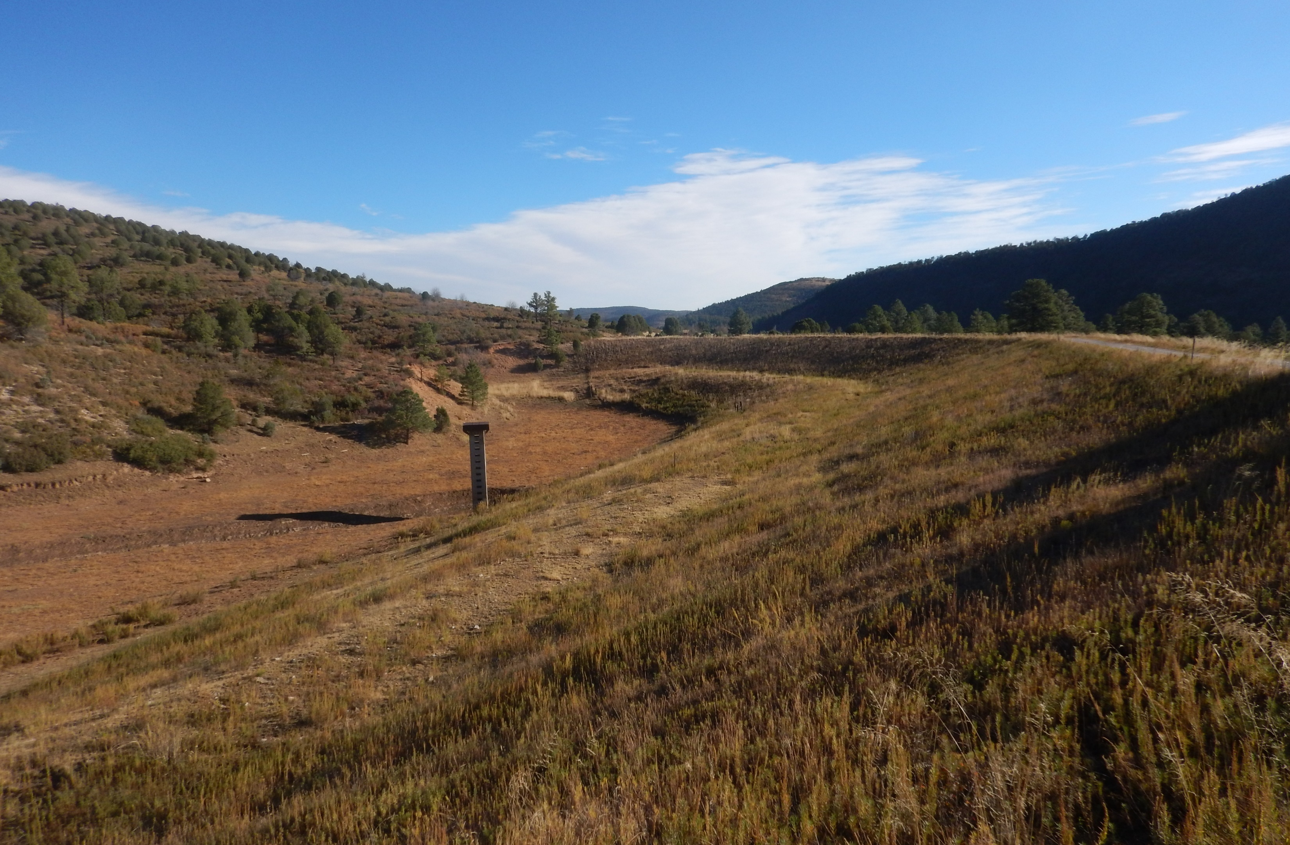
Open Discussion/Questions
Notes:
Heather

Slide 35
Next Steps
Initial Public/Agency Scoping Meeting (Today)
Public comments due to NRCS by February 27, 2025
Alternatives Development
Consider information from Public and Agency meetings
Refine purpose and need as appropriate
Develop alternatives and evaluate impacts
Identify preferred alternative
Next public meeting (alternatives presentation and solicit input )
Notes:
Heather

Slide 36
Schedule
Evaluate existing conditions
Spring 2025
Identify and evaluate alternatives
Spring and Summer 2025
Alternatives Meeting
Summer 2025
Public review of draft documents
Winter 2025
Public review of final documents
Spring 2026
Planning completion
Spring 2026
Notes:
Bob

Slide 37
Closing Comments
Final Thoughts
Planning phase of a bigger project.
Schedules and timelines are targets, not rigid.
The participation of public and agencies is voluntary BUT CRITICAL TO A SUCCESSFUL PROJECT.
The project is intended to reflect the values and opinions of the local agencies and community whenever possible.
Project webpage: https://www.nrcs.usda.gov/programs-initiatives/watershed-and-flood-prevention-operations-wfpo-program/new-mexico/watershed
Contact Merceidez Fabok with the NRCS:
Email: merceidez.fabok@usda.gov
Mail: USDA NRCS New Mexico, Att: Merceidez Fabok
100 Sun Ave. Northeast, Suite 602, Albuquerque, NM 87109-3434
Comments/Questions are due to NRCS by:
Thursday February 27, 2025
Notes:
Heather

