Slide 1
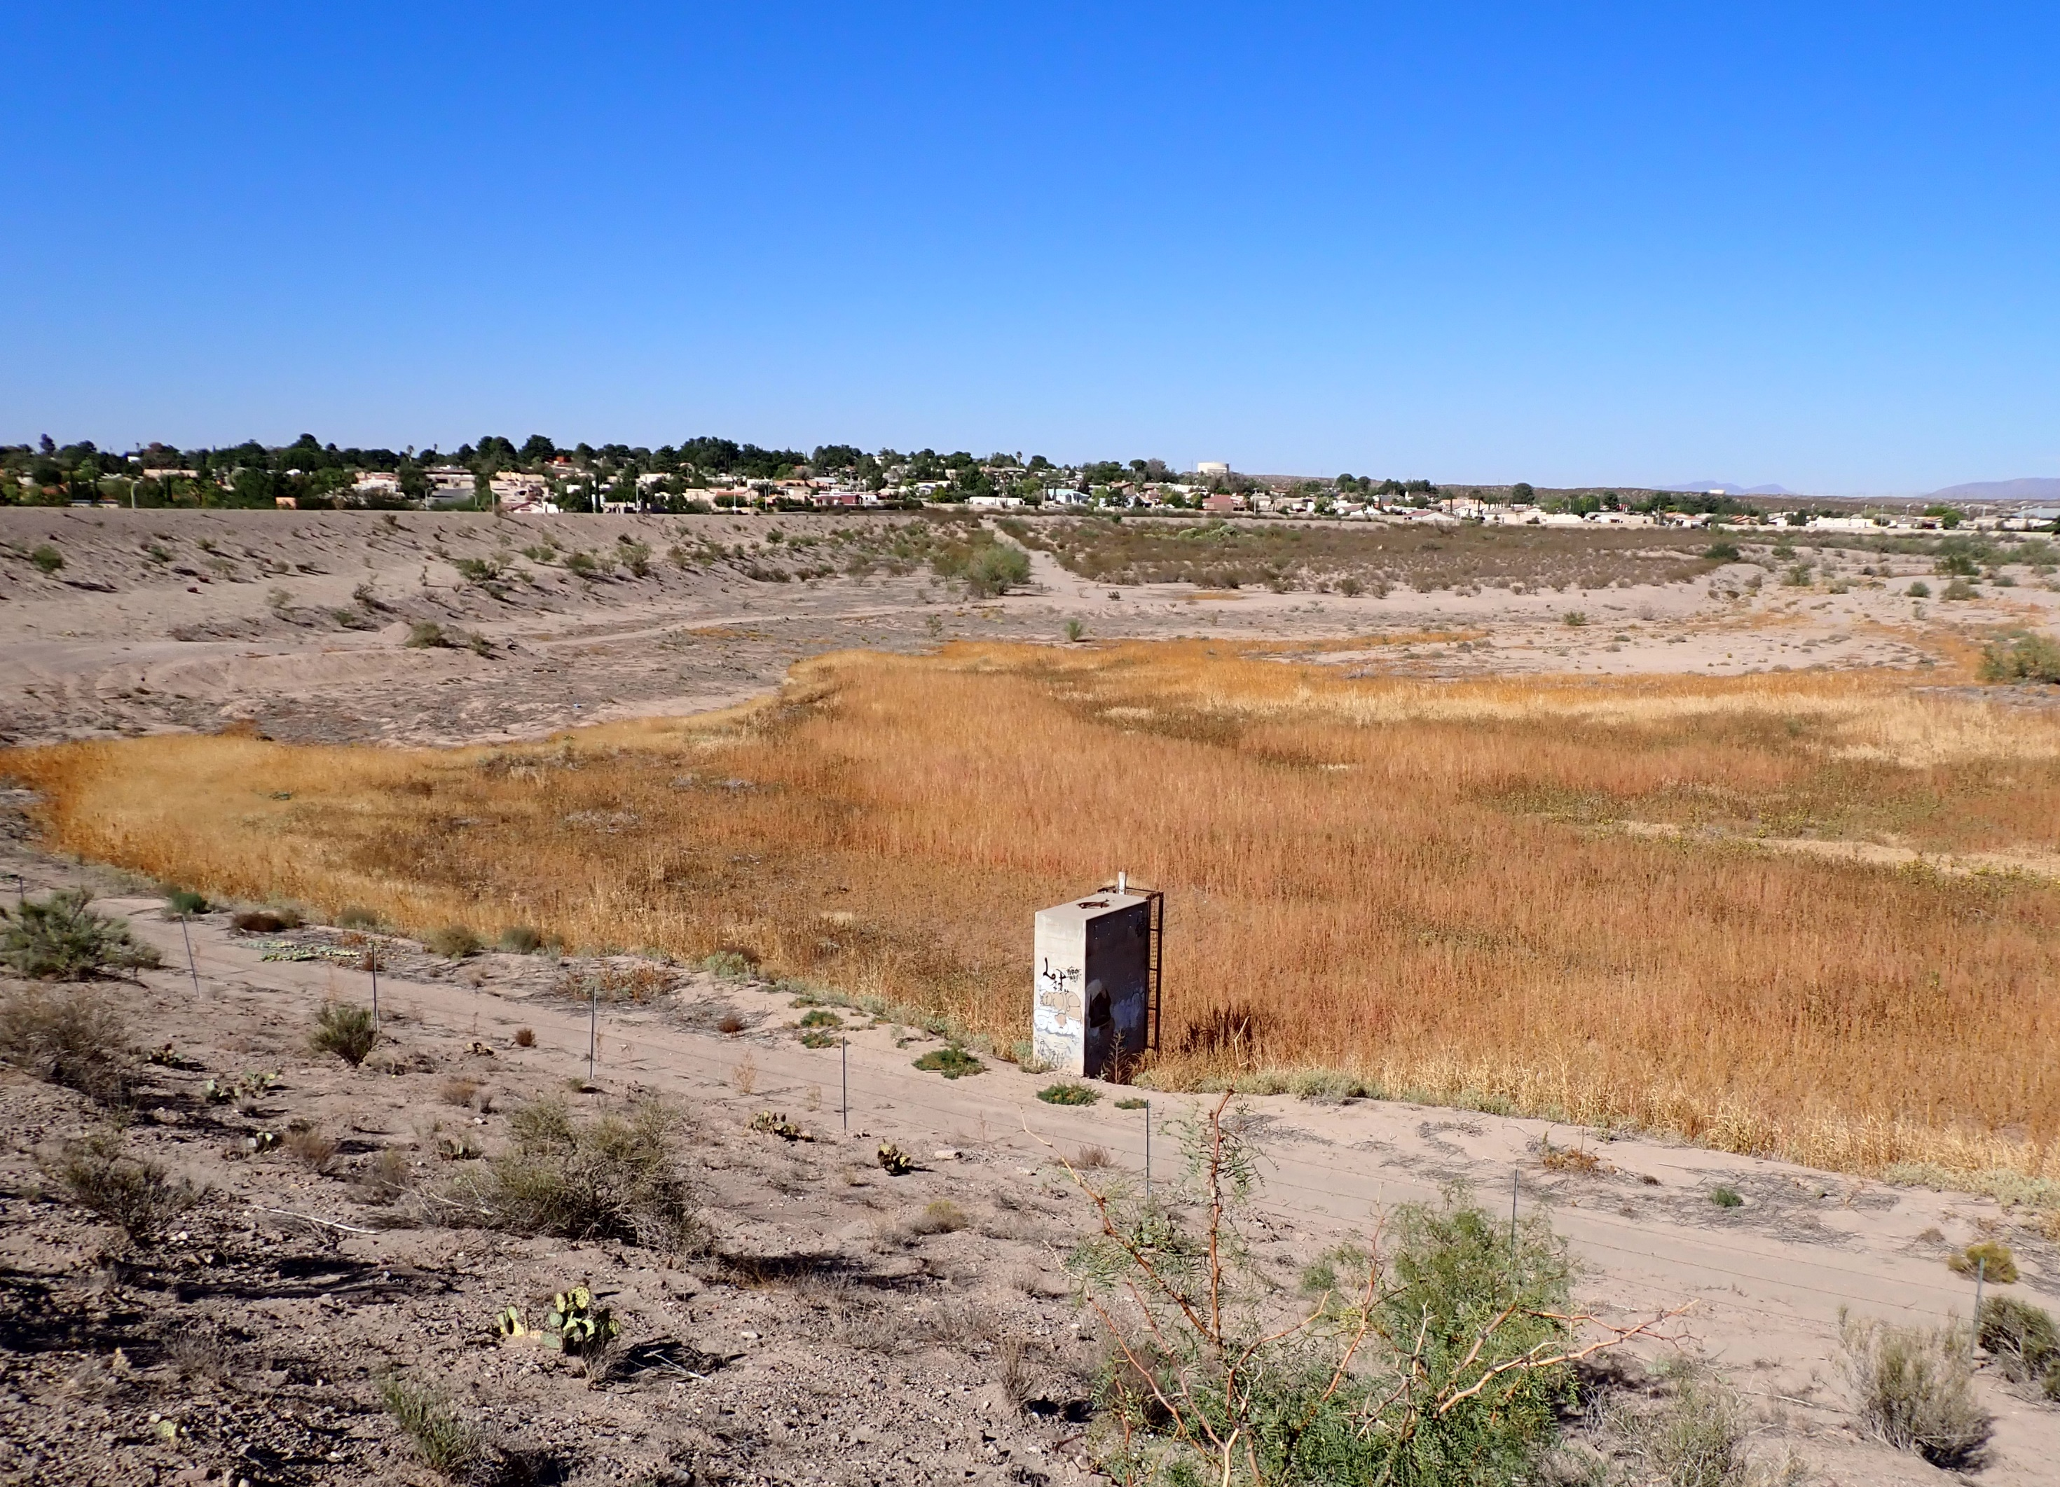



Supplemental Watershed Plan – Environmental Assessment for
Tortugas Site 1 Dam
(OSE D-270)
Agency/Tribal/Stakeholder Scoping Meeting
January 23, 2025
10:00 AM – 12:00 PM
Virtual – MS Teams
Notes:
NRCS

Slide 2
Meeting Agenda
Logistics and Introduction
Scoping Meeting Background
Project Location and Background
NRCS Watershed Rehabilitation Program
What Will the Supplemental Watershed Plan-EA include?
NEPA Process
Purpose and Need
Overview of Scope of Work
Initial Agency/Public Input
Agency/Tribal/Stakeholder Input and Comments
Discussion
Notes:
RJH

Slide 3
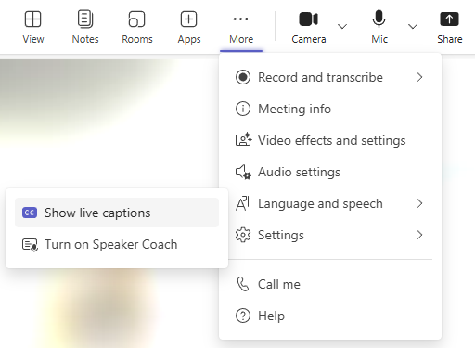
Meeting Logistics
Attendance Record
Meeting Functions
Chat function is enabled and being monitored;
Enter name, organization, and email/phone number to the meeting chat
Muted and unable to speak
Camera on/off control
Raise hand for comments/asking questions
Notes:
RJH

Slide 4

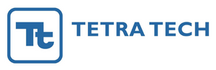
Introductions
Lead Federal Agency
USDA Natural Resources
Conservation Service (NRCS)
Project Sponsors
Elephant Butte Irrigation District
Merceidez Fabok | Watershed Program Manager
Elias Gnann, P.E. | State Conservation Engineer
Joshua Smith | Treasurer / Manager
Alex Rubio | Senior Engineering Manager
Consultant Lead
RJH Consultants, Inc.
Environmental Consultant
Tetra Tech, Inc.
Robert Huzjak, P.E. | Contract Manager
Jacquelyn Hagbery, P.E., P.G. | Project Manager
Ondrea Hummel, CERP | Project Manager / Senior Ecologist
Edmund Vandever| NEPA Specialist/ Biologist
Notes:
Teams.

Slide 5

Introductions
Cooperating Agency
New Mexico State University (NMSU)
Scott Eschenbrenner | Special Assistant to the President
Valerio Ferme, Ph. D. | President

Slide 6
Scoping Meeting Background
Tortugas Site 1 Dam Supplemental Watershed Plan-EA project was started in 2020 by other consultants but was not completed
The following was accomplished:
  Initial agency and public scoping meetings held in 2021
  Data collection
  Hydrology
  Environmental and cultural resources
As of September 2024 the project has been restarted with a new team of consultants
Today’s Agency/Tribal/Stakeholder scoping meeting to reintroduce personnel to the project and to make sure concerns are incorporated
The goal is to use what was done previously and to move the project forward
Notes:
RJH
Supplemental Watershed Plan and Environmental Document project started in 2020 by other consultants.
Restarted with new team of NRCS personnel and new consultant team in Sept 2024.

Slide 7
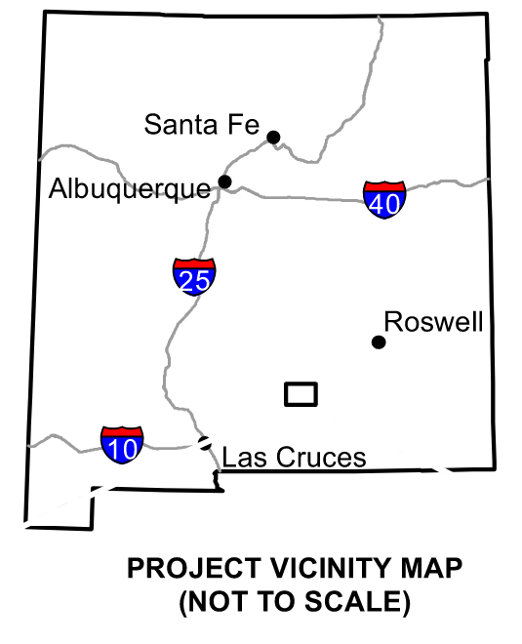
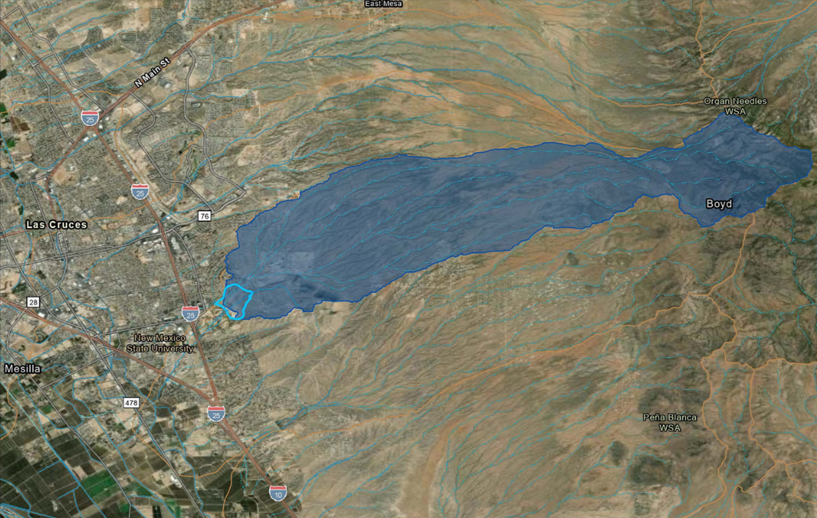


Project Location
Tortugas Site 1 Dam
Notes:
RJH

Slide 8
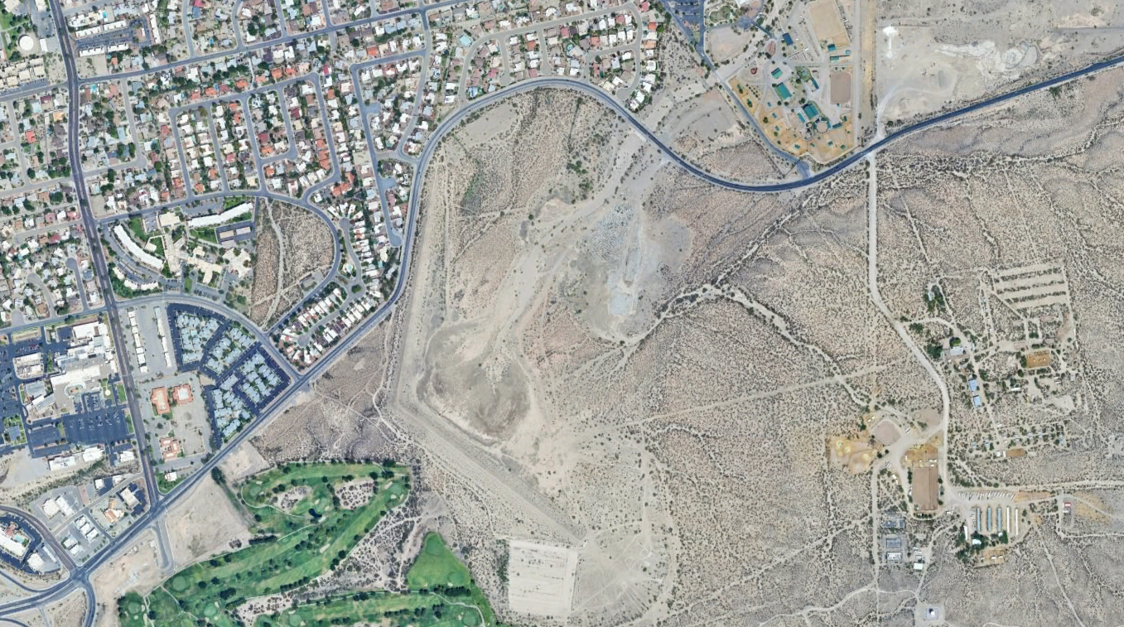
Dam Components
Riser Structure
Principal Spillway
Auxiliary Spillway
Dam (Embankment) Crest
Dam Crest
Dripping Springs Rd
S Telshor Blvd
Reservoir
Riser Structure & Principal SW Conduit
E University Ave
Auxiliary SW
N
NMSU Golf Course
Notes:
RJH

Slide 9
Project Background
Dam constructed in 1962 and modified in 1968 to provide flood prevention and watershed protection
Originally classified as significant hazard potential but now rated as high hazard potential
Documents previously completed found that the dam does not meet current design and safety standards with the following deficiencies:
  Inadequate principal and/or auxiliary spillway capacity and elevation
  Insufficient embankment crest width
  No embankment filters for drainage and seepage management
  Inundation of Dripping Springs Road with reservoir levels greater than 4,118 ft
  Excessive erosion on both upstream and downstream slopes
  Other deficiencies may still be identified
Notes:
RJH
PSH activates the auxiliary spillway (not meet NRCS criteria).
FBH overtop the dam by 1.1 ft.
4118 feet is about 3.8 ft below top of dam crest.

Slide 10
Benefits
Designed flood protection for 50-year storm event
Sediment retention
  Sediment periodically removed from reservoir
  Design sediment storage volume of 305 ac-ft for 50-year sediment storage life
  Existing sediment storage volume of 335 ac-ft provides about 55 years of sediment storage life remaining
Notes:
RJH
Designed to contain a 50-year storm without activating the ASW.

Slide 11
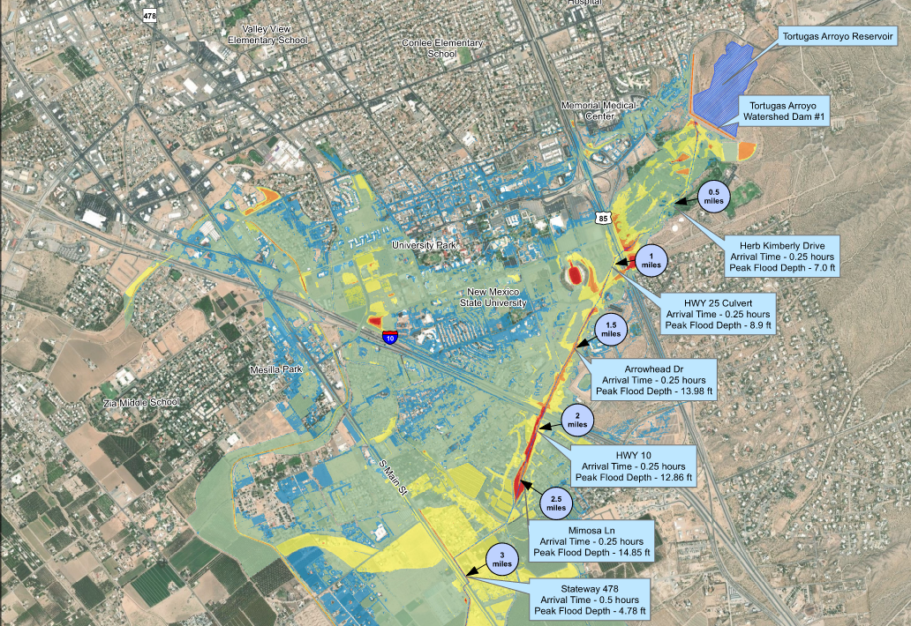
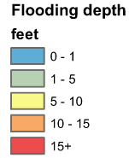
Dam Breach Inundation
Impacted Structures
New Mexico State University (25,000 students and faculty)
University Park (4,192 people)
Tombaugh Elementary (650 students)
Further downstream communities
I-25
University Park
I-10
NMSU
Tombaugh Elementary
N
Notes:
RJH
Data is draft and needs confirmation from RJH. Inundation mapping extends 15 miles d/s of dam to census-designated place of Vado, NM.

Slide 12
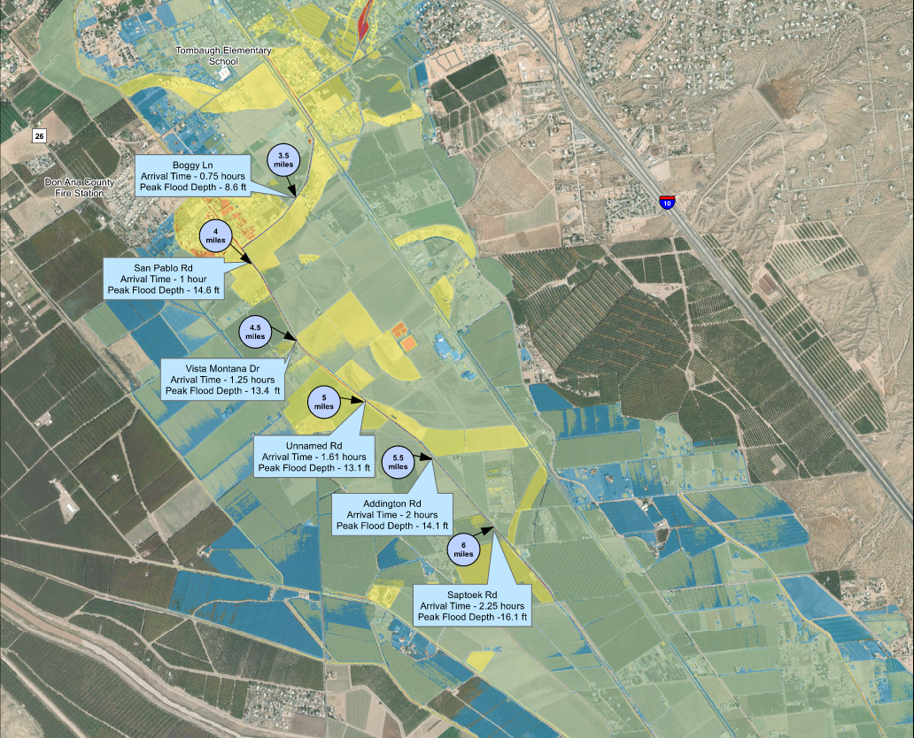
Dam Breach Inundation
N

Slide 13
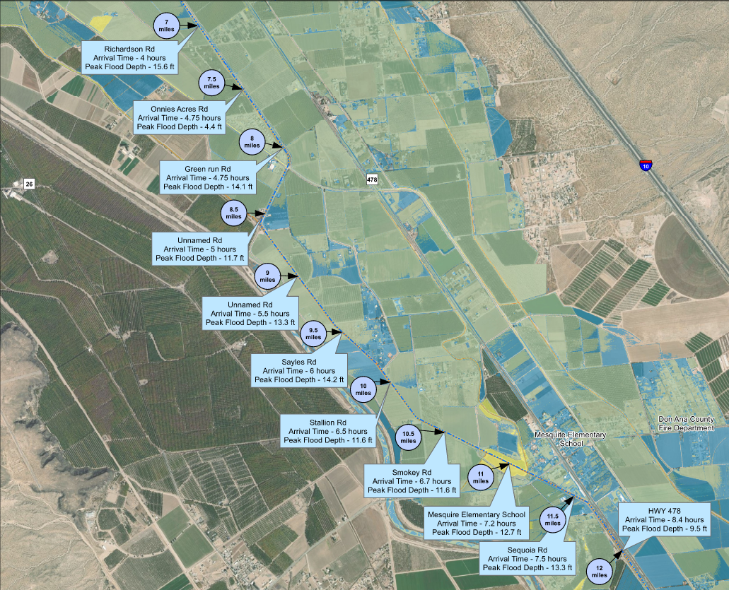
Dam Breach Inundation
N

Slide 14
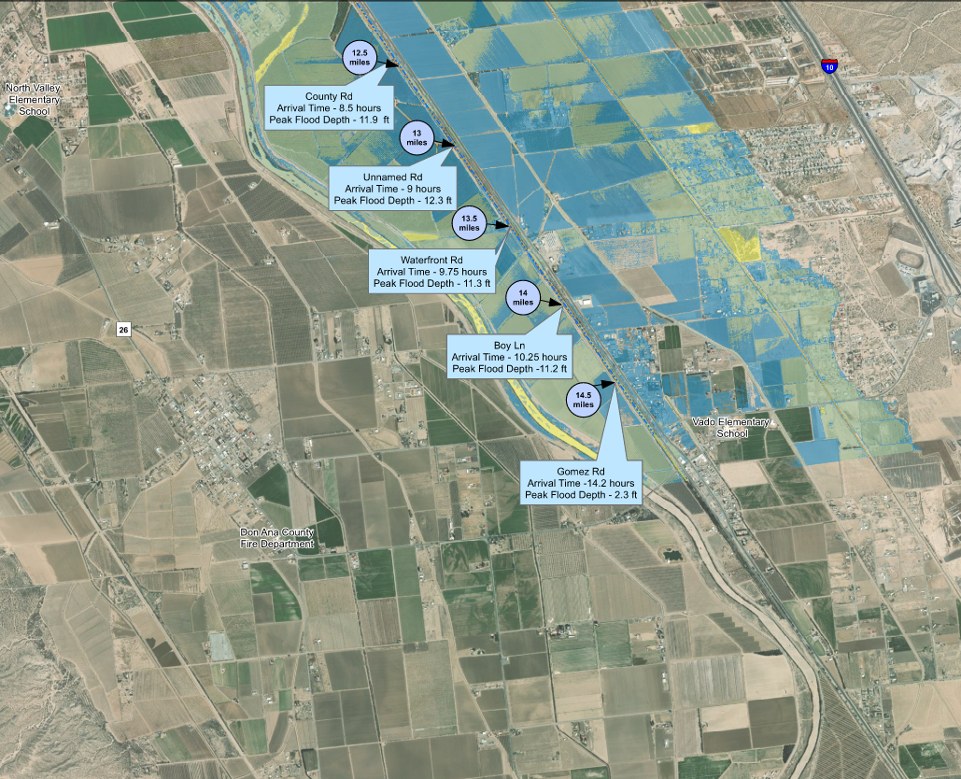
Dam Breach Inundation
About 15 miles downstream of dam
N

Slide 15
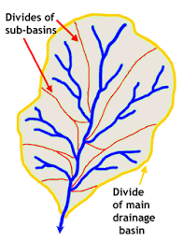
What is a watershed?
Watershed = the land that drains to one stream, lake, or river; includes surface water and underlying groundwater
Hydrologic Unit Codes - Used nationwide to describe drainage areas labelled with a series of numbers
Different numbers represent different scales
  The smaller the number the LARGER the area
    HUC-12 drainage basin will represent a smaller area than a HUC-8 drainage basin
Notes:
NRCS

Slide 16
The “NRCS Watershed Umbrella”
WFPO
Rehab
EWP
Watershed & Flood Prevention Operations Program
Helps units of federal, state, local and federally recognized tribal governments (project sponsors) protect and restore watersheds.
Rehabilitation Program
Helps project sponsors rehabilitate aging dams that are reaching the end of their design life and/or no longer meet federal or state safety criteria or performance standards
Emergency Watershed Protection Program
Helps people reduce imminent hazards to life and property threatened by excessive erosion and flooding caused by a natural disaster
Notes:
NRCS

Slide 17
Program Requirements
Rehab Program work may include any of the following:
  Protecting the integrity of the dam or extending the useful life of the dam beyond the original evaluated life expectancy.
  Repairing damage to the dam from a catastrophic event.
  Repairing structural components that are deteriorating at an abnormal rate.
  Upgrading the structural works of improvement to meet changed land use conditions in the watershed served by the structural works of improvement or changed safety criteria applicable to the structural measure.
  Decommissioning (removing) the structure and stabilizing the site, if requested by the sponsoring local organization (SLO).
Notes:
NRCS

Slide 18
Rehab Program Cost Share
65% Federal / 35% Sponsor
  Specific rate established in the statute
  Cost share revolves around the total eligible project cost, not to exceed 100% of the actual construction cost
    Project cost includes items like construction, in-kind services (planning, engineering, project administration), required replacement in-kind, required decent/safe/sanitary facilities, etc.
Notes:
NRCS

Slide 19
Rehab Program Steps
1. Dam Assessment
  Typically funded by NRCS, and completed by NRCS or Contractor
  Duration to complete is approx. 12 months
2. Rehab Planning
  Normally fully funded by NRCS
  Multiple options for who completes / creates the Watershed Plan
    Federal Contract
    Local-Led Agreement
  Duration to complete is approx. 18-24 months (+ or -)
3. Rehab Design
  Normally fully funded by NRCS
  Multiple options for who completes the design(s)
  Duration is approx. 1-2 years
4. Rehab Construction
  Funded at 65% Federal / 35% Sponsor for total construction costs
  Duration ranges from 2 years to 5 years due to:
    Acquisition of easements and or land rights
    Permits
Notes:
NRCS. These steps of the Watershed Planning process cannot be skipped or combined.

Slide 20
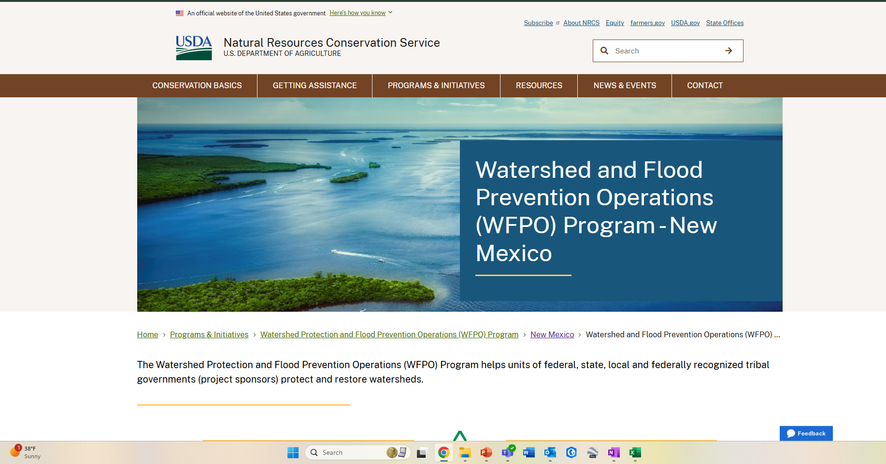
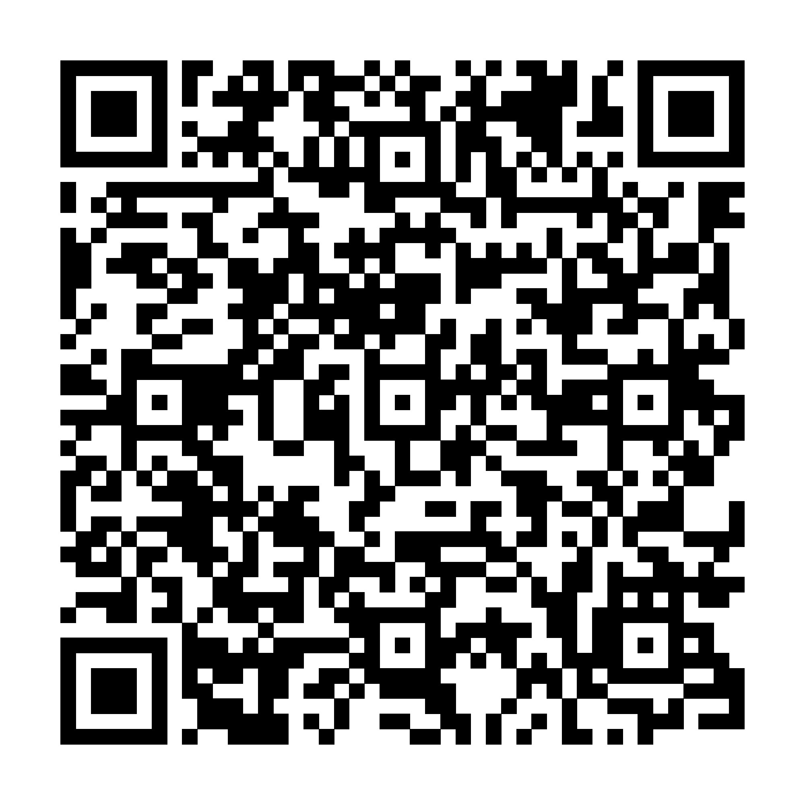
Link to NRCS WFPO Program Web Page:
https://www.nrcs.usda.gov/programs-initiatives/watershed-and-flood-prevention-operations-wfpo-program/new-mexico/watershed
Notes:
NRCS

Slide 21

What will the Supplemental Watershed Plan-EA Include?
Project Background Information
Soil Resources
Prime and Unique Farmland
Water Resources
Sole Source Aquifers
Water Quality
Floodplain Management
Wetlands
Wild and Scenic Rivers
Threatened and Endangered Species
Migratory Birds
Invasive Species
Fish and Wildlife
Cultural Resources
Historic Properties
Environmental Justice
Public Health and Safety
Economic and Social Conditions
Scenic Beauty
Land Use
Air Quality
Noise
Purpose and Need for the Project
Affected Environment
Development of Alternatives
Environmental Consequences
Evaluation of Alternatives
Selection of Preferred Alternative
Notes:
Tetra Tech

Slide 22
National Environmental Policy Act (NEPA) Process
NEPA ensures that federal actions comply with federal, state, and local laws and regulations and that federal agencies consider the environment in decision-making
NRCS funding or approval of a supplemental watershed project plan is a federal action subject to NEPA
An EA will be part of the supplemental watershed project plan to assess the environmental, social, cultural, and economic impacts of the identified alternatives
Notes:
Tetra Tech

Slide 23
Purpose and Need
Purpose
  Maintain flood prevention
  Continue to reduce downstream sediment deposition
Need
  Address dam safety and performance deficiencies
  Improve public safety
Notes:
RJH

Slide 24
Scope of Work
Project Planning Phases
Phase 1: Goals, Objectives, Purpose and Need
Phase 2: Inventory and Analyze Resources
Phase 3: Alternatives Formulation
Phase 4: Prepare Final Supplemental Plan-Environmental Document
Notes:
RJH/Tetra Tech

Slide 25
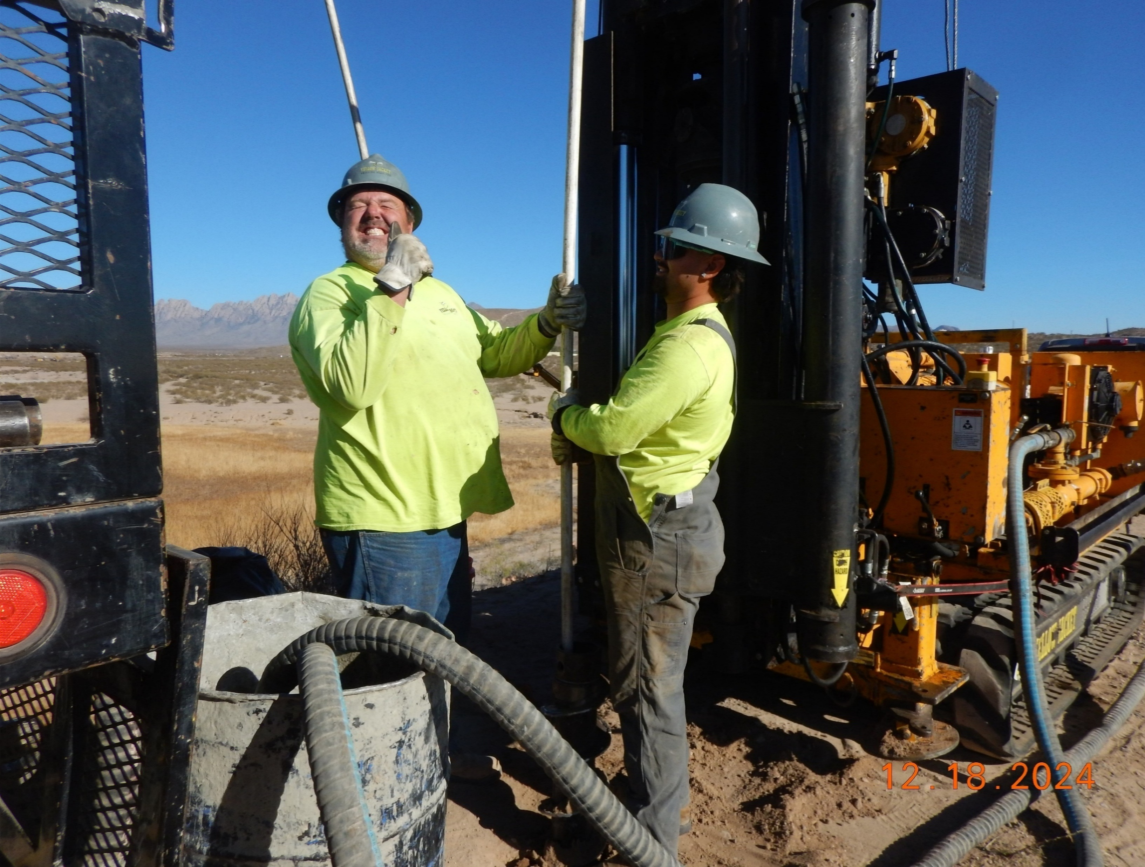
Phase 1: Goals, Objectives, Purpose and Need
Compile and Review Existing Data
Collect Additional Data
  Subsurface investigation - complete
  Topographic Survey – complete
  Sediment Survey – in progress
  Flooding Evaluations – in progress
  Public Participation – complete (2021)
Refine Purpose and Need
Notes:
RJH

Slide 26
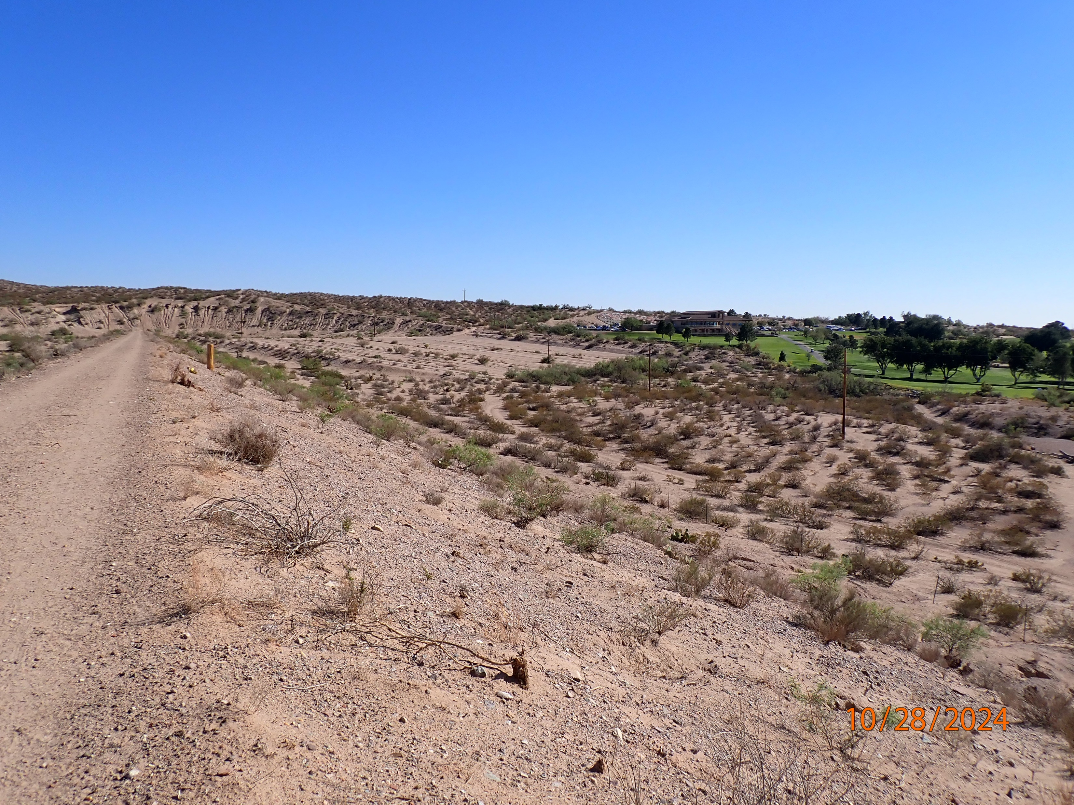
Phase 2: Inventory and Analyze Resources
Inventory Resources
  Environmental
  Economic
  Social
  Cultural
Analyze Identified Resources
  Local Research
  Desktop Analysis
  Field Investigations
  Evaluate Potential Impacts
Notes:
Tetra Tech

Slide 27
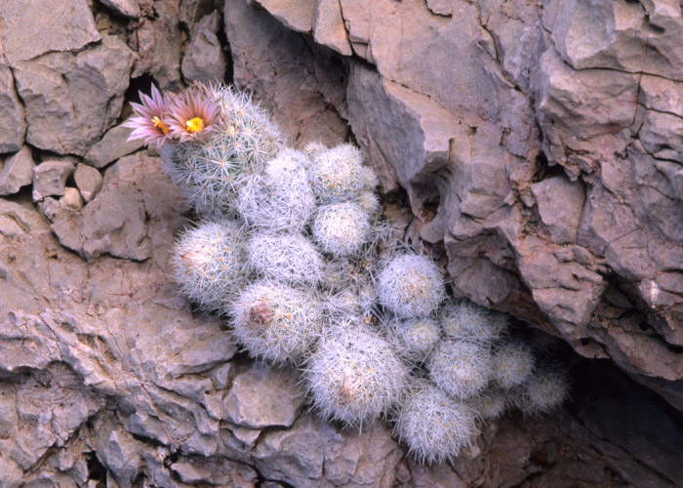
Environmental Resources
An initial desktop analysis was performed in March 2024. The Environmental Technical Report (Stantec, 2024) identified:
  None of the soils within project area are hydric; soils range from well drained to somewhat excessively drained.
  Doña Ana County and the City of Las Cruces have local dust ordinances for improving local air quality.
  Species with the potential to occur in the project area:
    Sneed pincushion cactus, night-blooming cereus
  Construction activities have potential to impact breeding or nesting activity for species provided protection under the Migratory Bird Treaty Act (MBTA).
Notes:
Tetra Tech

Slide 28
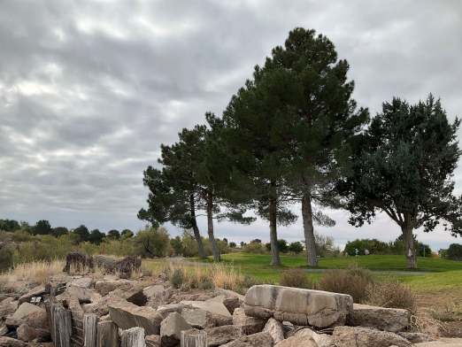
Environmental Resources
Further evaluation of this information and an update as needed will be performed:
  Soil Resources - an updated NRCS Soil Data Report was collected
    Prime and unique farmland
  Water Resources (surface, groundwater, wetlands, etc.)
    While the Tortugas Arroyo is predominantly ephemeral, the latest guidance requires an analysis of any intermittent waterway which will be conducted using the Streamflow Duration Assessment Method (SDAMs)
  Special Status Species – federally listed species, state Rare Plants
    Sneed pincushion cactus – federally endangered
    Black spine prickly pear – state endangered
    MBTA Species
  Other (non-listed) Fish and Wildlife Habitat
  Updates to other resources: air quality, climate, etc.
Notes:
Tetra Tech

Slide 29
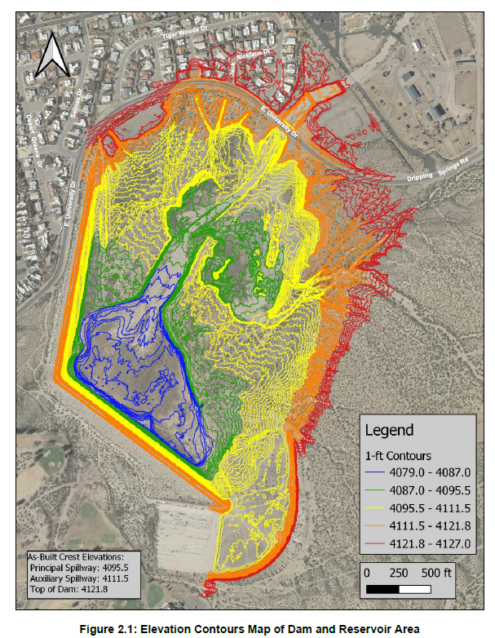
Economic Evaluation
Resources to be evaluated:
  Urban flood damages
  Agricultural production and estimated flood damages
  Demographic economic drivers
  Land use and property values
  Number and characteristics of structures at risk in the 500-year floodplain
  Water supply effects and costs
  Recreation analysis
  Operation, maintenance, and replacement costs
  Climate Change – reservoir O&M
Notes:
Tetra Tech. Map is existing elevation contours of the reservoir, showing some inundation in upstream end on the north side of Dripping Spgs Rd. Impacts will evaluate changed conditions both upstream and downstream (i.e., flood routings/breach inundations).

Slide 30

Ecosystem Services
Ecosystem services (either tangible or intangible) are the critical link between ecological function and social well-being.
  Provisioning
    Food and Water
  Regulating
    Regulation of ecosystem processes – flood control, erosion control, air quality, climate regulation, pollinator services for agriculture, regulation of human disease, water purification
  Cultural
    Recreational, spiritual and religious
  Supporting
    Soil formation and nutrient cycling
Notes:
Tetra Tech

Slide 31
Social Resources
Social Population and Demographics Existing Conditions Study (Stantec, 2024) identified:
  Environmental Justice (EJ), Civil Rights, and Social Issues
    Population, demographics, economic activity
    Ensure fair treatment
  Public engagement completed should include outreach to EJ communities
  Alternatives should consider potential impacts to community facilities and transportation infrastructure within the Study Area
A review of the previous survey and report is being conducted to identify additional needs
Notes:
Tetra Tech

Slide 32
Cultural Resources
Cultural Resources Survey (Zia, 2023) identified:
  The dam site is not considered to be associated with an important event.
  The dam site is ineligible for inclusion in the National Register of Historic Places.
  Domestic refuse dumps are present in the reservoir area, but do not contain important information potential.
  There are no potential adverse effects to cultural resources.
A review of the previous survey and report identified the need for:
  Historic context of the dam under National Register Criterion A and C
NRCS will complete this assessment and is coordinating with SHPO and will complete the consultation for the project
Notes:
Tetra Tech

Slide 33
Phase 3: Alternatives Formulation
Identify and formulate reasonable alternatives
  No action
  Nonstructural (could include decommission)
  Structural rehabilitation
  Locally preferred (if requested by Sponsor)
  Evaluate impacts to resources
  Cost Estimates
Identify the preferred alternative
Notes:
RJH

Slide 34

Phase 4: Prepare Supplemental Plan-Environmental Assessment
Compile collected data for existing structures
Identify and evaluate alternatives
Identify and evaluate impacts of alternatives
Select preferred alternative with public input
iStock
Notes:
RJH

Slide 35
Initial Agency & Public Input/Responses
Initial Agency/Stakeholder meeting held in August 2021
Initial Public Scoping Meeting held in December 2021
Numerous public comments regarding recreational use and artwork located near the auxiliary spillway
Comments were addressed by NRCS
Notes:
RJH

Slide 36
Agency/Tribal/Stakeholder Input
Three scheduled opportunities for public and agency input:
  Additional Agency/Stakeholder Scoping Meeting - today
    Provided: Project re-introduction
    Requested: Input on objectives, alternatives, and prioritization
  Alternatives Meeting
    Provided: Report on how input was incorporated and presentation of alternatives
    Requested: Input on selected alternative
  Supplemental Plan-Environmental Assessment Review
    Provided: Draft Supplemental Plan-Environmental Assessment
    Requested: Comments on the Supplemental Plan-Environmental Assessment
Notes:
RJH

Slide 37
Input on Resources
Stakeholder Involvement
What resource opportunities/impacts are of particular importance?
Are there any other known opportunities or impacted resources?
Ecosystem Services approach comments?
General concerns or comments?
Resource List
Soil Resources
Prime and Unique Farmland
Water Resources
Sole Source Aquifers
Water Quality
Floodplain Management
Waters of the US
Regional Water Resource Plans
Wild and Scenic Rivers
Air Quality
T&E Species
Migratory Birds
Bald and Golden Eagles
Essential Fish Habitat
Critical Habitat
Ecologically Critical Areas
Invasive Species
Fish and Wildlife
Natural Areas
Riparian Areas
Forest Resources
Wetlands
Recreation
Cultural Resources/Tribal Consult
Environmental Justice
Social Issues
Local, Regional, National Economy
Public Health and Safety
Scenic Beauty
Parklands
Scientific Resources
Land Use
Recreation
Ecosystem Services
  Provisioning
  Regulating
  Supporting
  Cultural
Other…
Notes:
Tetra Tech
Resource & ecosystem services concerns rating table. Matches 2024 NWPM Figure 501C-1 and the scoping resources comment form.

Slide 38



Input: How to Submit Comments?
Submit your comments on the project by February 22, 2025
There are three ways to comment:
Comment Card
Submit a written
Comment at today’s
meeting
Mail
USDA NRCS New Mexico
Attn: Merceidez Fabok
100 Sun Avenue Northeast, Suite 602
Albuquerque, NM 87109-3434
l
Email
Merceidez.Fabok@usda.gov l
Notes:
RJH

Slide 39
Discussion on Possible Benefits & Considerations
Possible benefits and other considerations while developing alternatives
  Increased flood protection
Landowner considerations
Recreational use of facilities
Avoid impacts to critical infrastructure (NMSU, I-10 and I-25, etc.)
Other considerations?
Notes:
RJH

Slide 40
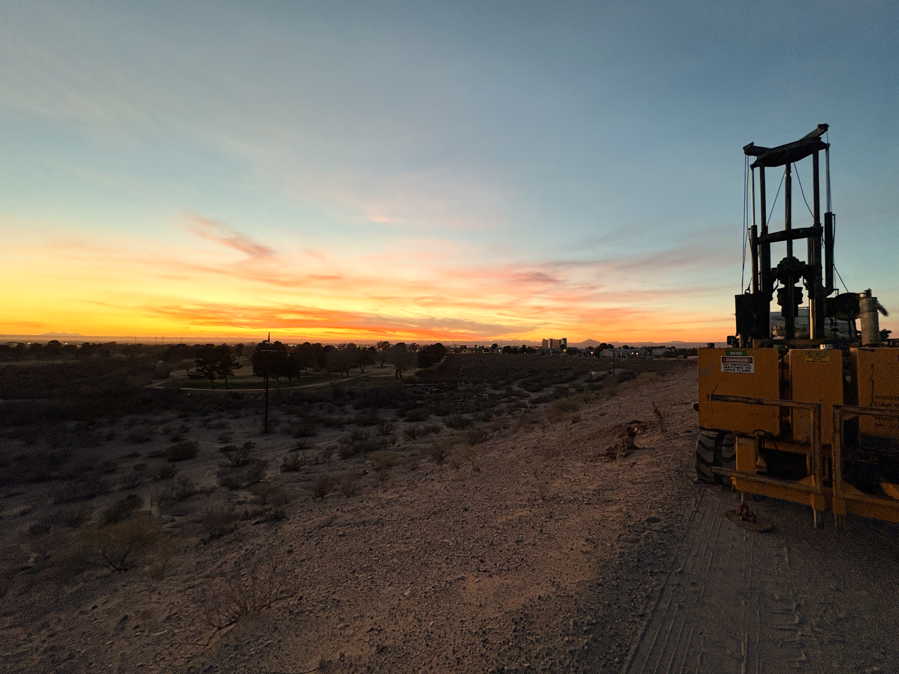
Open Discussion/Questions

Slide 41
Next Steps
Additional Agency/Stakeholder Scoping Meeting (Today)
  Agency comments due to NRCS by February 22, 2025
Alternatives Development
  Consider information from initial and current Agency meetings and previous public meeting
  Refine purpose and need as appropriate
  Develop alternatives and evaluate impacts
  Identify preferred alternative
  Next agency/public meeting (alternatives presentation and solicit input )
Notes:
RJH

Slide 42
Schedule
Evaluate existing conditions
Spring 2025
Identify and evaluate alternatives
Spring and Summer 2025
Alternatives Meeting
Summer 2025
Public review of draft documents
Winter 2025
Public review of final documents
Spring 2026
Planning completion
Spring 2026
Notes:
RJH

Slide 43
Closing Comments
Final Thoughts
Planning phase of a bigger project.
Schedules and timelines are targets, not rigid.
The participation of public and agencies is voluntary BUT CRITICAL TO A SUCCESSFUL PROJECT.
The project is intended to reflect the values and opinions of the local agencies and community whenever possible.
Project webpage: https://www.nrcs.usda.gov/programs-initiatives/watershed-and-flood-prevention-operations-wfpo-program/new-mexico/watershed
Contact Merceidez Fabok with the NRCS:
Email: merceidez.fabok@usda.gov
Mail: USDA NRCS New Mexico, Att: Merceidez Fabok
100 Sun Ave. Northeast, Suite 602, Albuquerque, NM 87109-3434
Comments/Questions are due to NRCS by:
Saturday February 22, 2025
Notes:
RJH

