Slide 1
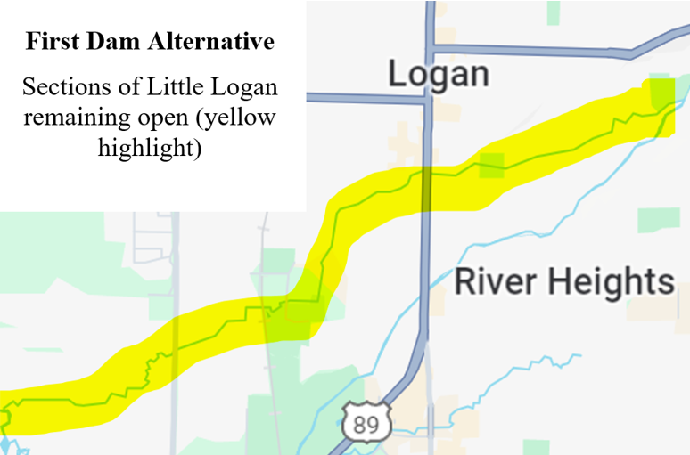
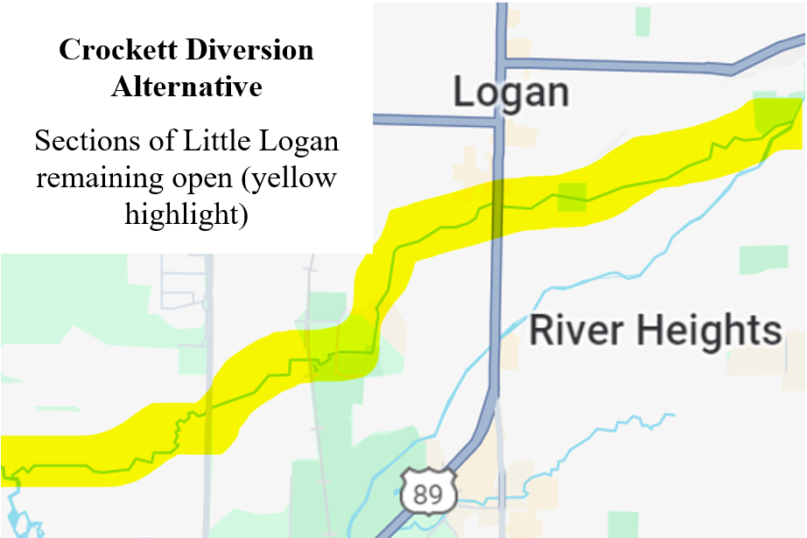
Logan River Watershed Project Information Regarding the Little Logan
The Logan River Watershed Planning Team has received comments about two potential alternatives which address concerns about the Little Logan. No alternative has been proposed that would pipe or enclose the entire Little Logan.
First Dam Alternative
This alternative has been updated. Under this alternative, the existing Crockett Diversion dam in the Logan River would be reconstructed with overflow gates to allow for natural flow to enter the Little Logan, allowing for fish passage and recreational portage to River Hollow Park. The Little Logan would continue to be supplied with irrigation water to maintain flow during the irrigation season starting at the Logan River, including through Jens Johansen Park, Merlin Olsen Park, the Cache County Fairgrounds, Willow Park, and Majestic Park. Between River Hollow Park and Crockett Avenue, the distribution pipe for the pressurized irrigation system would be buried and a trail constructed on top of it and the Little Logan would continue to flow within the same corridor.
Crockett Diversion Alternative
Under this alternative, the Little Logan would be supplied with water to maintain flow during the irrigation season through all the sections of the Little Logan, including River Hollow Park, Jens Johansen Park, Merlin Olsen Park, the Cache County Fairgrounds, Willow Park, and Majestic Park.
The Crockett Diversion dam in the Logan River would be replaced. Instream flows would be provided in the Logan River to improve water quality, flow continuity, and river aesthetics along the Logan River.
Additional descriptions of the alternatives are available on the project webpage: https://bit.ly/LoganRiverWatershedProject
Need more information? Contact the project team at 435-213-2872 or loganriver@utwatershed.com.

