Slide 1
Side | by | Side
Photos
of some of
Connecticut’s Soil Types

Slide 2
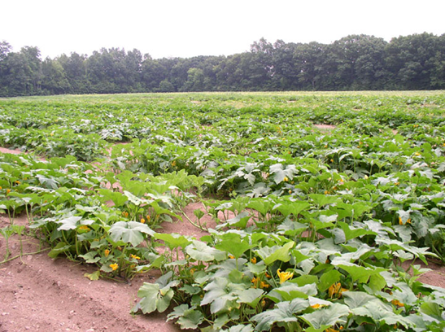
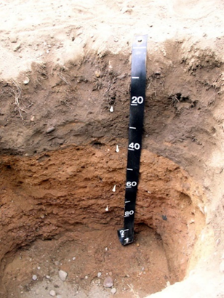
Manchester Cropped
Manchester Cropped Landscape
Manchester Cropped Profile

Slide 3
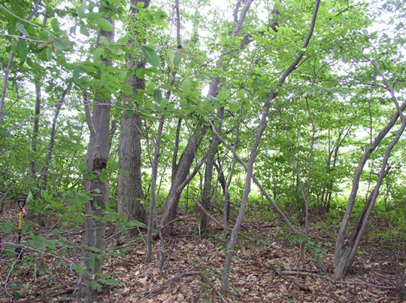
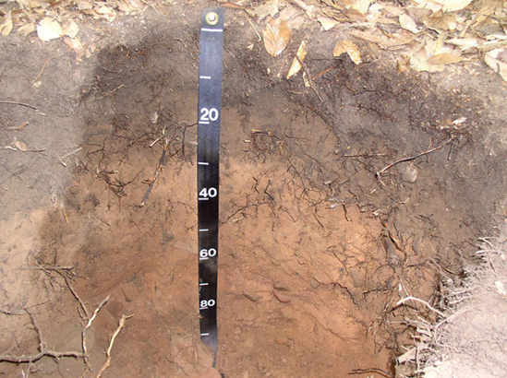
Manchester Forested
Manchester Forested Landscape
Manchester Forested Profile

Slide 4
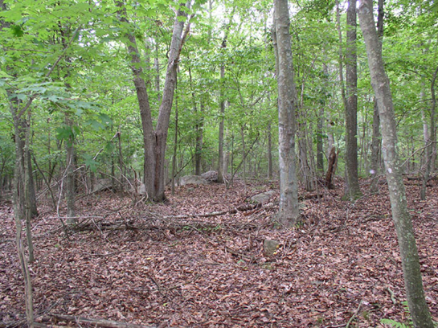
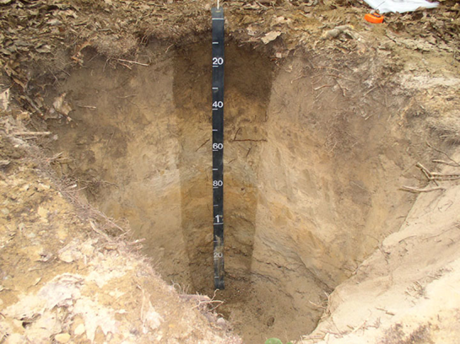
Narragansett Forested
Narragansett Forested Landscape
Narragansett Forested Profile

Slide 5
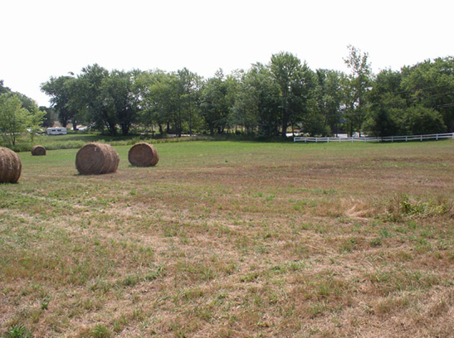
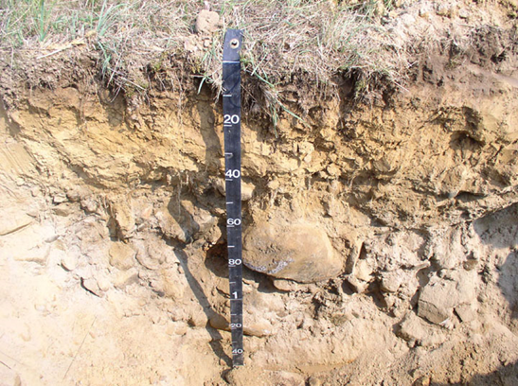
Narragansett Hayfield
Narragansett Hayfield Landscape
Narragansett Hayfield Profile

Slide 6
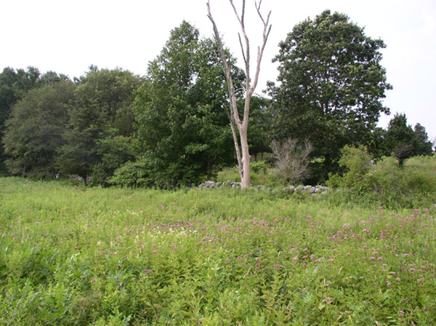
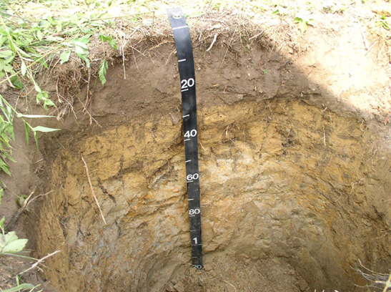
Sutton Old Field
Sutton Old Field Landscape
Sutton Old Field Profile

