Slide 1
State Technical Advisory Committee Meeting November 2023

Slide 2
FY 24 Climate Smart Practices
Notes:
The USDA defines climate smart agriculture as activities that store carbon and improve resilience and soil health

Slide 3

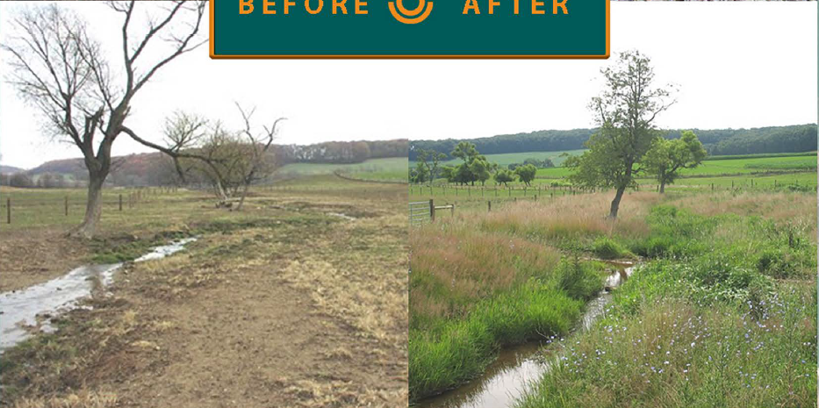
Climate Smart Ag and Forestry
Producers can respond to climate change by reducing or removing GHG (mitigation and building resilience (adaptation) while sustainably increasing ag productivity and income.

Slide 4
New Practices FY 24
313 Waste Storage Facility
336-Soil Carbon Amendment
367 Roofs and Covers
592 Feed Management
632 Waste Separation Facility
314 Brush Management
315 Herbaceous Weed Treatment
338 Prescribed Burning
4

Slide 5
New Practices FY 24
383 Fuel Break
384 Woody Residue Treatment
643 Restoration of Rare or Declining Natural Communities
372 Combustion System Improvement
430 Irrigation Pipeline
441 Irrigation System, Microirrigation
442 Sprinkler System
533 Pumping Plant
5

Slide 6
Facilitating Practices
Conservation practices that facilitate the management or the function of a CSAF activity but may not achieve the desired effects on their own
Examples: Conservation Crop Rotation (328) may need facilitating practices such as Pest Management Conservation System (595),Cover Crops (340), or Irrigation Water Management (449). Prescribed Grazing (528) may need facilitating practices such as Watering Facility (614), Stream Crossing (578), Brush Management (314), Fence (382), or Livestock Shelter Structure (576).
6

Slide 7
Removed Practices
Removed from the list for FY2024:
Upland Wildlife Habitat Management (Code 645)
Enhancements Removed
  E645B, E645C
  E328G, E328G
  E528D, E528E
7

Slide 8
TOOLS
COMET-Planner™ is an evaluation tool designed to provide estimates of greenhouse gas reductions expected by adopting NRCS conservation practices. Use of this tool is intended for conservation planning purposes and does not provide site-specific calculations. Please visit COMET-Farm for an estimate tailored to site specific conditions of your farm.
COMET-Farm™ is an interactive online tool to estimate whole-farm, ranch, and forestry emissions and mitigation options.
Notes:
The CSAF list of core practices has already been vetted for use by the national climate team. If there are

Slide 9
Additional Resources
  Programs - FY2024 IRA Documents - All Documents (sharepoint.com)
  Climate-Smart Agriculture and Forestry Mitigation Activity List (usda.gov)
  NRCS Climate - Home (sharepoint.com)
  Southwest Climate Hub | USDA Climate Hubs
  Climate Smart Agriculture and Forestry Mitigation Activities FAQ’s
  NRCS Climate Smart Mitigation Activities
  NRCS Inflation Reduction Act
9

Slide 10
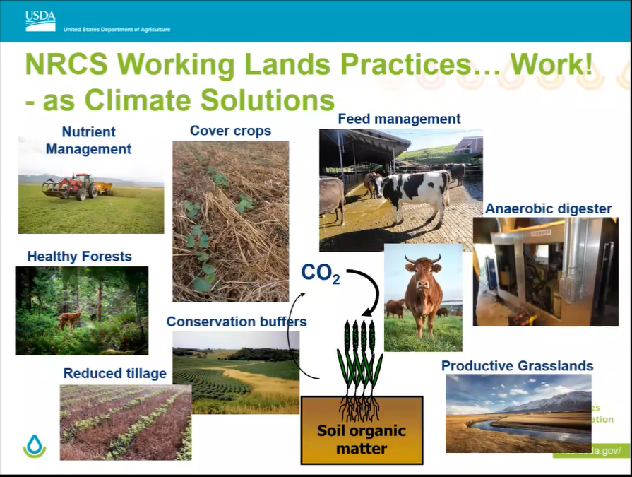

Slide 11
EQIP CIC Priority Practice List

Slide 12
EQIP CIC Background
Producers may use incentive contracts as a “steppingstone” from correcting resource issues on specific land units through EQIP, to achieving sustainable stewardship on their entire operation
https://www.nrcs.usda.gov/eqip-conservation-incentive-contracts

Slide 13
FY 24 EQIP CIC Priority RC’s and Land Uses
Livestock Production Limitation
Feed and Forage Balance
Inadequate Livestock Shelter
Terrestrial Habitat for Wildlife and Invertebrates
Soil Quality Limitation
Aggregate Instability
Compaction
Concentration of Salts and other Chemicals
Land Uses-Crop Pasture Range Forest

Slide 14
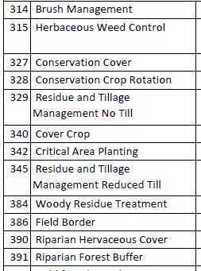
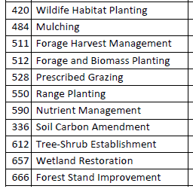
FY 24 EQIP CIC Primary Practices

Slide 15
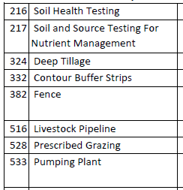
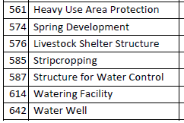
EQIP CIC Supporting Practices

Slide 16
Utah Minimal Effects Worksheet

Slide 17
Background
The 1985 National Food Security Act requires producers participating in USDA programs to comply with the Wetland Conservation (WC) Compliance

Slide 18
Background
To remain eligible to receive benefits, they must certify that:
• they have not produced crops on a converted wetland after December 23, 1985
• they did not convert a wetland after November 28, 1990, in order to make agricultural production possible.
• An AD 1026 form was filed with FSA

Slide 19
Background
NRCS assists producers with meeting participants wetland compliance responsibilities by issuing certified wetland determinations.
Certified wetland determinations identify the location of all wetlands on the participants land and the scope of protection that must be provided in order for a producer to maintain eligibility for USDA program benefits.

Slide 20
Minimal Effects Definition
The purpose of a minimal effects exemption is to allow for treatments that will have no or minimal impact to the functional capacity in the wetland
Notes:
Examples are Russian olive or tamarisk

Slide 21
Minimal Effects Worksheet Objective
The purpose of the minimal effects worksheet is to expedite non-native, invasive tree and shrub removal within or near wetlands
The document walks a planner through a decision tree to determine whether the site meets the criteria to remove invasive woody vegetation without a Certified Wetland Determination
Notes:
Examples are Russian olive or tamarisk

Slide 22

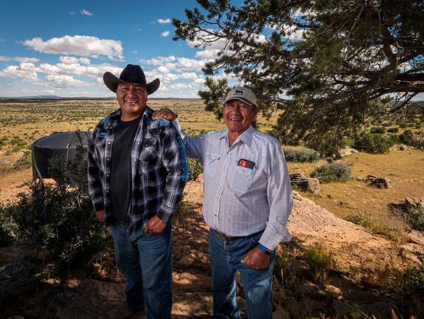
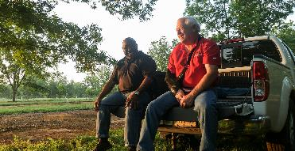

Questions?

