Slide 1
Natural Resources
Conservation Service
Programs Review

Slide 2
2023 Spending Summary
Forestry | $ 36,700.00
Irrigation Conveyance | $ 5,600,000.00
irrigation Efficiency | $ 8,900,491.00
Pasture Management | $ 280,000.00
Rangeland Health | $ 8,906,000.00
Soil/Erosion Health | $ 821,000.00
Urban Farming | $ 1,350,000.00
Water Quality | $ 939,900.00
Watershed Health/Restoration | $ 763,000.00
Salinity in CO river | $ 5,300,000.00
Wildlife | $ 275,700.00
Energy | $ 16,920.00

Slide 3
2023 Conservation Innovation Grant
Objective: Assess the irrigation conveyance efficiencies of automated headgates and flow meters in the delivery of irrigation water.
3 automated headgates, installed on the Bear River Canal system. – completed by June 2024
Flow measurement data collection for 3 years. To provide real data to the NRCS that demonstrates water conservation and maintains or improves crop production.
Funding $63,140.55

Slide 4
2023 Conservation Innovation Grant

Slide 5
Soil Health Outreach Grant
Utah Department of Agriculture and Food (UDAF)
Goal:
Promote the adoption of soil health practices by sharing knowledge regionally and statewide.
Increase the number and quality of soil health events across the state.
30 events
3000 participants
Federal funding $549,935

Slide 6
Strategic Fund Pool Highlights
Cache Soil Health
Walsburg SFP

Slide 7
Cache Soil Health

Slide 8
Cache Soil Health
Objective: Realize increased soil health in the future with continued utilization of cover crops and following soil health principles.
$31,700 Contracted. 114.8 acres treated
$89,872 Contracted 765.21 acres treated
Partners: Cache Conservation District - Interseeder
Outreach:
Cover Crop Field Days-in conjunction with USU
Articles in the CD newsletter
Cover Crop lead for the NRCS office

Slide 9
Cache Soil Health

Slide 10
Wallsburg SFP--------RCPP
Objective
To improve water quality and aquatic habitat in both Main Creek and Deer Creek Reservoir (a drinking water source for over 50% of Utahns), this project supported activities on a section of Main and Spring Creeks.
Practices
Stream restoration efforts
Irrigation efficiency improvements
Grazing management improvements

Slide 11
Wallsburg SFP--------RCPP
Partnerships
Wasatch County, Wallsburg Town, Utah Division of Water Quality, Utah Department of Agriculture and Food, EPA, USFWS, Provo River Watershed Council, and the Utah Division of Wildlife Resources.
Outcomes
The reduction of stream temperature was enough to de-list Main Creek for temperature on the state 303 (d) list of impaired waters
61% reduction in E. coli loading in Main Creek

Slide 12
Funding Allocations
SFP funding 2016-2017 $374,505
RCPP funding 2018-2021 $300,000

Slide 13
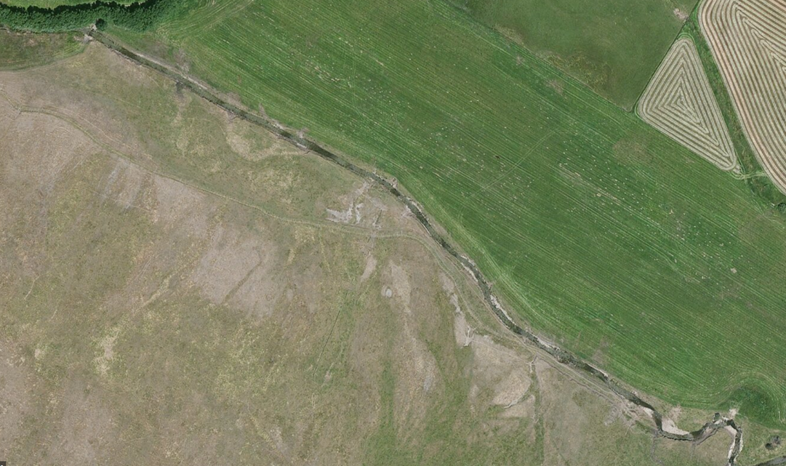

Slide 14
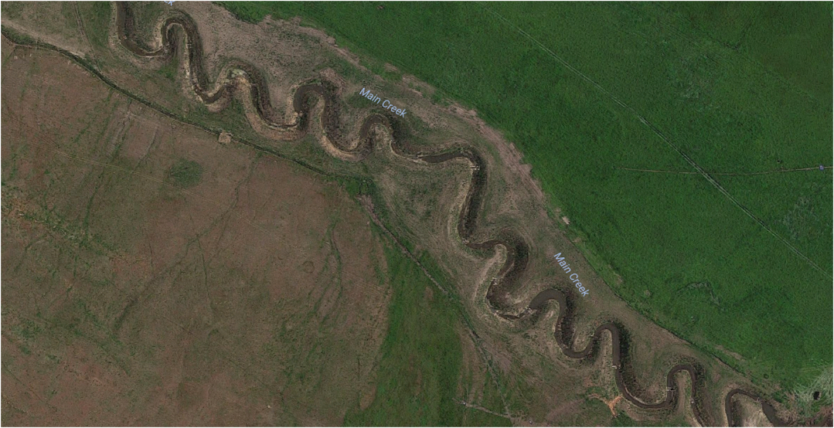

Slide 15
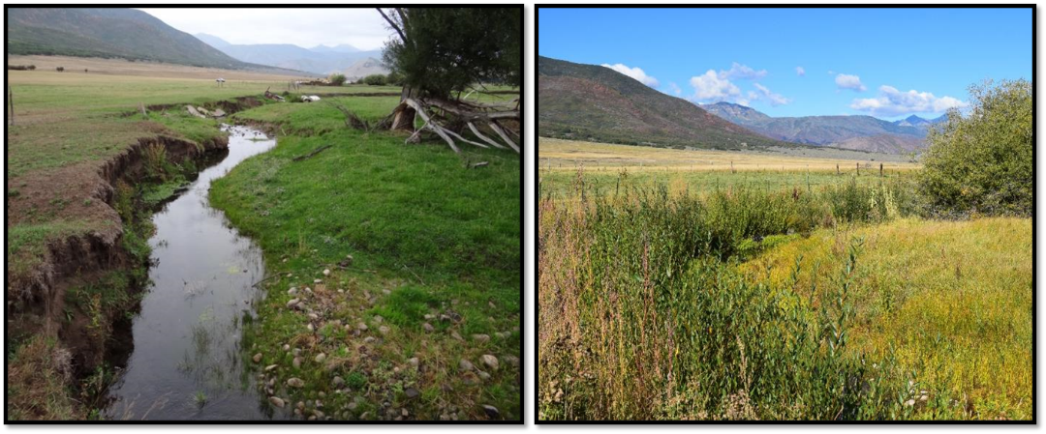

Slide 16
Top EQIP/AMA 10 Practices

Slide 17
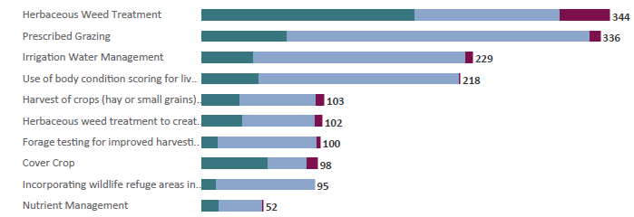
Top 10 CSP Activities

Slide 18
UFO - EMily

Slide 19
Strategic Fund Pools
Resource concern | 2024 | 2023 | 2022 | Total
Irrigation Conveyance Improvements | 3 |  | 4 | 7
Invasive Species |  |  | 5 | 5
Water Quality |  |  | 2 | 2
Irrigation Efficiency | 1 | 2 | 2 | 5
Urban Farming | 1 | 3 |  | 4
Soil Health |  | 2 | 1 | 3
Rangeland Health | 3 | 2 | 1 | 6
Watershed Health/Restoration |  | 2 | 1 | 3
Forestry |  |  | 1 | 1
Pasture Management |  |  | 1 | 1
 |  |  |  | 37

Slide 20
Interactive Map
https://storymaps.arcgis.com/stories/d04659775de942ff8c761ab971b0ddf6

Slide 21
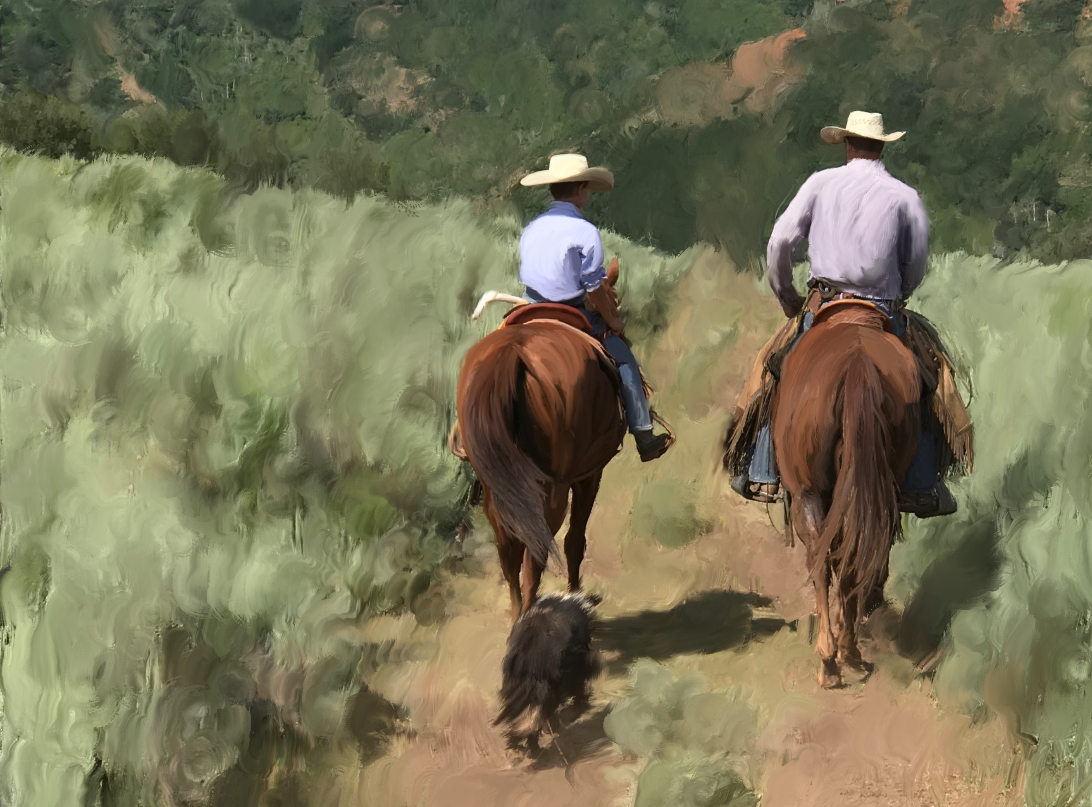
Questions?

