Slide 1
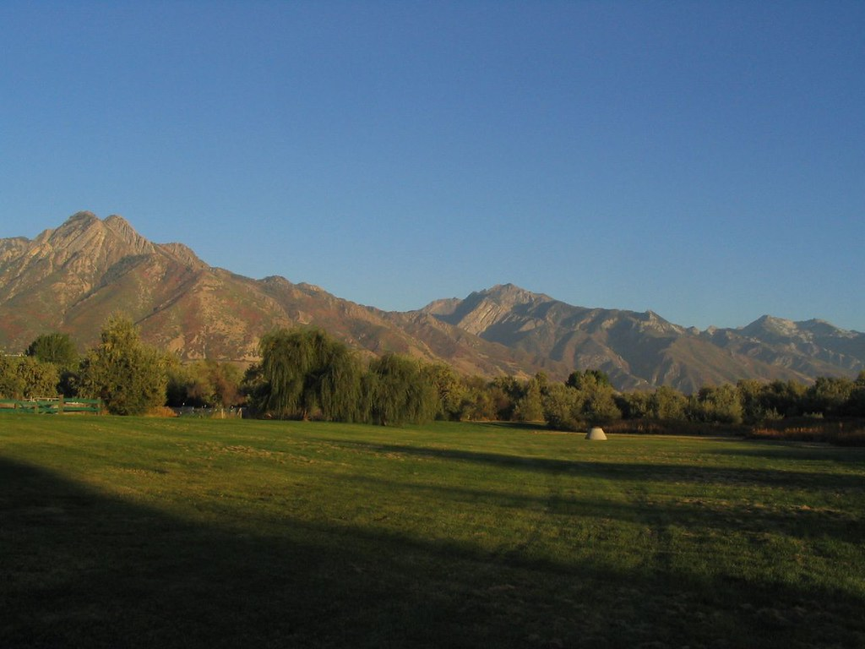
NORTHFIELDS
Highly Sensitive Natural Resource

Slide 2
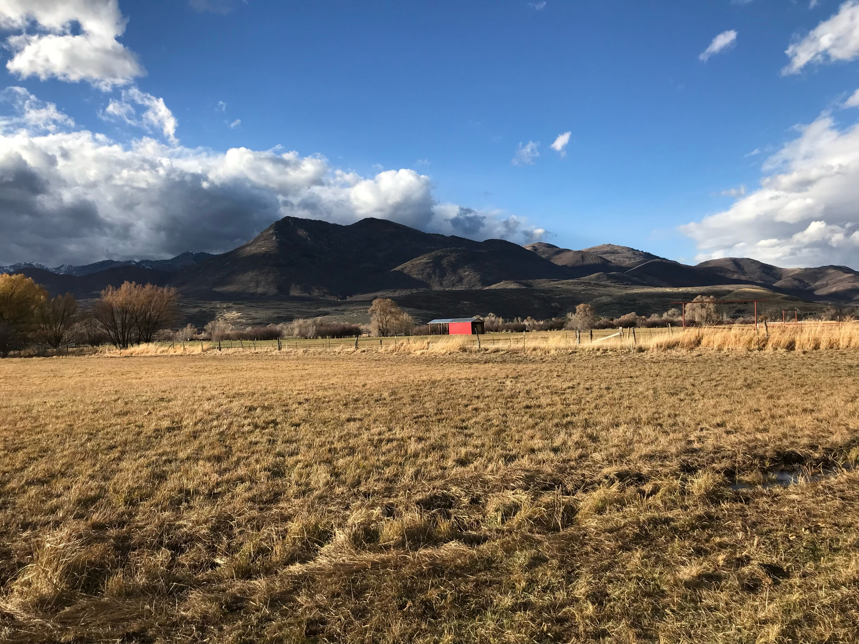
Introduction
Notes:
Utah Open Lands prioritizes the Northfields along the Provo River in Wasatch County, as conservation easement emplacement in this area supports the Biden-Harris administration’s goals for climate-smart agriculture nationwide.

Slide 3
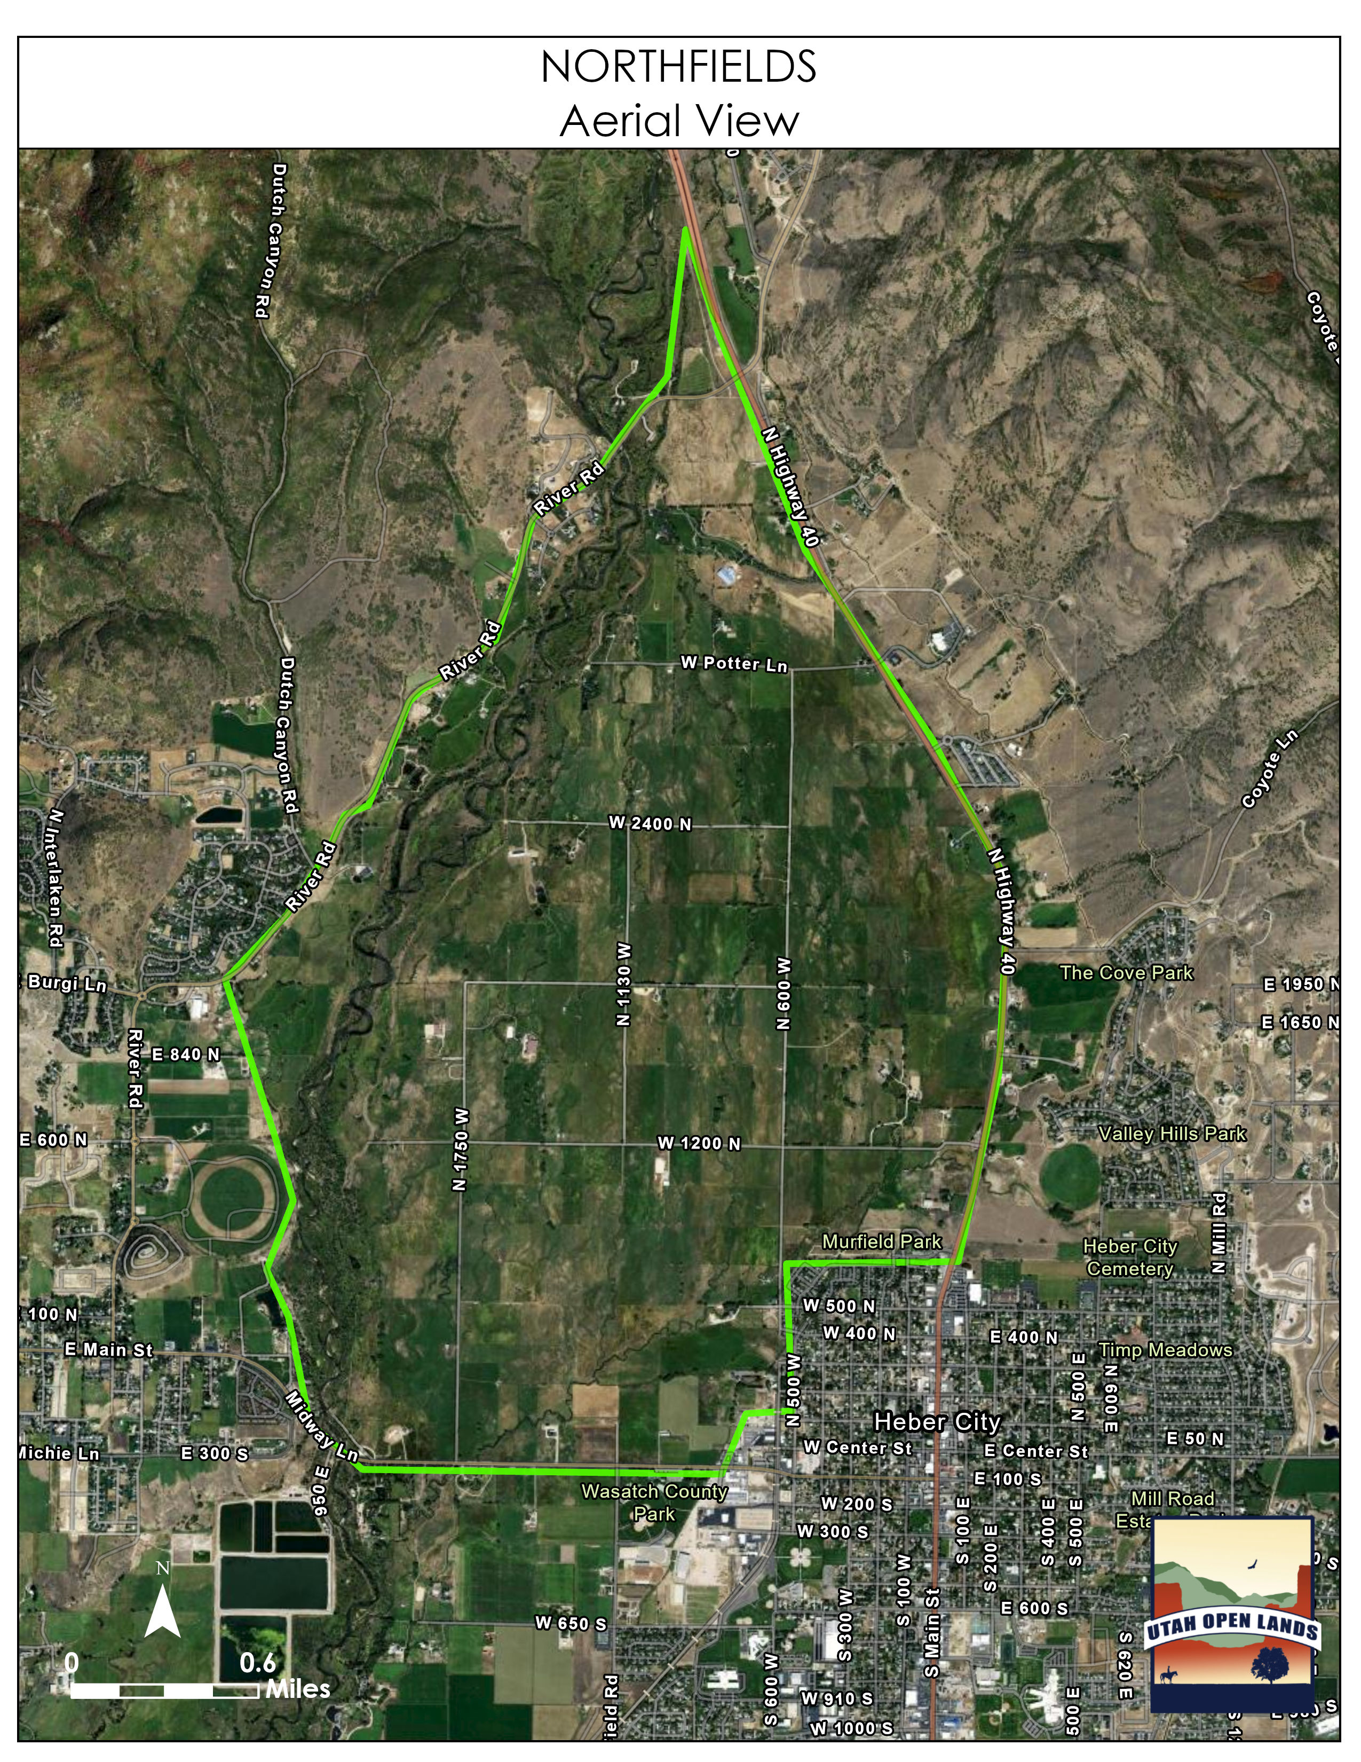
Notes:
The Northfields encompasses approximately 3,254 acres of land zoned Agricultural 20 Acre (A-20). Of these, over 1,000 acres are freshwater emergent wetlands.
(according to the Wasatch County Zoning Information Map)

Slide 4
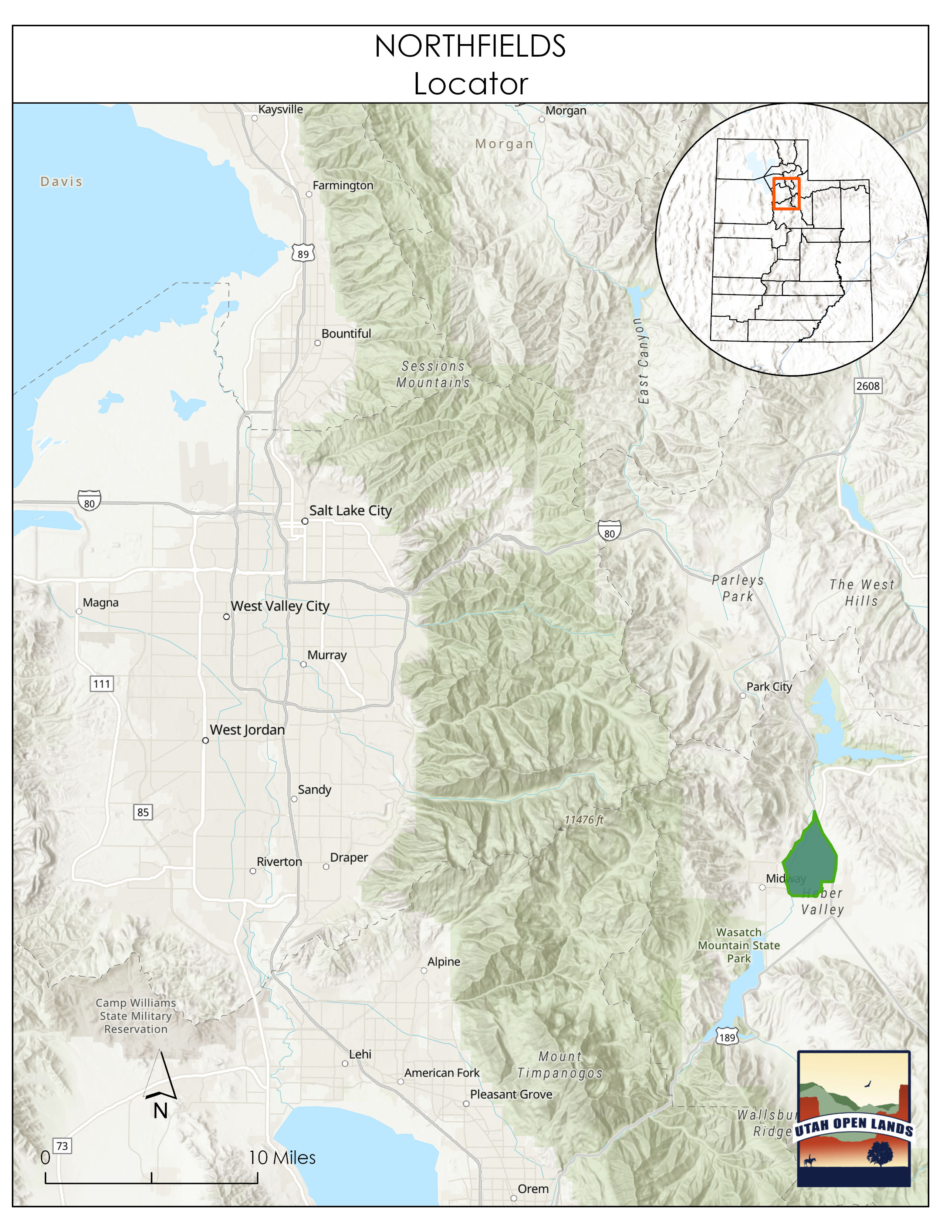
Notes:
This area represents grasslands in areas of highest risk for conversion to non-grassland and non-agricultural uses.
The conversion of these lands to development will result in the release of soil carbon stores in particular due to the fact that very few landowners in the area even till their ground.
The main agricultural pursuit is hay and pasture for cattle. According to the most recent USDA Census of Agriculture, pastureland comprises 75% of land in farms by use in Wasatch county.
The Northfields are part of a watershed which eventually feeds the Great Salt Lake. Conservation Easements contribute to both water quality and quantity.

Slide 5
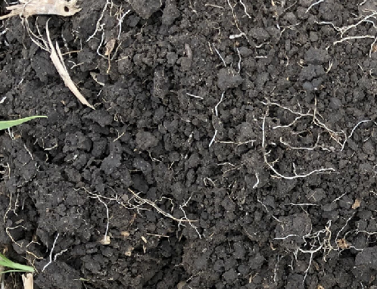
Soil
Notes:
Agricultural use of the Northfields is vital for carbon sequestration.

Slide 6
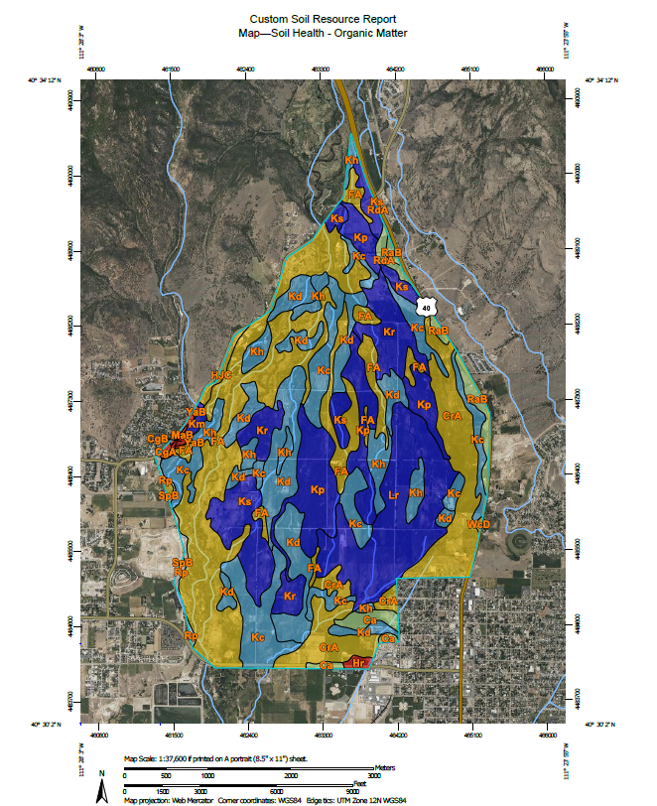
100% High Organic Matter Soil
Notes:
According to the NRCS National Cooperative Soil Survey, 100% of the area soils have ratings of soil organic matter at or above a 3% rating, with significant portions being much higher. Only 0.4% of the area is exactly 3%, all other portions are higher.

Slide 7
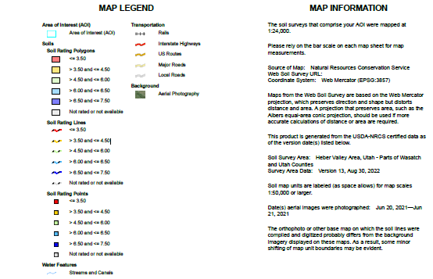

Slide 8
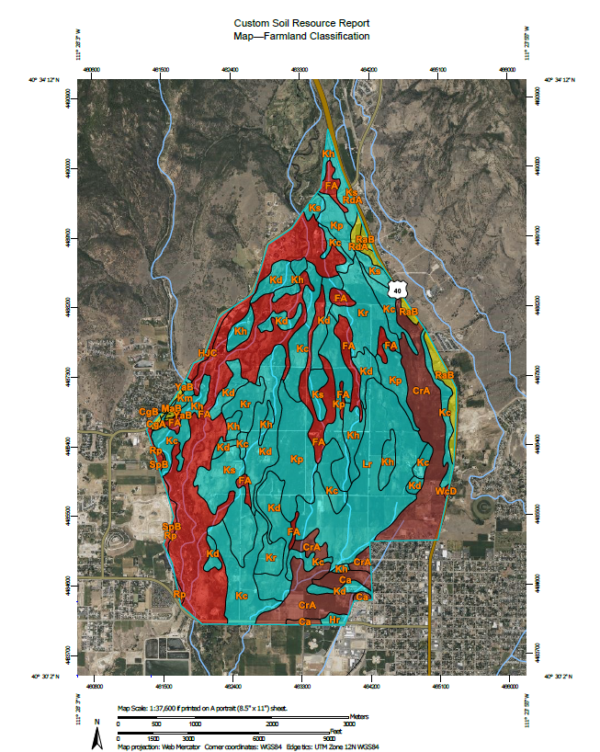
76% Prime or Significant Soils
Notes:
According to the NRCS National Cooperative Soil Survey, the area consists of 76% of prime farmland or farmland of statewide importance.

Slide 9
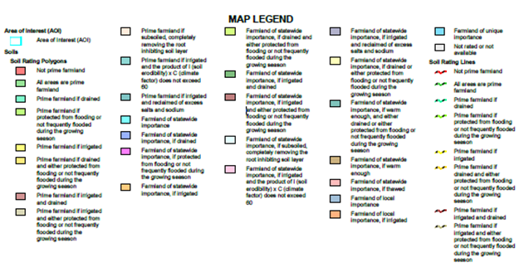

Slide 10
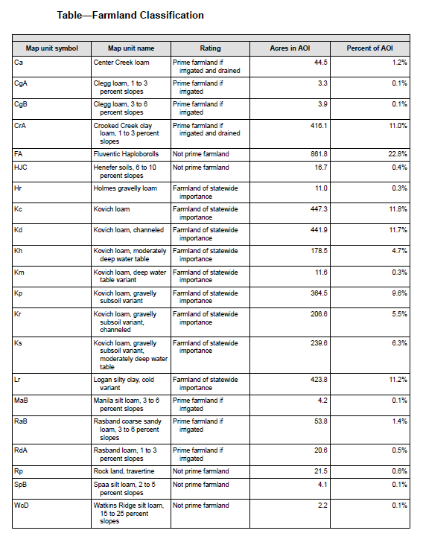
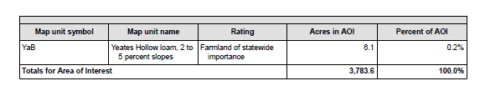

Slide 11
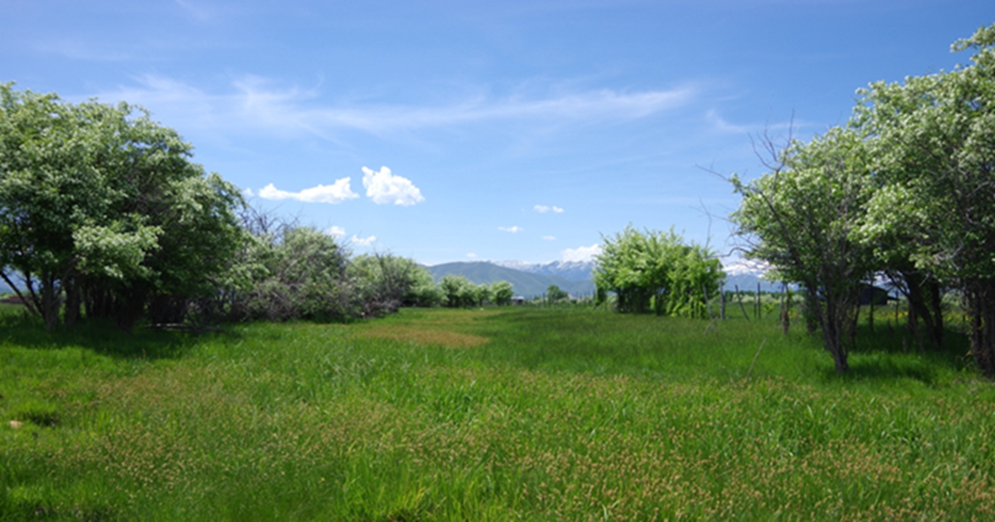
Water Resources
Wetland community, Jason Baker
Notes:
In addition to carbon sequestration, other potential ecosystem services provided include water quality improvement, flood protection, climate change resiliency, and sustained biodiversity.
The Northfields are part of the Middle Provo watershed which flows to Utah Lake and the Jordan River. Utah Lake’s only outlet is the Jordan River which is a tributary to the Great Salt Lake. The Jordan River is one of only three main rivers (which in total comprise 66% of the total inflow) that feed the Great Salt Lake. The Jordan River contributes roughly 22 percent, second only to the Bear River.
Additionally, the Provo River has been identified as a blue ribbon fishery for the state containing Bonneville Cutthroat Trout.

Slide 12
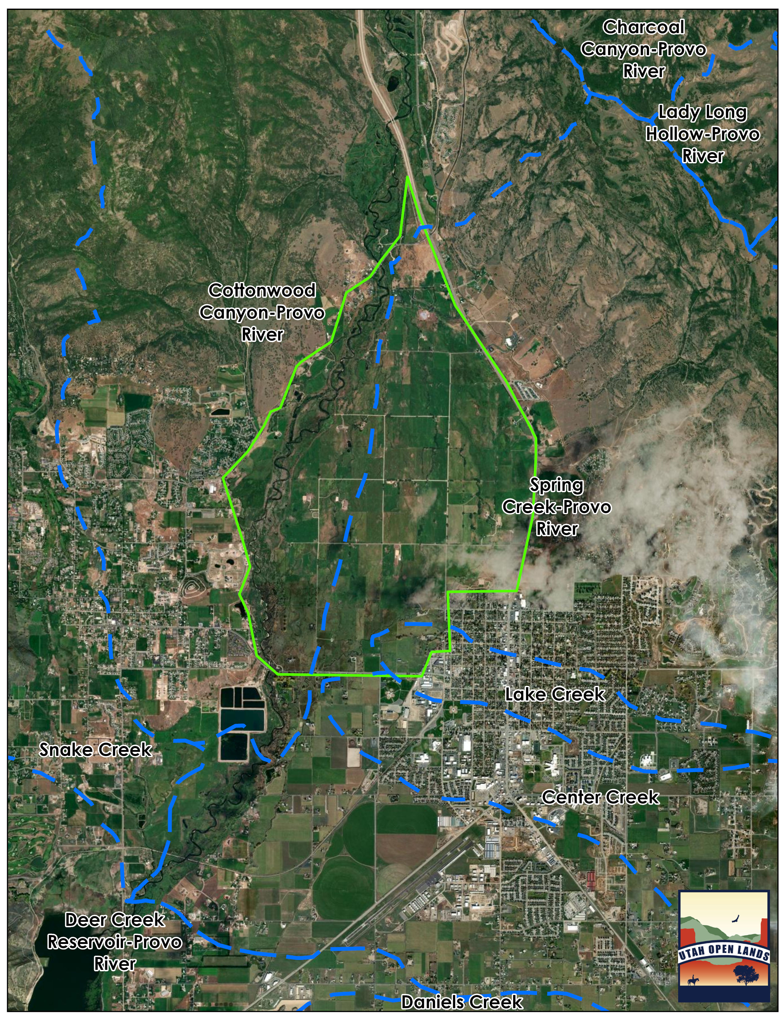
Notes:
The Northfields includes the Provo River- Cottonwood Canyon, Spring Creek, and Lake Creek- Watersheds.

Slide 13
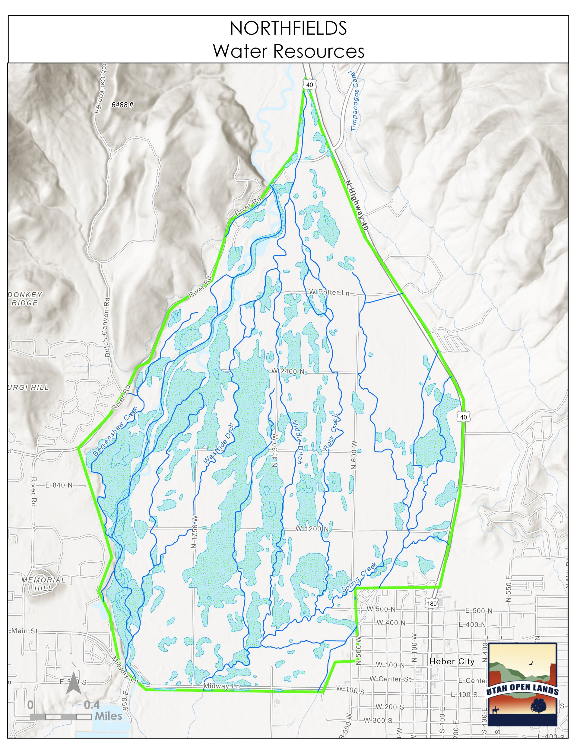
Approximately 1/3 of the area is wetlands.
Notes:
Approximately 1/3 of the area is wetlands.

Slide 14
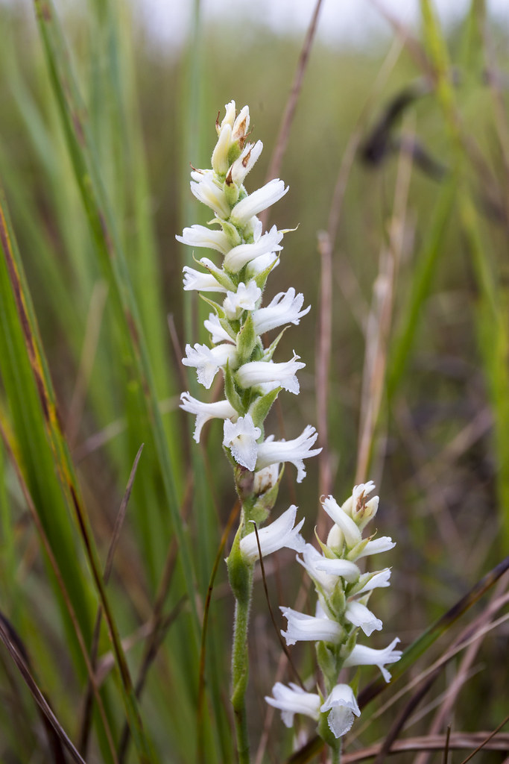
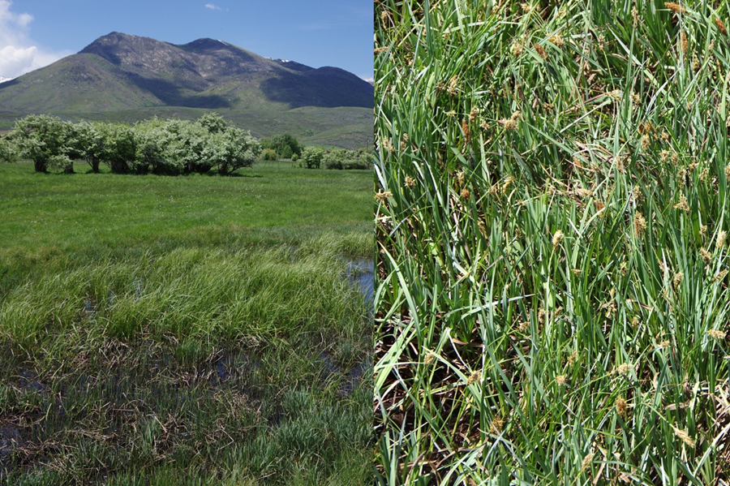
Carex rostrata (Beaked Sedge) and Carex nebrascensis (Nebraska Sedge), Jason Baker
Notes:
The grasses in the area represent naturalized grasslands and initial botanical surveys have indicated extensive wet meadows and riparian habitat along with the likely presence of Ute Ladies Tresses Orchid.

Slide 15
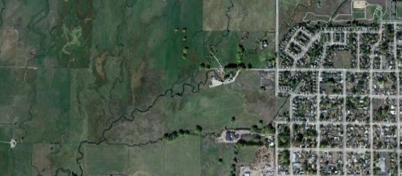
CONVERSION THREAT
Notes:
The area preserves significant agricultural uses that are important for Wasatch County in order to preserve its rural heritage. Large portions of the area have been designated Agricultural Protection Areas; according to a July 2023 KPCW article, approximately 570 acres of the Northfields, with 62 more acres pending. These designations indicate both landowner and county commitments to retention of agricultural lands.

Slide 16
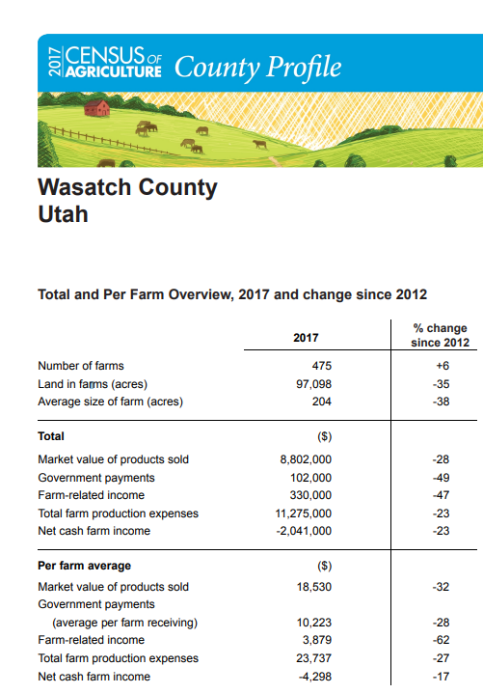
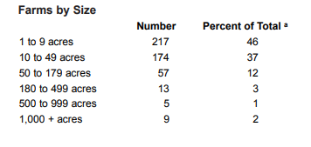



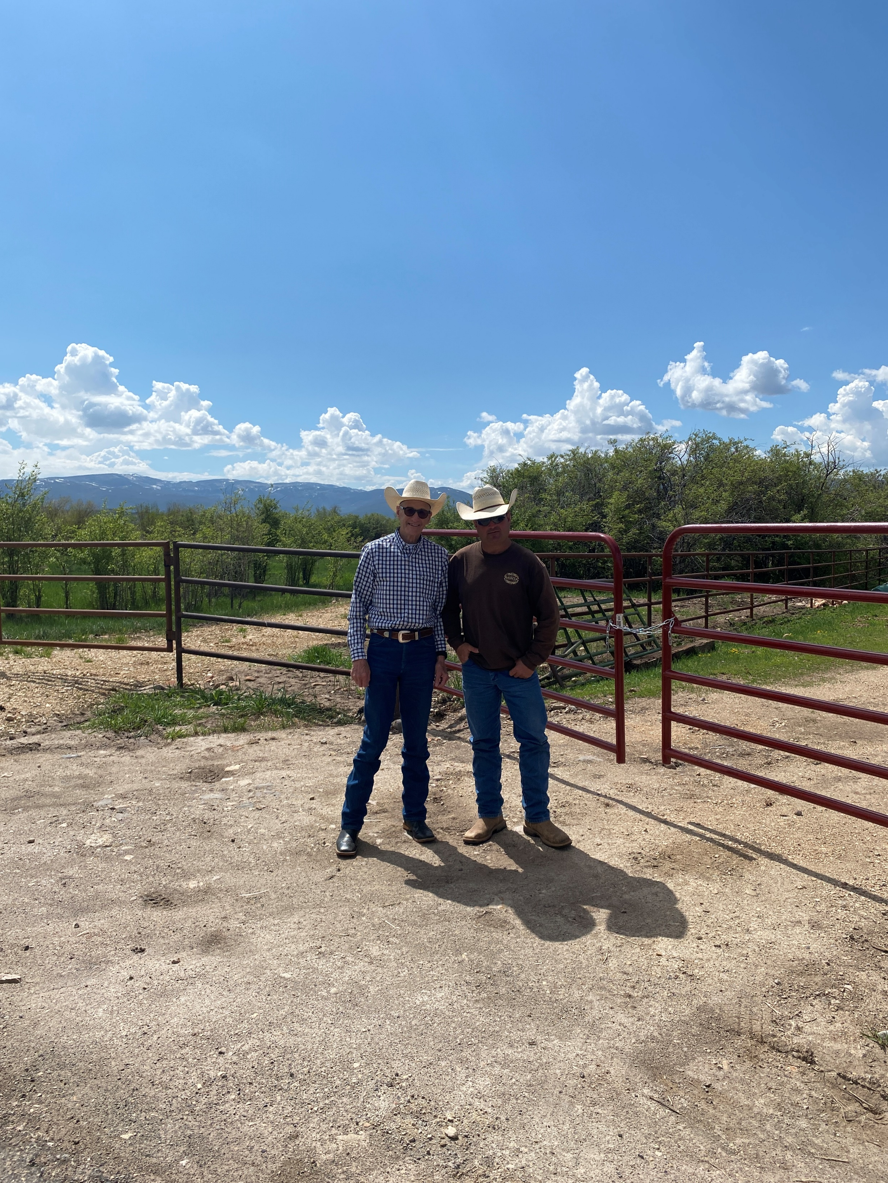
Notes:
According to the most recent USDA Census of Agriculture, farmland acres in Wasatch County decreased by 35% from 2012 to 2017. Farm-related income decreased by 47% overall and by 62% on average per farm. 12% of Wasatch County land is in farms and 94% are family farms.

Slide 17
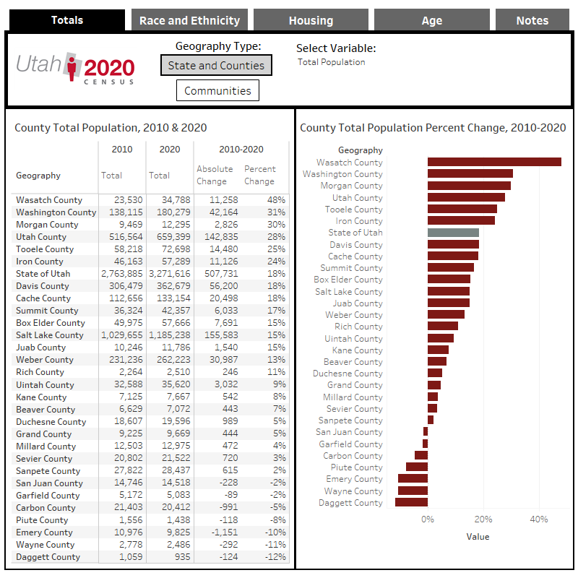
(c) 2018 David Eccles School of Business
All Rights Reserved
Notes:
According to the 2020 Census, Wasatch County is the fastest growing county in Utah, with a 47.9% change in population growth rate between 2010 and 2020.
Wasatch housing units also showed the greatest growth rate in Utah, an increase by 36.7% in the same 10-year span.

Slide 18
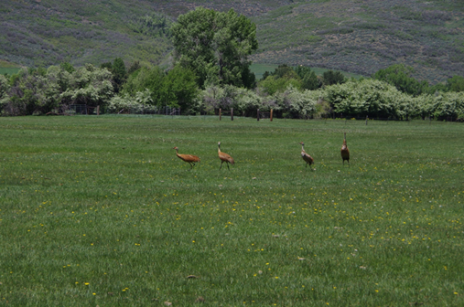
HABITAT
Image Credit: Jason Baker
Notes:
The area preserves significant wildlife habitat which in turn potentially supports at least bobcat, California quail, cougar, Hungarian partridge, and ruffed grouse. The area also retains habitat appropriate for several wildlife species identified as priorities for conservation by the State of Utah. Of the listed priority Utah Species of Greatest Conservation Need (SGCN), the following have been documented on or near the Northfields: Monarch butterfly (a candidate for listing under the Endangered Species Act) and the greater sage grouse (a priority under USDA’s Working Lands for Wildlife). 100% of the area is within the Greater Sage-Grouse Initiative area under the Working Lands For Wildlife. Further, the area is less than 4 miles from a Utah DNR documented greater sage-grouse lek.
Additional Utah SGCN potentially supported by the habitat with historic occurrences (some dating back to the early 1900s but some as recently as 2012) in the area include: bald eagle, black swift, Columbia spotted frog, ferruginous hawk, Lewis’s woodpecker, mountain marshsnail, northern leopard frog, southern leatherside chub, western toad and western yellow-billed cuckoo.
Chorus frogs and sandhill cranes are frequently observed, and there are reports of SGCN bald eagle, Rocky Mountain elk, mule deer, and wild turkey. A 2023 botanist report confirmed habitat suitable for SGCN Ute ladies’ tresses.

Slide 19
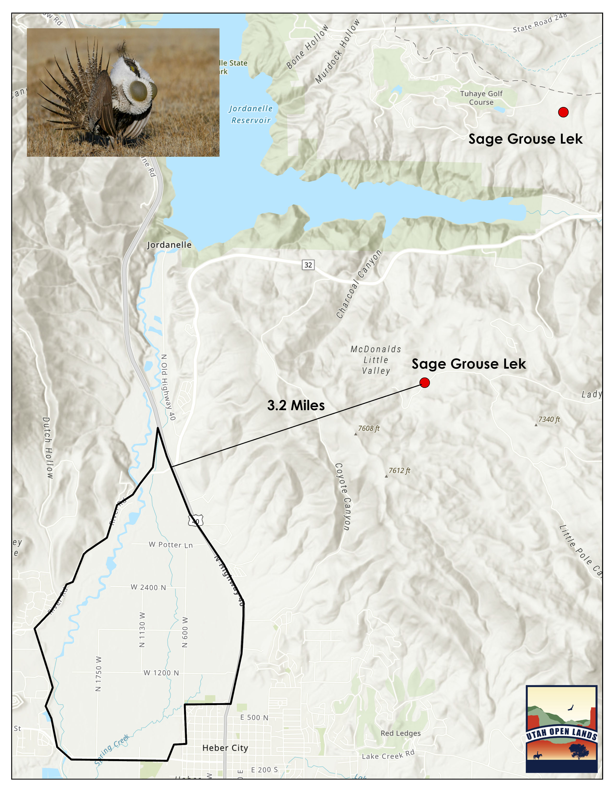

Slide 20
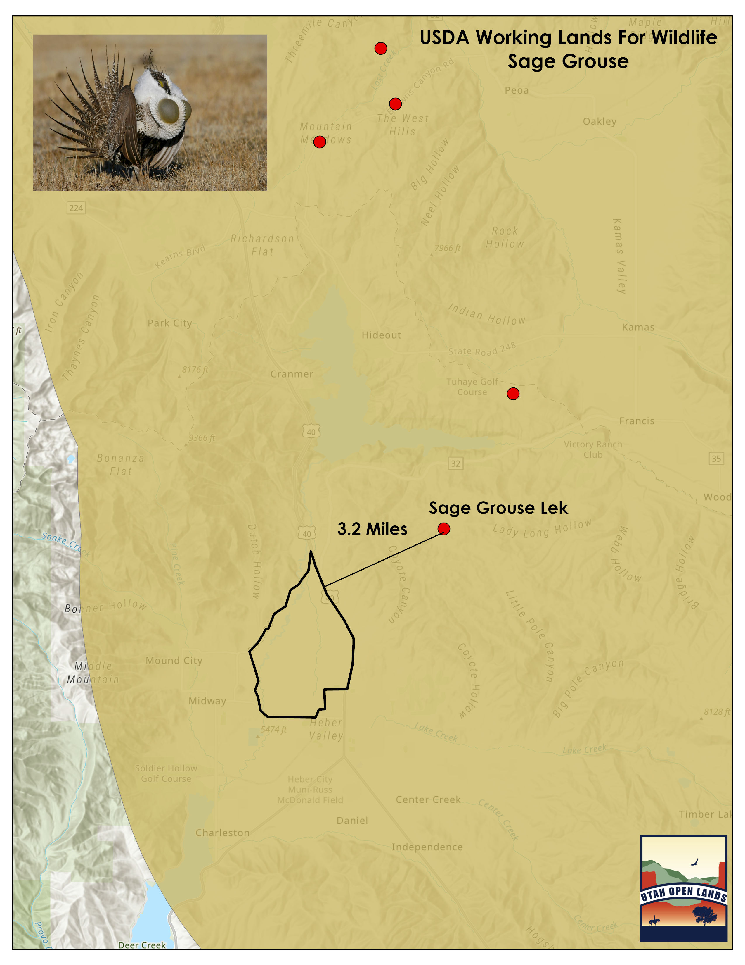

Slide 21
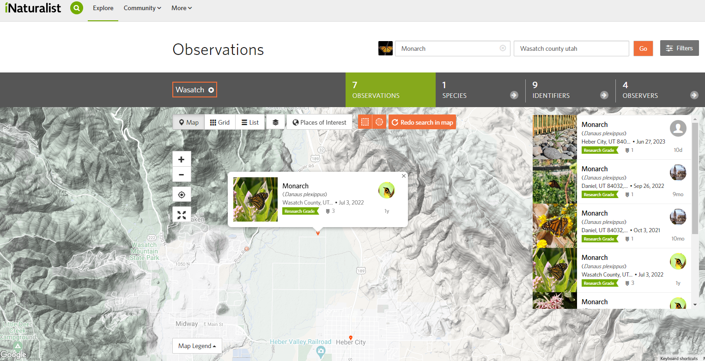
Notes:
Monarch butterfly have been observed in the Northfields, and there are many milkweed plants (a host plant for the butterfly) along roadways. The Monarch butterfly is a Federal candidate species and a Utah Species of Greatest Conservation Need.

Slide 22
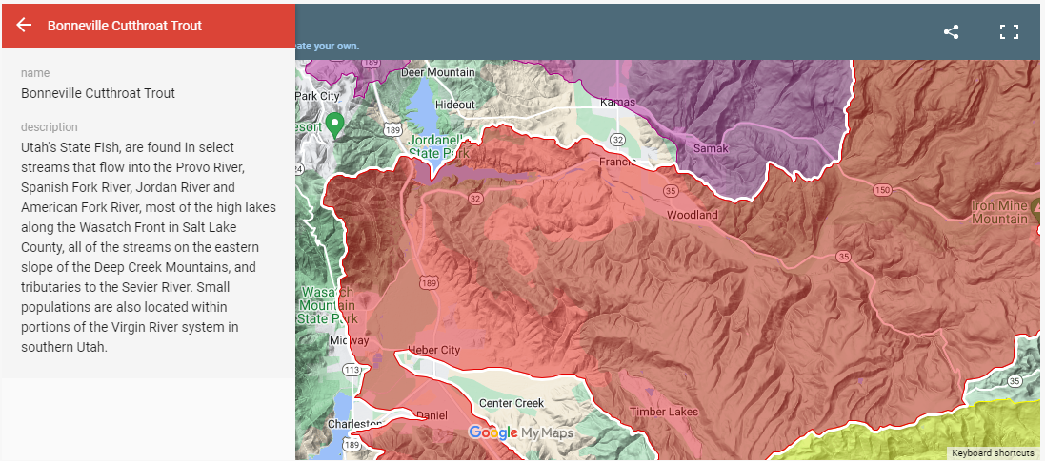
Copyright © 2016-2023 Trout Unlimited, All Rights Reserved
Notes:
Bonneville Cutthroat Trout are a Utah Species of Greatest Conservation Need and are found in the Provo River along the Northfields.

Slide 23
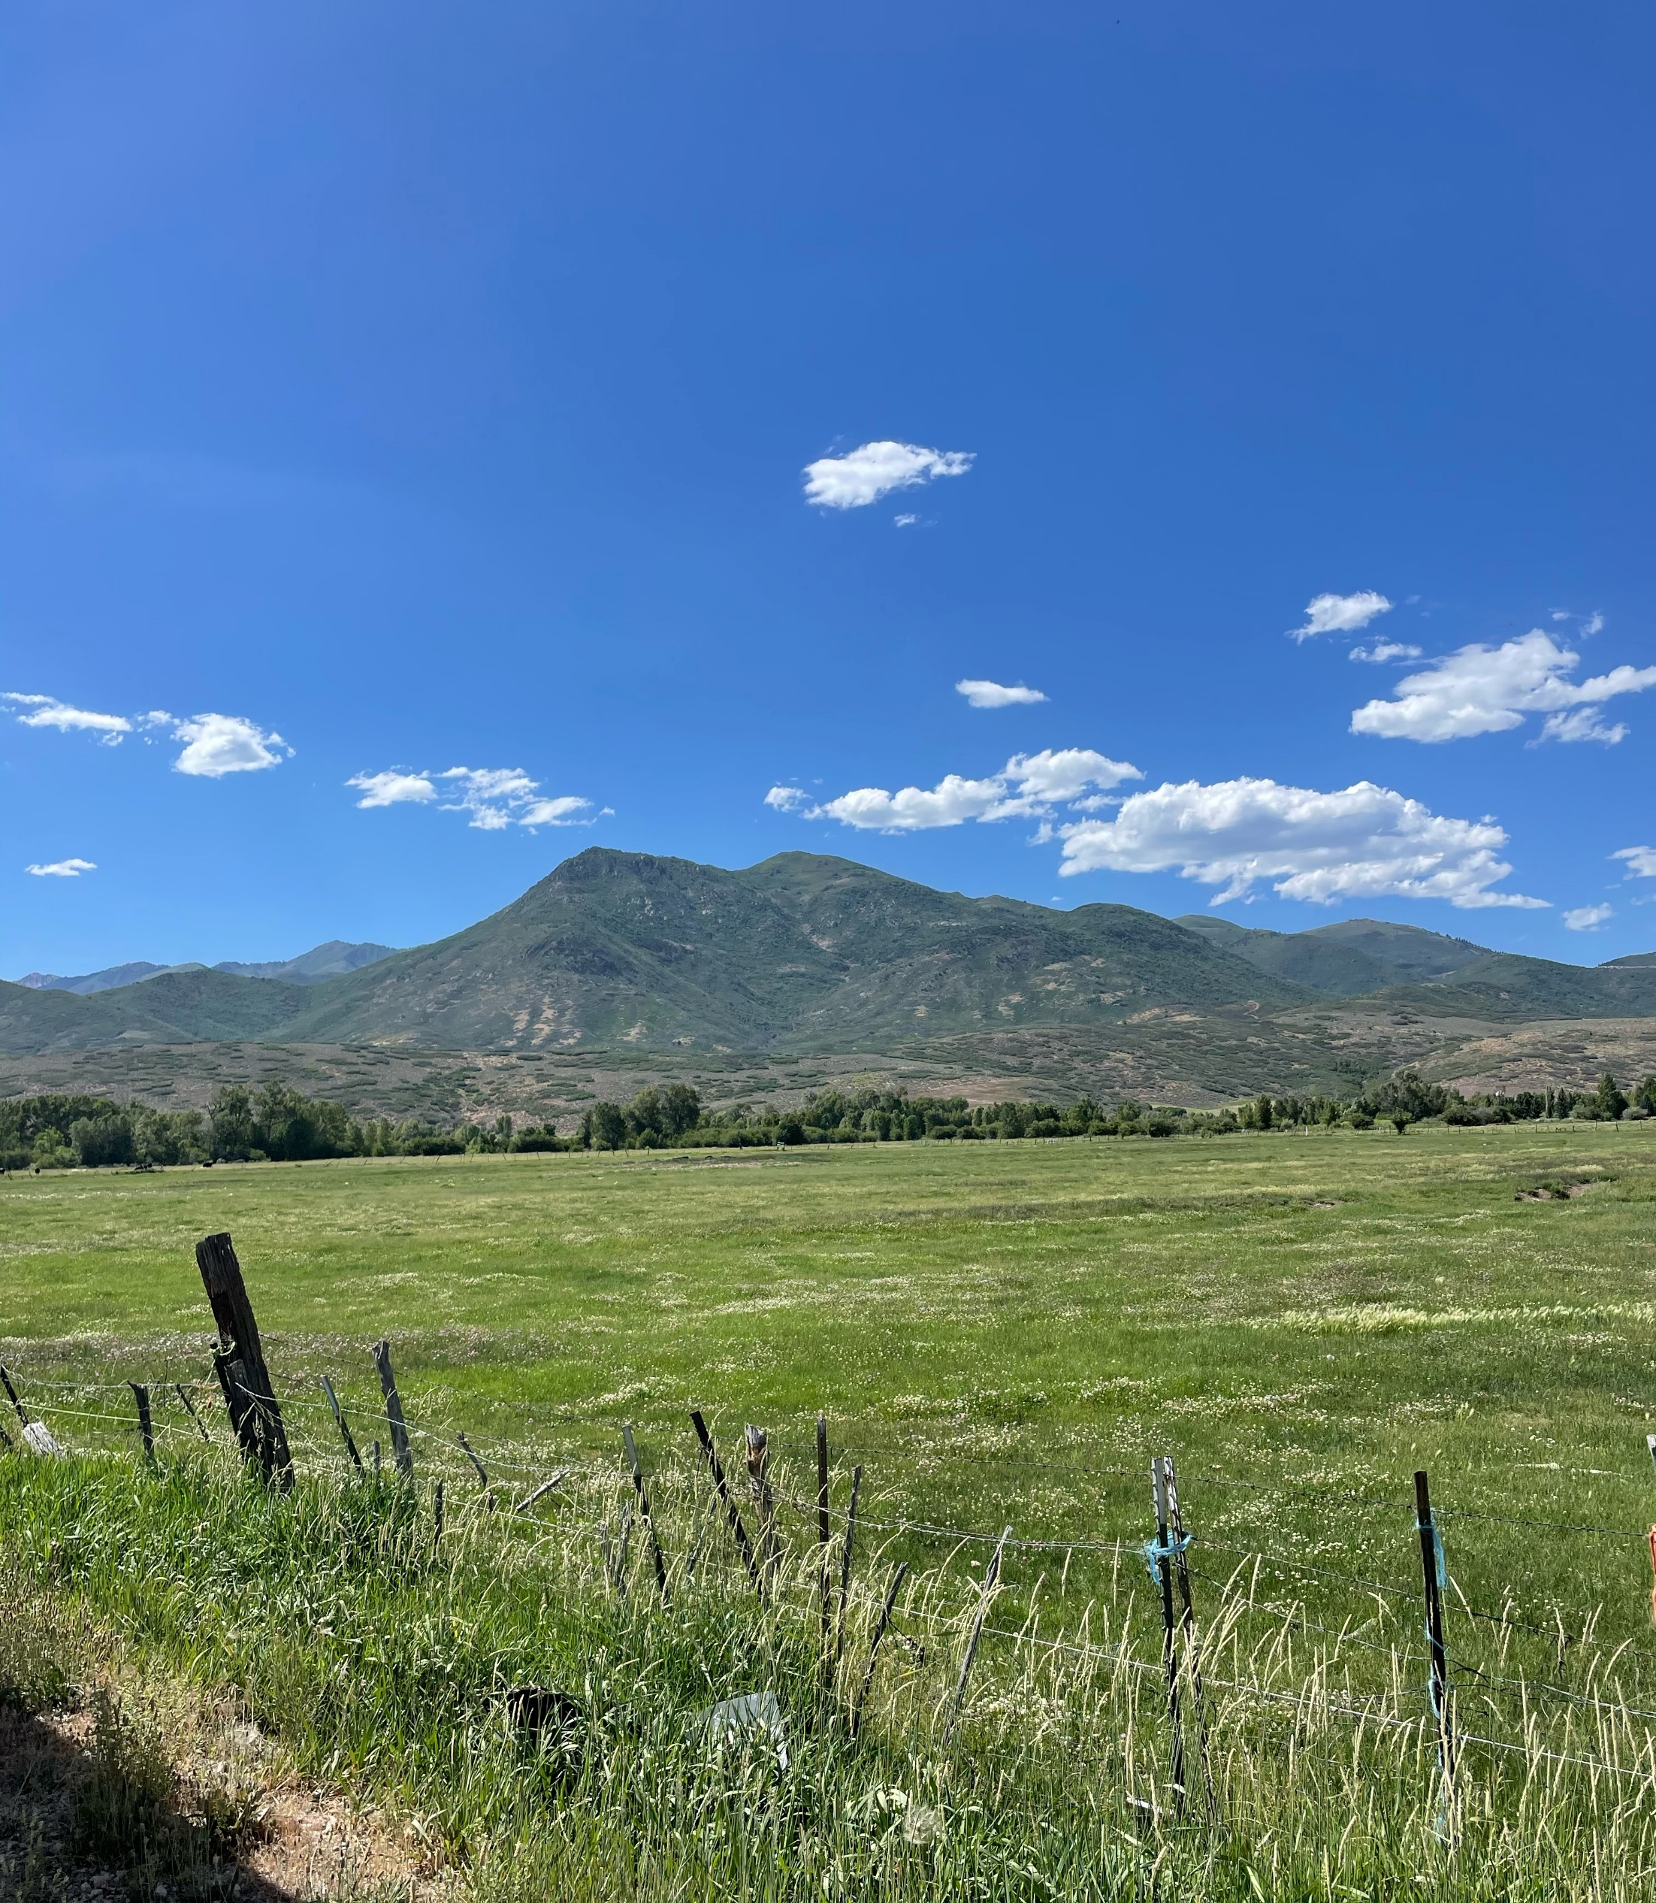
OPEN SPACE
Notes:
The area could extend critical open space, to include other agricultural producers who have protected their land by conservation easements.
Kohler Dairy and Kem C Gardner Midway Legacy Preserve agricultural conservation easements are in close proximity.
Protected Utah Reclamation Mitigation and Conservation Commission land (the Provo River Restoration Project) runs along the Northfields. The Utah Reclamation Mitigation and Conservation Commission is a federal agency and this was a $45 million restoration project.
The area preserves significant view corridors of green space and agricultural uses.
The area represents relatively natural scenic agricultural open space which is highly visible from public route U.S. 189 which flows into the Provo Canyon Scenic Byway and the Alpine Loop, which sees millions of local, national, and international visitors annually. Further, the area preserves scenic view sheds along the Provo River.

Slide 24
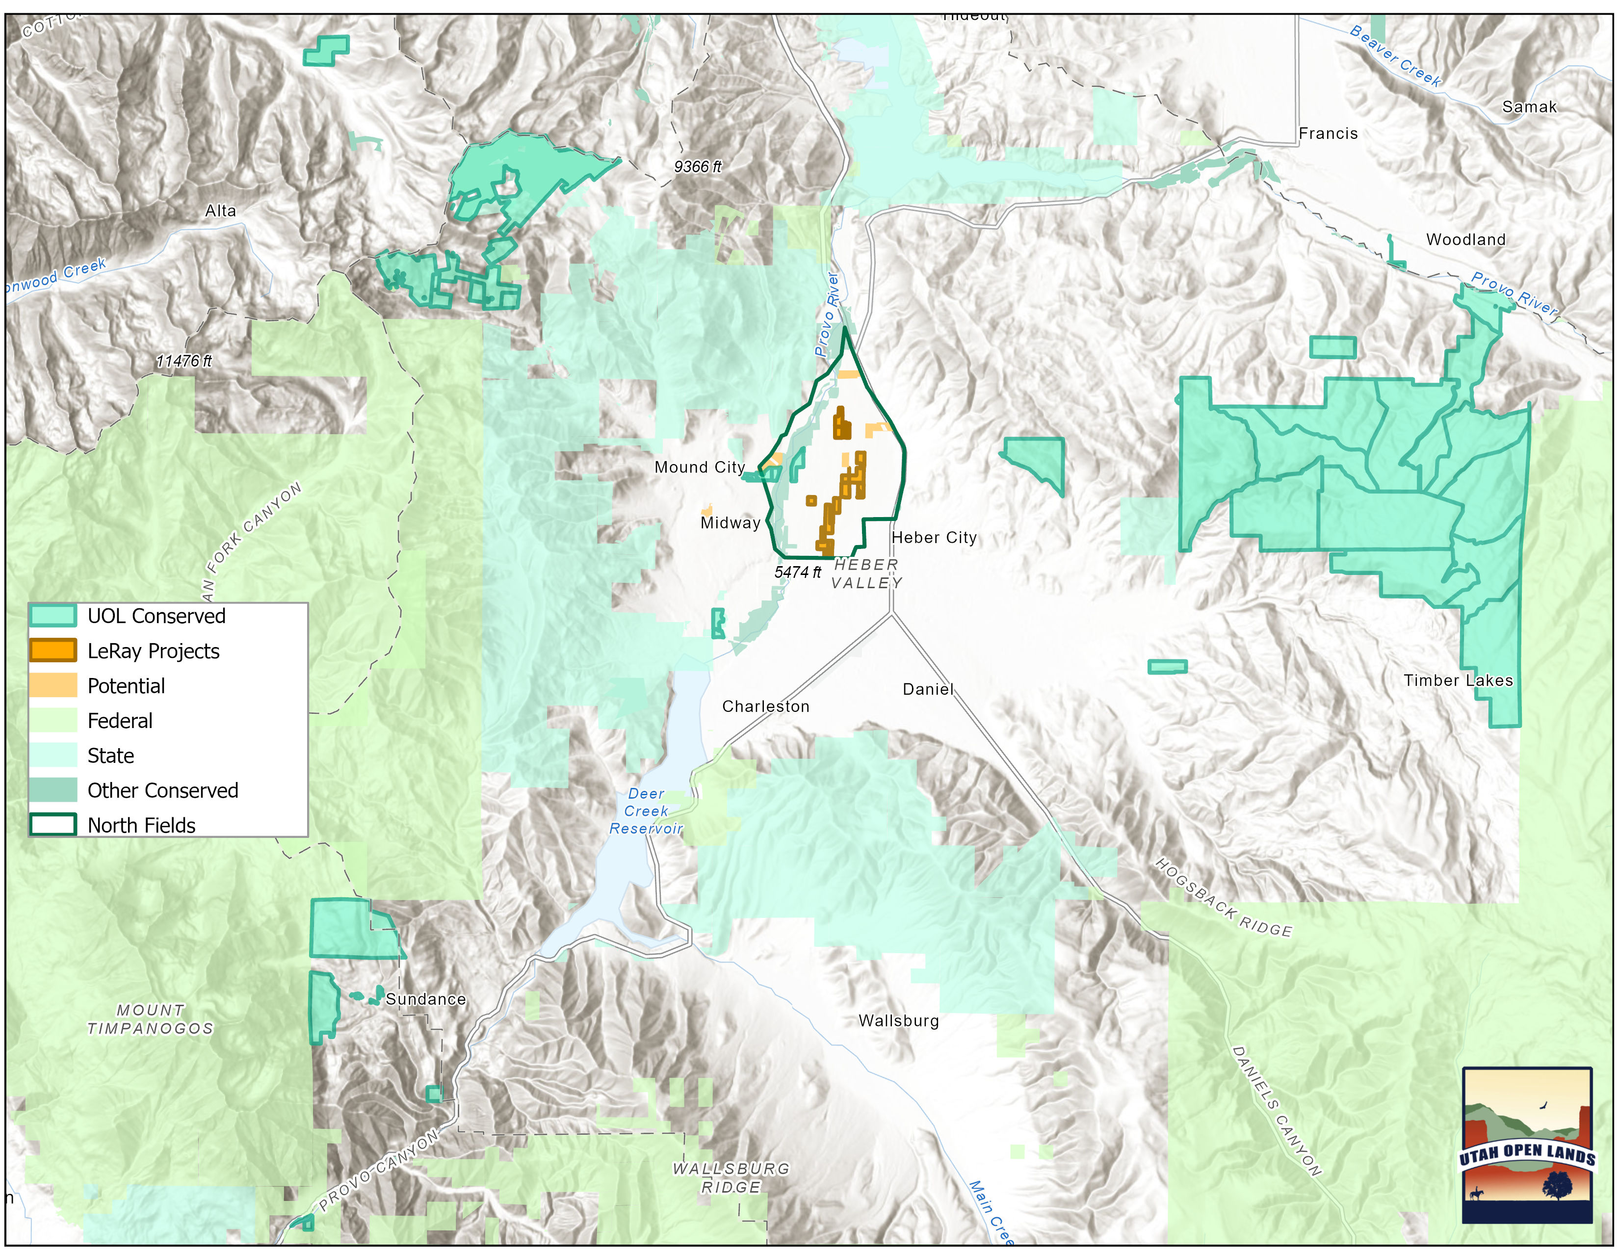

Slide 25
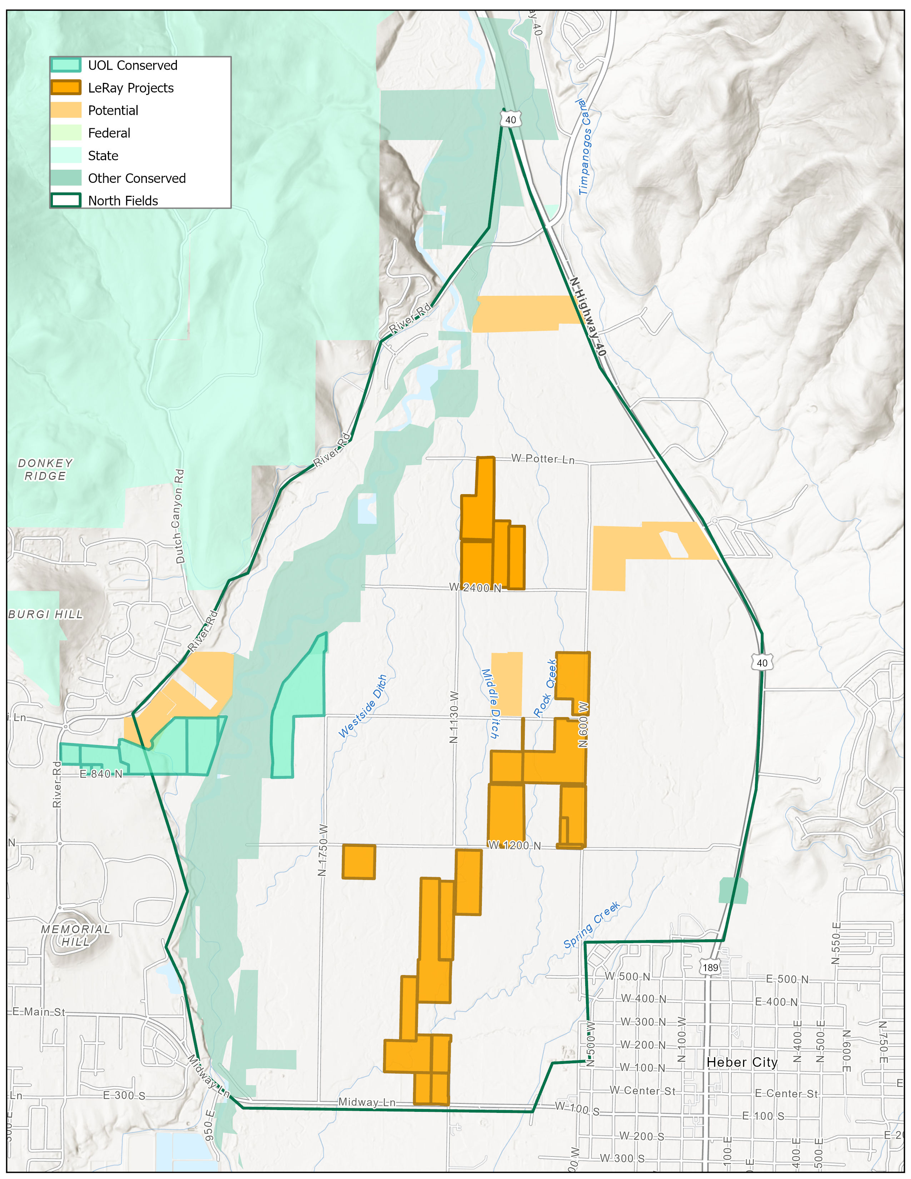

Slide 26
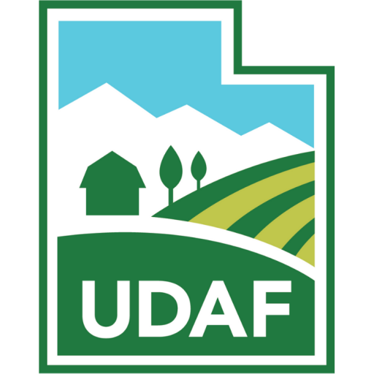
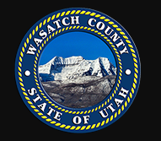


LOCAL SUPPORT
Notes:
Wasatch County has already spent $758,100 from their Open Space Bond on one ranch within the Northfields. In November 2018, Wasatch County residents passed a $10 million open space bond. In March 2019, the County Council adopted the Wasatch County Code Chapter 3.06 Preservation of Open Lands. This bond was passed to protect agricultural open space among other types of open space. Utah Open Lands has also recently gained a $1 million commitment from Midway City and $2 million from Wasatch County for a conservation easement on the Lundin farm, which is in Midway and in close proximity to the Northfields. (remove??) Protection of this area is also in line with State conservation policies to Preserve the Great Salt Lake encoded in bills HB410, HB429, and HB423. Together these bills allocate over $110 million to improve watershed management and optimize agricultural tools.
Utah Open Lands obtained $1 million in grants this fall from the LeRay McAllister fund on behalf of two Northfields properties- the Flying A Ranch (Giles family) and Laren Gertsch.
PARTNERS:
Utah Open Lands has significant public partners which include the Utah Reclamation Mitigation Conservation Commission who holds conservation easements in the Northfields, Utah’s Department of Agriculture and Food who have supported the creation of Agricultural Protection Area designations and provided funding for conservation easements, local Conservation Districts, Utah DEQ, and USFWS. Private donors have contributed over $100,000 this summer and UOL is working with land owners who are willing to contribute at a minimum 30% of the value of the conservation easements they seek to protect their lands.

Slide 27
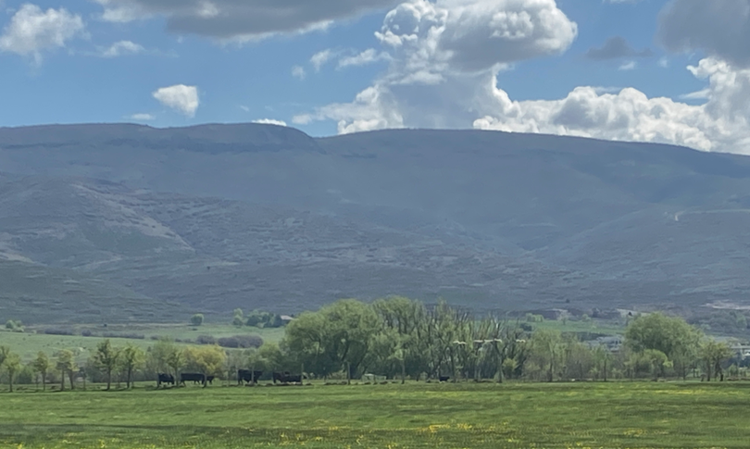
Notes:
Finally, the area contains a historic irrigation ditch first dug in the area in 1875, prior to the incorporation of Heber City as a town in 1889.

