Slide 1
Watersmart in Washington
Keith Griswold, Assistant State Conservationist for Programs

Slide 2
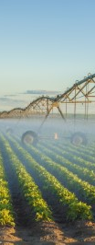
What is EQIP-Watersmart?
NRCS’s EQIP Watersmart Initiative (WSI) is a collaboration with the Bureau of Reclamation (BOR) Watersmart (https://www.usbr.gov/watersmart/ ) to coordinate investments in priority areas for improving water conservation and drought resilience.
BOR makes their Watersmart programs available across the Western US to help states, tribes, and local entities plan for and implement projects that increase water supply by providing funds to modernize existing infrastructure and otherwise build drought resilience.
NRCS uses EQIP WSI funds to complement BOR Watersmart funded projects by helping eligible farmers and ranchers make improvements that align with the paired BOR Watersmart project.
Eligible farmers and ranchers with operations in a selected EQIP WSI priority area will be automatically ranked in the EQIP-WSI targeted fund pool when they apply for EQIP funding.

Slide 3
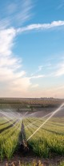
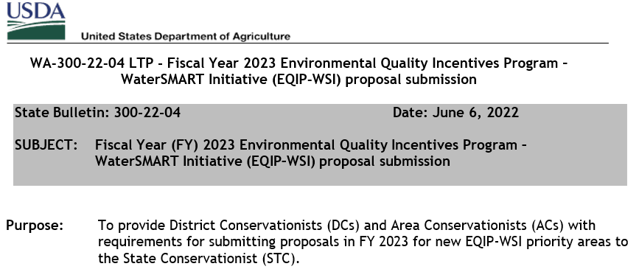
How can my Tribe or Conservation District get a EQIP Watersmart Project area in WA?

Slide 4
EQIP-WSI is implemented in priority areas proposed by the local District Conservationist (DC), reviewed by the State Conservationist, and submitted to National Headquarters (NHQ), and selected in a competitive process by NHQ.
Local partners that are interested in EQIP-WSI priority area proposal should work with local District Conservationists to determine what areas meet the requirements listed below.
• Identify a specific completed BOR Watersmart project and describe how it will be complemented by EQIP-WSI activities.
• Identify the type and extent of conservation practices proposed for implementation in the priority area.
• Describe any special environmental concerns, risks, or significant barriers that may impact delivery of EQIP-WSI assistance.
• Describe how EQIP-WSI assistance will leverage community partnerships and inclusive approaches to benefit disadvantaged communities.

Slide 5
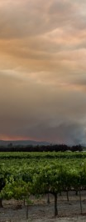
Where are the current WA Watersmart project areas?

Slide 6
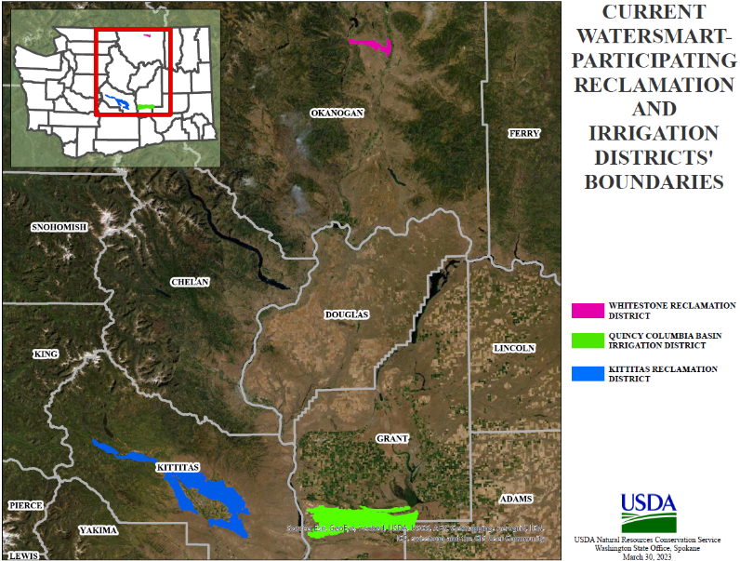

Slide 7
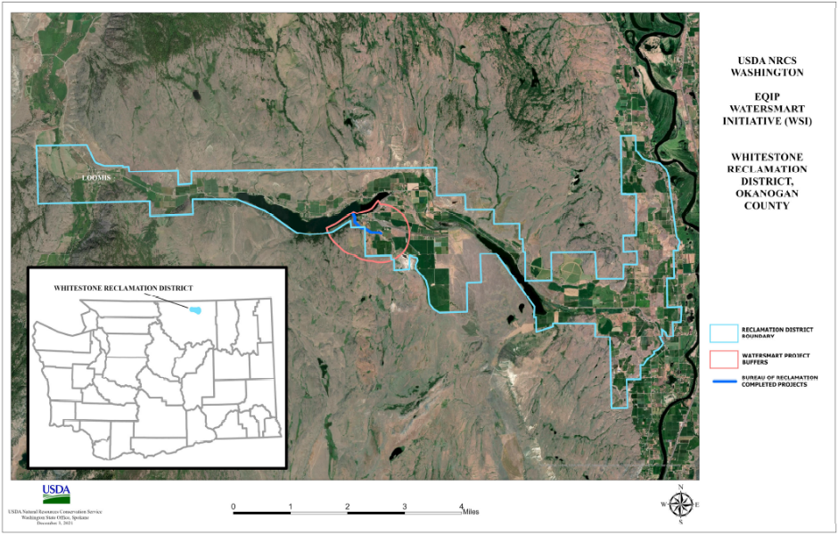
Whitestone Watersmart Project Area
Year | EQIP-WSI FA Funds
2022 | $900,000
2023 | $287,000
2024 | $423,000
2025 | $30,000
2026 | $30,000

Slide 8
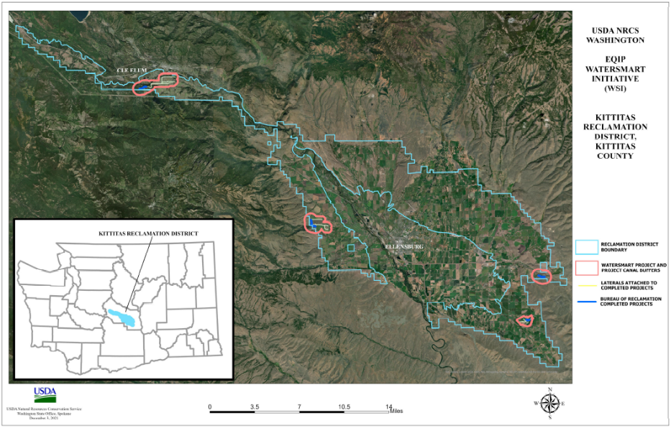
Kittitas Watersmart Project Area
Year | EQIP-WSI FA Funds
2022 | $1,000,000
2023 | $1,800,000
2024 | $1,000,000
2025 | $1,800,000
2026 | $1,000,000

Slide 9
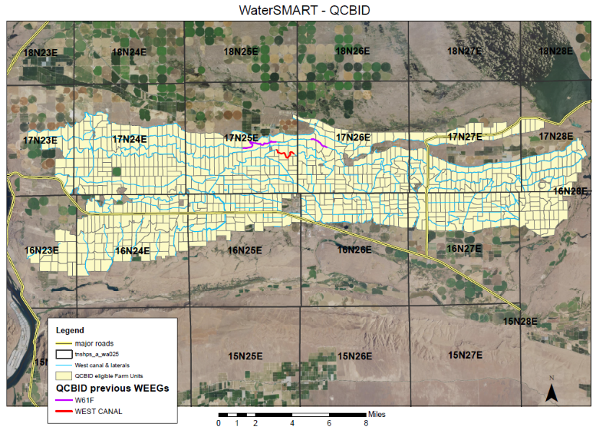
Quincy Columbia Basin Irrigation District (QCBID) Watersmart Project Area
Year | EQIP-WSI FA Funds
2023 | 1,800,000
2024 | 2,200,000
2025 | 2,200,000
2026 | 2,200,000
2027 | 2,200,000

Slide 10
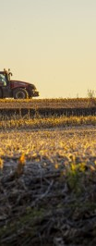
What should I do if I’m interested in a new EQIP-WSI project area?
Contact your local District Conservationist
Estimated announcement for FY24 proposals in June 2023

Slide 11
Questions?

