Slide 1
PROGRAMS
NM NRCS
FY 20/21 RCPP Classic
Funding Announcement will be re-posted soon
November 4th deadline will be pushed back to November 30.
FY 20/21 RCPP Classic
Alternative Funding Arrangement – Announcement forthcoming

Slide 2
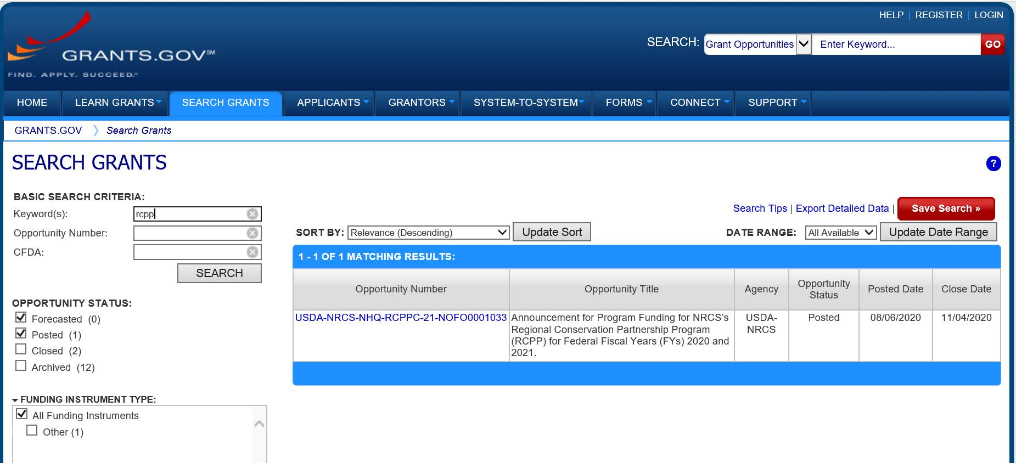
PROGRAMS
NM NRCS
Application can be found in www.grants.gov
RCPP in the Keyword.

Slide 3
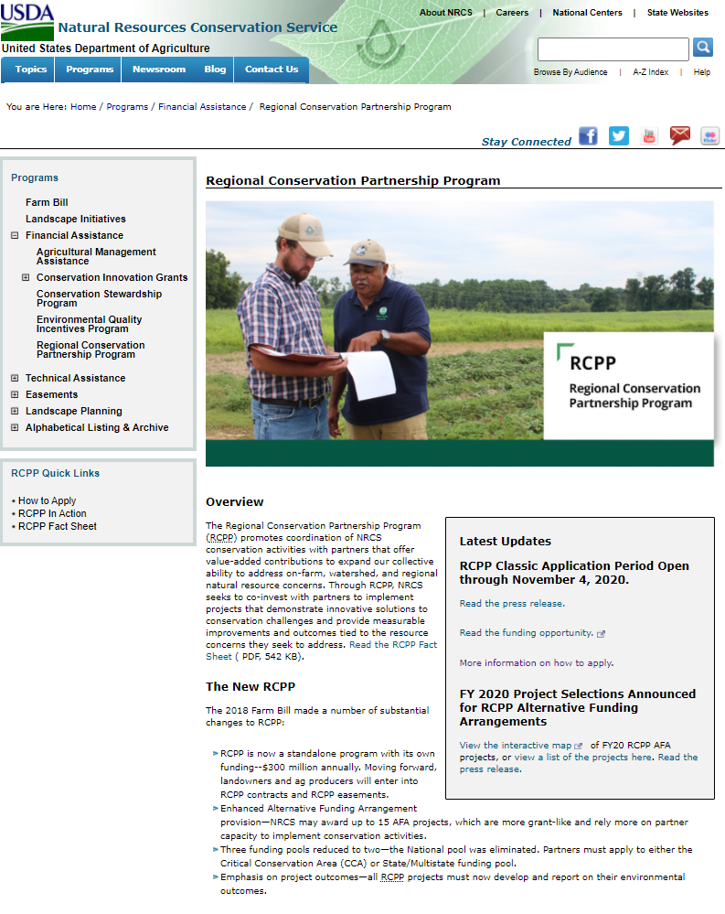
PROGRAMS
NM NRCS
General Information: https://www.nrcs.usda.gov/wps/portal/nrcs/main/national/programs/financial/rcpp/

Slide 4
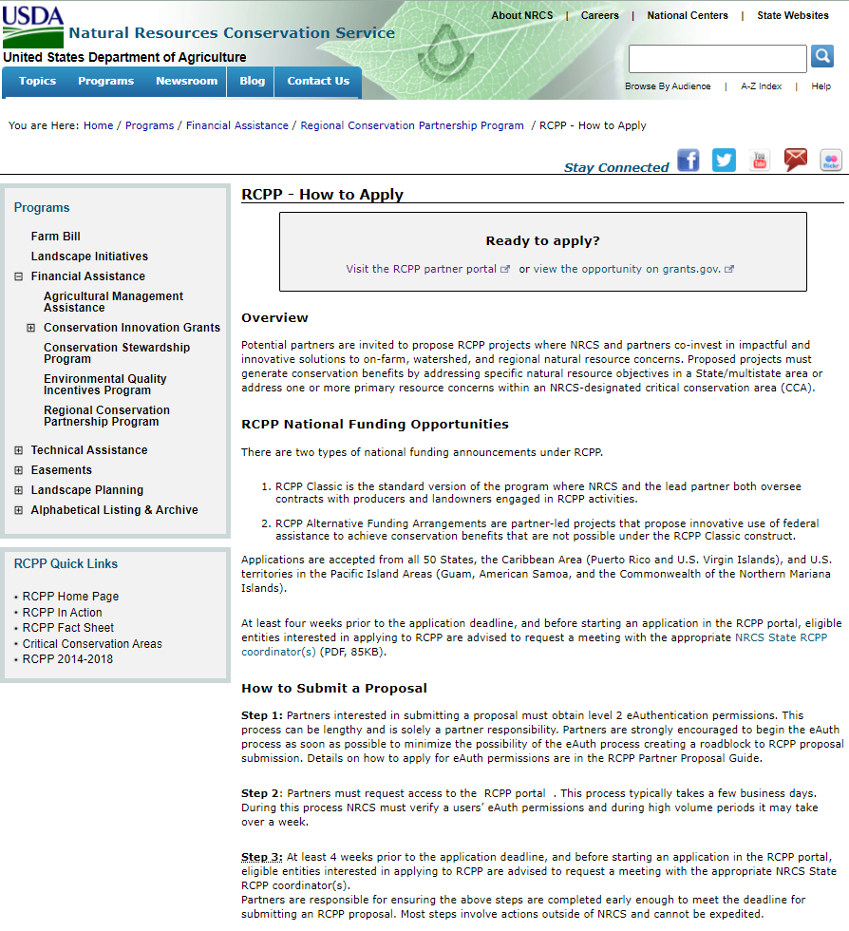
PROGRAMS
NM NRCS
How to Apply: https://www.nrcs.usda.gov/wps/portal/nrcs/detail/national/programs/financial/rcpp/?cid=nrcseprd1477816

Slide 5
PROGRAMS
NM NRCS
FY 19/20 RCPP Classic
Project # | Project Title | Lead Partner | Lead State | Funding Amount | Funding Pool | CCA | Summary
1893 A-0040 | San Juan Non-Native Phreatophyte Removal Program | San Juan SWCD | NM | $1,042,208 | State | N/A | The San Juan Soil and Water Conservation District aims to protect, reduce wildfire risk by removing non-native Russian olive and Salt Cedar infestations in identified high priority areas. The project will also undertake native plant and tree restoration activities, and to encourage a renewed connection with the river.
1905 A-0056 | Eastern New Mexico Prairie Grassland Initiative | NMACD | NM | $2,025,974 | CCA | Prairie Grassland | To increase suitable and occupied habitat to meet critical habitat needs of Lesser Prairie-chicken. Habitat improvements will occur through chemical and physical destruction of Mesquite patches across five priority areas identified using a mesquite density model and a study by scientists at New Mexico State University.

Slide 6
PROGRAMS
NM NRCS
FY 19/20 (2015) RCPP Renewal
Project # | Project Title | Lead Partner | Lead State | Funding Amount | Funding Pool | CCA | Summary
514 2127 A-0057 | 2015 NM Restoration Initiative for Rangeland, Forestland, and Wildlife on Ranches w Fed Lands | NMACD | NM | $4,000,000 | State |  | The objective of the proposal is to facilitate and promote surface water conservation, increase irrigation system efficiencies/effectiveness and improve water quality on agricultural lands and for downstream purposes. Critical riparian habitats for dependent wildfire and plant species will be conserved. Water quantity and quality will be improved by restoring families and communities. Traditional acequias in irrigated valley of northern New Mexico provide multiple hydrological benefits including, aquifer recharge, temporary reservoir storage, and delayed return flow.
287 2137 A-0046 | 2015 North Central NM Watershed Restoration Project | Claunch Pinto SWCD | NM | $2,313,359.00 | State |  | Claunch-Pinto SWCD and its partners have identified over 35,000 acres for forest restoration treatments on private, public, state and tribal lands that are located within both the upland ponderosa pine, pinon, and juniper watersheds, and in the lower elevation riparian ones. Claunch-Pinto SWCD and their partners are committed to successful restoration treatments aimed at improving watershed health and mitigating the extreme risk of wildfire.

