Slide 1
Payment Schedules

Slide 2
2021 State Payment Schedules | NRCS (usda.gov)
Payments schedules and scenarios are found at
https://www.nrcs.usda.gov/wps/portal/nrcs/detailfull/national/programs/financial/?cid=nrcseprd1328426

Slide 3
Program percentages- NM are set to highest allowed
* Based upon input from the State Technical Committee and agency partners, a State Conservationist may establish for a specific practice a maximum payment percentage percent to encourage adoption of the practice and adequate participation in the program. The percent selected should represent the least-cost principle, but states are encouraged to use the same percentages for as many practices as possible.

Slide 4
EQIP Practice Caps- set by contract item
Limit the payments for high contract practices.
Works for practices like Irrigation Pipeline where one contract item is created for each functional unit.
Harder for practices like Brush Management where there can be multiple contract items on a field.
Caps are set with input from local working group level for team fund accounts.
Caps have not been set for State level accounts. Please provide input.

Slide 5
Woody Residue Treatment (384)
To knock down dead standing mesquite where this increases risk of predation to lesser prairie chicken.
New scenarios for FY2022 based on canopy cover intercept of what would have existed prior to the herbicide application. Typical scenario size is 120 acres.
Standing residue, light- 5-9%
Standing residue, medium- 10-24%
Standing residue, heavy – at least 25%

Slide 6
Center pivot, lined- one scenario did not fit the range of sizes
Center pivot, lined 0-60 acres- typical size 30 acres. Length of poly lining is 644 feet.
Center pivot, lined 61-100 acres- typical size 80 acres. Length of poly lining is 1053 feet.
Center pivot, lined 101 acres and larger- typical size 120 acres. Length of poly lining is 1300 feet.
Big gun sprinklers
New scenario for portable big gun sprinkler, without the retracting wheel.
Existing scenarios are for traveling gun system on retracting wheel, hose less than 2 inches, 2-3 inches and more than 3 inches.

Slide 7
Irrigation Pipeline (430)
Two new scenarios for boring under roads
Pipe Boring Casing Only <= 8 inch
Pipe Boring Casing Only >= 10 inch

Slide 8
Solar pumping plant (533)
Proposing 3 scenarios- Remote, less than and equal to 1 KW, greater than 1 kw
Payment will be by kilowatt instead of by each.
National created new components that combine the pump and solar panels but are separated by fixed component cost and variable component cost.
2495 | Solar Pumping System, Fixed Cost Portion | Fixed cost portion of a solar powered pumping system. This portion is a base cost for a complete system including the photovoltaic panels, pumping plant, support braces, electric controllers, service drop, etc., and is not dependant on KiloWatt. The total cost will include this fixed cost plus a variable cost portion. Includes the cost of materials only. | Each | $3,705.10
2496 | Solar Pumping System, Variable Cost Portion | Variable cost portion of a solar powered pumping system. This portion IS dependent upon the total kilowatts of the photovoltaic panels, but also includes the pumping plant, support braces, electric controllers, service drop, etc. The total cost will include this variable cost plus a fixed cost portion. Includes the cost of materials only. | Kilowatt | $2,650.88

Slide 9
Urban agriculture and small farms
New National scenarios for Urban and small scale, most pay by each 1,000 sq feet:
Irrigation system, microirrigation (441)- drip tape or emitters, typical size is 1600 sq ft.
Conservation Cover (327)- pollinator habitat, typical size 1000 sq ft
High Tunnel (325) – 3 new scenarios, typical size 600 sq ft
Cover crop (340) – multi-species for every 1000 sq ft
Conservation Crop Rotation (328)- diverse rotation, typical size 1000 sq ft
Residue and Tillage Management, no-till (329)- no till and no dig, 1000 sq feet
Composting Facility (317)- pad plus 2 bins, 9 by 5 feet
Existing small farm scenarios.
Cover Crop - 1 acre or less, each
Nutrient management, guidance is for 1 acre or less, each
Stormwater Runoff Control (570)- rain garden, 36’ x 30’

Slide 10
Obstruction Removal (500) after disaster events
New national scenarios
Removal and disposal of light scattered debris
Removal and disposal of heavy scattered debris
Removal and disposal of light sand and flood sediment 12-30 inches
Removal and disposal of light sand and flood sediment > 30 inches
Removal and disposal of non-vegetative scattered debris
Removal and disposal of open (no walls) steel and or concrete structures; over 9,000 sq.ft.

Slide 11
Restoration of Rare and Declining Habitat
Could be used for playa restoration, one-rock dams in small drainages, small wetlands. Other situations?
Changed to a 5-year lifespan.
New national scenarios
Very small acres planting with seedlings or plugs
Specialized Species on Cropland, with FI
Specialized Species on Fallow or Non-Cropland, no FI
High Species Richness on Fallow or Non-Cropland, no FI
High Species Richness on Cropland, with FI

Slide 12
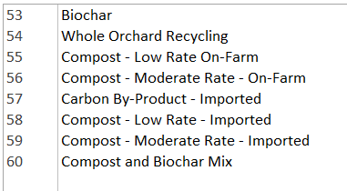
Interim Practices that can be adopted
* Adoption does not necessarily mean that these will be on the EQIP payment schedule for FY2022.
Soil Carbon Amendment (808) (can be found in eFOTG in Colorado)
Annual Forages in Grazing Systems (810) (can be found in eFOTG in Indiana)

Slide 13
Technical Service Providers and CAPS
Conservation Activity Plans (CAPS) will be divided into 3 types:
Planning- inventory of natural resources, analysis of data, present alternatives, make decisions.
Design and implementation – preparation of site-specific implementation instructions (designs, jobsheets, etc.) for a practice and supporting practices.
Evaluation and monitoring – assessments to determine the effectiveness of practices
Improvements coming for TSP certification and payment calculations.
Technical Service Providers | NRCS (usda.gov)

Slide 14
Conservation Stewardship Program

Slide 15
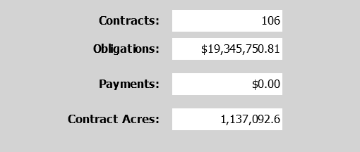
Sign-up Stats
2021- 1 Renewals- unfunded were rolled into classic
2021- 1 Classic
2022- 1 Renewals- 50 applications
*unfunded applications will be ineligible for 2 years.
**Includes applications that would be renewing a second time
Funded | 63
BFR | 8 | 13%
VFR | 1 | 2%
SD | 22 | 35%
Unfunded | 140 | 77% | of total
Funded | 43 | 23% | of total
BFR | 11 | 26% | of funded
VFR | 1 | 2% | of funded
SD | 9 | 21% | of funded

Slide 16
CSP New Mexico ranking criteria found online New Mexico Fund Accounts and Ranking Criteria | NRCS New Mexico (usda.gov)
https://www.nrcs.usda.gov/wps/portal/nrcs/detailfull/nm/programs/financial/csp/?cid=nrcseprd1313542

Slide 17
Two approaches for priorities: Financial Assistance is spread out throughout the state.
Financial Assistance is targeted to specific areas, activities or partner projects to accomplish specific goals.
Year of the monarch
Priority to clearing of mesquite for aplomado falcon

Slide 18
Ranking weights
NM %
Adjustment A means that the better the inventory condition the higher the score.
Adjustment C means that enhancements get more points than practice.
Planned practice effects- the more activities that are planned, the higher the ranking. Considers the number of land units with the activity but not acres.

Slide 19
Program Priorities- 180 points
Will an activity be scheduled in a source water priority area? 80 points -- few to no applications in source water areas
The scheduled activities will cover what percent of the operation?
75% or more 100 points- change to 75 points
50-74% 75 points -- change to 50 points
25-49% 50 --- change to 25 points
10-24% 25 --- change to 10 points
Less than 10%, 0 points
Will a nutrient management activity be implemented for at least 3 years?
Will be the enhancement E528C, Contingency plan for wildlife, be implemented for at least 3 years?
Create category questions by ecotype- pinyon juniper, Chihuahua desert, short grass prairie?
Will E643B be implemented in natural drainages with erosion control structures?
Reduce weight to 15%?
What to prioritize?

Slide 20
Resource Priorities- 200 points
Not state priorities
Air quality emissions
Aquatic habitat
Field pesticide loss
Salt losses to water
Storage and handling of pollutants
Weather resilience
Give priority to certain resource concerns over others?

Slide 21
More years of implementation
The priority activity for rangeland is Prescribed Grazing (528),
cropland is Cover Crop (340), No-till (329), Reduced tillage (345); and
pasture is Prescribed Grazing (528) and Forage Harvest Management (511).
For all land uses Integrated Pest Management Conservation System (595) is a priority activity.
For 3 or more years, can be different enhancements of the same practice, 70 points
For 2 years, can be different enhancements of the same practice, 50
One year, 25
None planned 0
Add Conservation Crop Rotation (328) for cropland?
Prioritize a certain enhancement?

Slide 22
Wildlife resource priorities
Wildlife friendly fence
Escape ramps in watering facilities
Pollinator habitat
Wildlife habitat- add specific question? Improve habitat for turkey by? Improve habitat for ground nesting birds by?

Slide 23
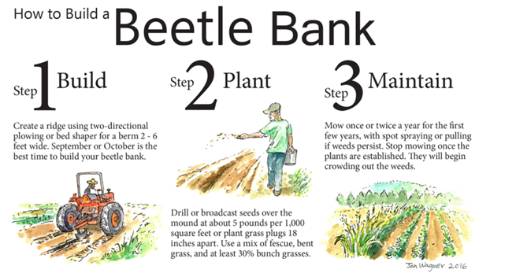
Soil Health
Multi-species cover crop mix.
Priority activities such as conservation crop rotation and grazing management.
Add a question about certain strategies such as beetle banks, using compost as mulch, biochar?
Habitat Highlight: Beetle Banks | Bee Better Certified™

Slide 24
ACEP- Agricultural Conservation Easement Program

Slide 25
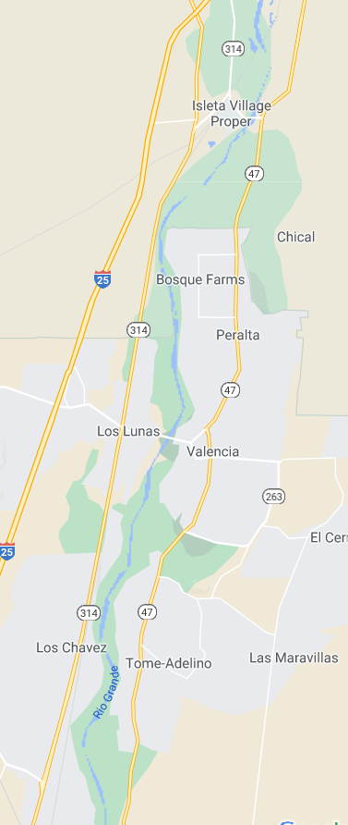
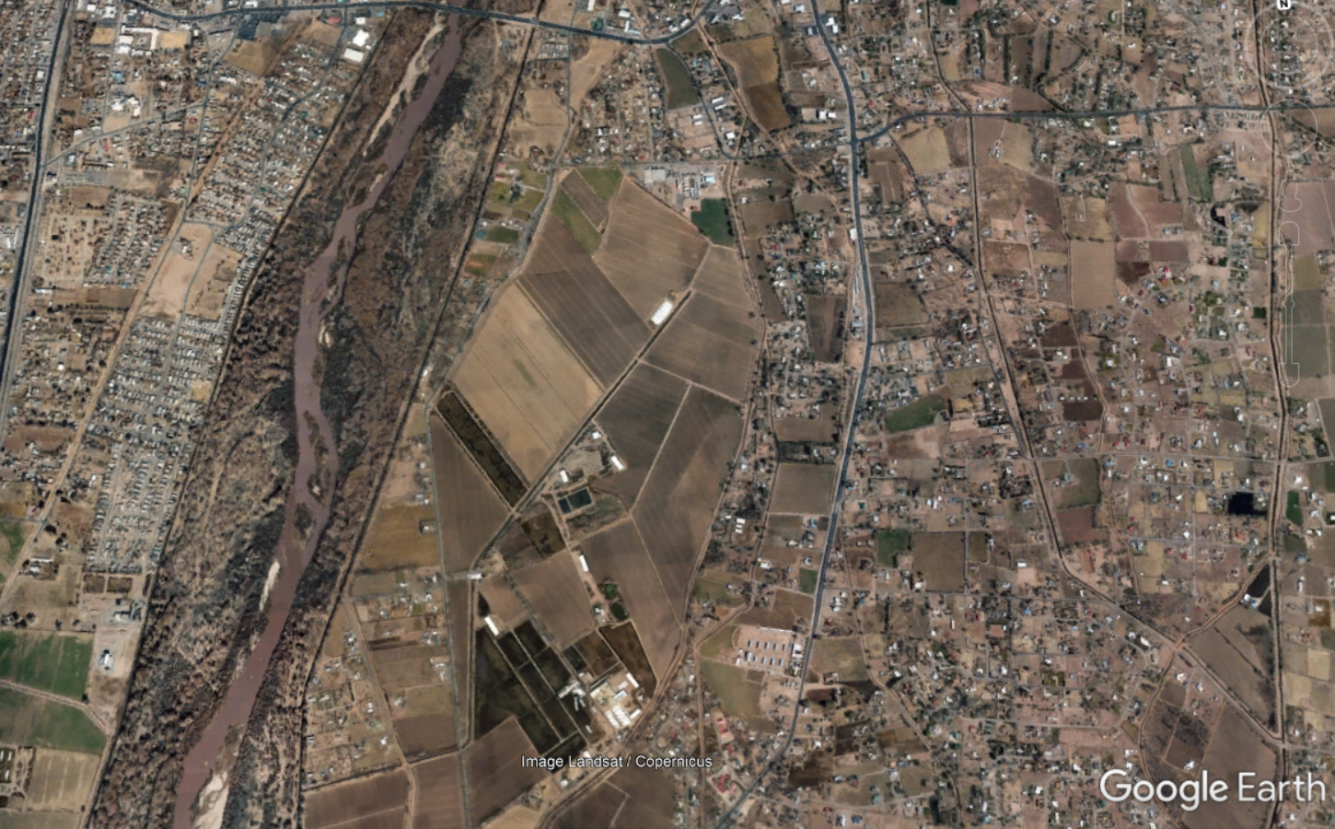
ALE- Agricultural Land Easement
Maintain priority for crop and pasture lands
In Valencia county
Prime soils or soils of state importance
Close to Rio Grande, Pecos, Gila, San Juan River
Notes:
The policy identifies required and recommended elements that the WRCG must include (440 CPM-528-N-528.131(B)(2) and (3)). During FY 2021, States should review their WRCGs developed in FY 2020 and complete any updates, refinements, or additions to the existing WRCG as follows:
1) States must fully complete the portion of the WRCG wherein the historic wetland types and associated habitats are described, and associated information included in the WRCG in accordance with 440 CPM-528-N-528.131(B)(2)(i).
2) States must fully complete the portion of the WRCG wherein the technical considerations and criteria for alternative communities are documented and described in the WRCG in accordance with 440 CPM-582-N-528.131(B)(2)(ii) and 528.132. At a minimum this must be completed prior to:
a) The execution of an enrollment agreement for any application on which the preliminary WRPO includes the restoration (including establishment) of an alternative community; or
b) The completion or revision of any WRPOs or issuance of compatible use agreements (CUAs) that would provide for the restoration or management of alternative communities on existing enrollments.
3) States must fully complete the portion of the WRCG wherein the technical considerations and criteria used to determine the eligibility, limits, and extents of acres that may be enrolled under the adjacent land eligibility criteria are documented and described in the WRCG in accordance with 440-CPM-528-K-528.105(I) and 528.131(B). This portion of the WRCG and any associated State Conservationist or EPD Director authorizations must be completed and documented prior to the execution of an enrollment agreement that includes acres determined eligible based on the adjacent land eligibility criteria.
4) States should review the items identified as ‘recommended’ (rather than required) for inclusion in the WRCG as described in 440-CPM-528-K.528.131(B)(3). States should prioritize for FY 2021 the development and completion of those recommended elements of the WRCG that will provide the greatest utility in supporting and aiding objective, sound, and consistent decision-making in the technical aspects of program delivery.

Slide 26
ALE- Agricultural Land Easement
Grasslands of special significance
Contain riparian habitat or perennial stream - add wetland
Close Rio Grande, Pecos, Gila, San Juan River
Are there areas in the state where threat of development is high?
Are there grasslands that provide higher level of wildlife or ecological values than others?
Notes:
The policy identifies required and recommended elements that the WRCG must include (440 CPM-528-N-528.131(B)(2) and (3)). During FY 2021, States should review their WRCGs developed in FY 2020 and complete any updates, refinements, or additions to the existing WRCG as follows:
1) States must fully complete the portion of the WRCG wherein the historic wetland types and associated habitats are described, and associated information included in the WRCG in accordance with 440 CPM-528-N-528.131(B)(2)(i).
2) States must fully complete the portion of the WRCG wherein the technical considerations and criteria for alternative communities are documented and described in the WRCG in accordance with 440 CPM-582-N-528.131(B)(2)(ii) and 528.132. At a minimum this must be completed prior to:
a) The execution of an enrollment agreement for any application on which the preliminary WRPO includes the restoration (including establishment) of an alternative community; or
b) The completion or revision of any WRPOs or issuance of compatible use agreements (CUAs) that would provide for the restoration or management of alternative communities on existing enrollments.
3) States must fully complete the portion of the WRCG wherein the technical considerations and criteria used to determine the eligibility, limits, and extents of acres that may be enrolled under the adjacent land eligibility criteria are documented and described in the WRCG in accordance with 440-CPM-528-K-528.105(I) and 528.131(B). This portion of the WRCG and any associated State Conservationist or EPD Director authorizations must be completed and documented prior to the execution of an enrollment agreement that includes acres determined eligible based on the adjacent land eligibility criteria.
4) States should review the items identified as ‘recommended’ (rather than required) for inclusion in the WRCG as described in 440-CPM-528-K.528.131(B)(3). States should prioritize for FY 2021 the development and completion of those recommended elements of the WRCG that will provide the greatest utility in supporting and aiding objective, sound, and consistent decision-making in the technical aspects of program delivery.

Slide 27
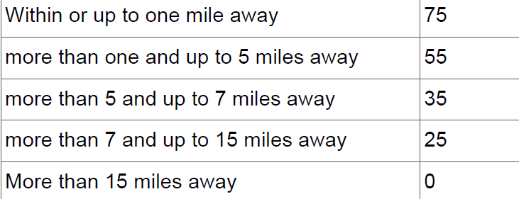
Distance from rivers, change for cropland
How to decide between low ranked cropland and higher ranked GSS application?
If an application for cropland gets zero points for distance to river but GSS gets high points?
Up to half mile away
One-half to 1 mile away
More than 1 and up to 2 miles away
More than 2 and up to 3 miles away

Slide 28
ACEP Wetland Reserve Easement (WRE)

Slide 29
Wetland Reserve Easement- Valuation method
New Mexico chooses individual appraisals instead of area wide market analysis.
Easement payment is the smaller of:
90% of market value- NM chooses the highest allowed, must consider State Technical Committee input
Amount landowner is willing to accept.
$5,000 per acre. This may be increased on case-by-case basis based on individual parcel with approval from national NRCS.
Any suggestions or objections?

Slide 30
ACEP-WRE: Wetland Restoration Criteria and Guidelines (WRCG)
States must have a State-specific WRCG document.
Developed over time and used to support technical determinations and decisions related to wetland restoration activities on easements or 30-year contracts.
Technical criteria must be established by wetland type.
Provides justification to allow NRCS to pay for 3 treatments for Brush Management and Herbaceous Weed Treatment.
Notes:
The policy identifies required and recommended elements that the WRCG must include (440 CPM-528-N-528.131(B)(2) and (3)). During FY 2021, States should review their WRCGs developed in FY 2020 and complete any updates, refinements, or additions to the existing WRCG as follows:
1) States must fully complete the portion of the WRCG wherein the historic wetland types and associated habitats are described, and associated information included in the WRCG in accordance with 440 CPM-528-N-528.131(B)(2)(i).
2) States must fully complete the portion of the WRCG wherein the technical considerations and criteria for alternative communities are documented and described in the WRCG in accordance with 440 CPM-582-N-528.131(B)(2)(ii) and 528.132. At a minimum this must be completed prior to:
a) The execution of an enrollment agreement for any application on which the preliminary WRPO includes the restoration (including establishment) of an alternative community; or
b) The completion or revision of any WRPOs or issuance of compatible use agreements (CUAs) that would provide for the restoration or management of alternative communities on existing enrollments.
3) States must fully complete the portion of the WRCG wherein the technical considerations and criteria used to determine the eligibility, limits, and extents of acres that may be enrolled under the adjacent land eligibility criteria are documented and described in the WRCG in accordance with 440-CPM-528-K-528.105(I) and 528.131(B). This portion of the WRCG and any associated State Conservationist or EPD Director authorizations must be completed and documented prior to the execution of an enrollment agreement that includes acres determined eligible based on the adjacent land eligibility criteria.
4) States should review the items identified as ‘recommended’ (rather than required) for inclusion in the WRCG as described in 440-CPM-528-K.528.131(B)(3). States should prioritize for FY 2021 the development and completion of those recommended elements of the WRCG that will provide the greatest utility in supporting and aiding objective, sound, and consistent decision-making in the technical aspects of program delivery.

Slide 31
Wetland criteria- some things to determine
Wetland types: Riverine, spring/Cienega, playa
Ratio of adjacent land to wetland: 5:1 (max allowed)
Noxious weeds allowed for eligibility:
No class A or on Federal weed list,
Class B: very little which can be eradicated and future spread prevented.
Class C: less than 30% canopy cover where groundwater table is less than 4 feet.
Less than 10% canopy cover where groundwater table is greater than 4 feet.
Other- Control of feral cats, dogs and pigs will be done with live traps only.
Control of coyotes, prairie dogs, bears, termites, bees, ants and other wildlife will rarely be allowed unless ordered by State or local government.

Slide 32
WRE- Grazing Rights Option
Will offer this option for all wetland types across the state to reduce thatchy overgrowth on wetland and adjacent lands.
Will document in WRCG the benefits and limitations of grazing.
Pecos sunflower, grazing must stop by end of March before germination of sunflower.
Riparian areas- may require fencing out newly planted areas.
Playas- will require fence at least 100 feet from high water mark

Slide 33
Conservation Innovation Grants

Slide 34
CIG State priorities
The State Conservationist of each State has the discretion to implement a State component of CIG Classic. Each State implementing a State component of CIG Classic will publish notices of funding availability, application, and submission information for State competitions that are separate from the national notice. State Conservationists establish the funding priorities for State competitions and may choose to use the CIG Classic national priorities or select other priorities that better suit a State’s natural resource challenges. States may request input on CIG priorities from their State technical committees.
Conservation Innovation Grants | NRCS New Mexico (usda.gov)
https://www.nrcs.usda.gov/wps/portal/nrcs/main/nm/programs/financial/cig/

Slide 35
State Funded Projects
2020--Quivira Coalition: Comparing organic matter amendments in dry rangeland environment
2019-- Center of Excellence: Short Duration/High intensity grazing and its effects on vegetation and soil health in southeastern New Mexico
2019-- Playa Lakes Joint Venture: A Groundwater Recharge Calculator for Restoration Practices on Playa Wetlands
2019-- Quivira Coalition: Building Farmer and Rancher capacity to support soil health in New Mexico
2018 -- New Mexico State University: Improving soil health and ecosystem services through circular grass buffers strips, cover cropping and crop diversification in New Mexico
2016--New Mexico State University: Strategies for soil and water conservation and sustainable forage corn production system: cutting height, row spacing and forage quality considerations

Slide 36
CIG State priorities- any part
Increased reliance on biodiversity and ecological principles to control pests.
Beetle banks, crop rotation, reduced use of pesticides, farmscaping
Support the adoption of soil health management systems.
Transition to diverse rotations, integrate livestock, soil health networks
Water conservation.
Increase groundwater recharge, transition to dryland, utilize cover crops to conserve soil moisture
Fish and wildlife habitat.
Habitat along ditch banks, mosaic of brush, grazing rotation that leaves adequate cover and food.
Any one in particular to prioritize? Others to add?

Slide 37
Thank you
Athena.cholas@usda.gov

