Slide 1
Overview Ana Gomes- August 26, 2021
CART

Slide 2
What is CART?
Conservation
Assessment
Ranking
Tool
Set of Business Practices to streamline Conservation Planning and Program Delivery
Program Neutral integrated Information Technology (IT) Software Application
Any USDA Conservation Program!
Notes:
Objectives here were to have one centralized place to evaluate a client’s farm or ranch.

Slide 3
How does CART work? => Integrating IT
Phase I
Collect & Analyze
Identify Problem
Determine Objective
Inventory Resources
Analyze Resource Data
Phase II
Decision Support
Formulate Alternatives
Evaluate Alternatives
Make Decision
Phase III
Implementation & Evaluation
Implementation Requirements
Implement the Plan
Evaluate the Plan
Conservation Desktop
Future
Conservation Assessment Ranking Tool
Protracts
Environmental Assessment
Funds Manager
CAPS -
Outcomes
Resource Concerns
Planning Criteria (Threshold)
Existing Conditions
Conservation Plan
CAPS – Resource Assessment
CAPS -
Designs
Checkout
Conservation Practices
Economics
Notes:
We have a conservation planning process, which if you are familiar with NRCS planning it’s 9 steps, but really here it’s condescended into three phases, analyzing sites helps a planner understand the needs, how to get things implemented.. Did we achieve the goals

Slide 4
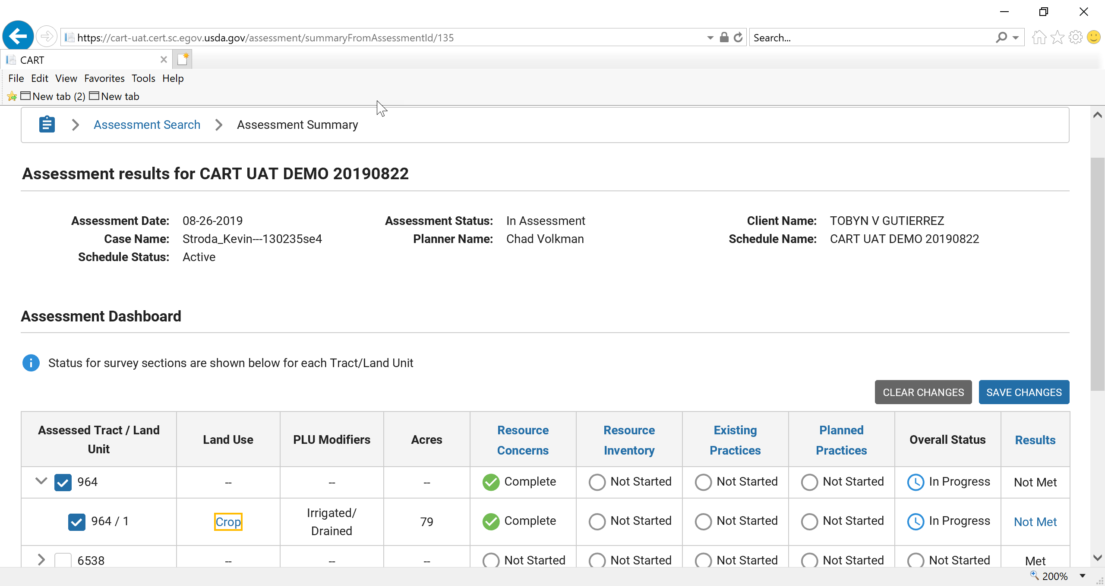
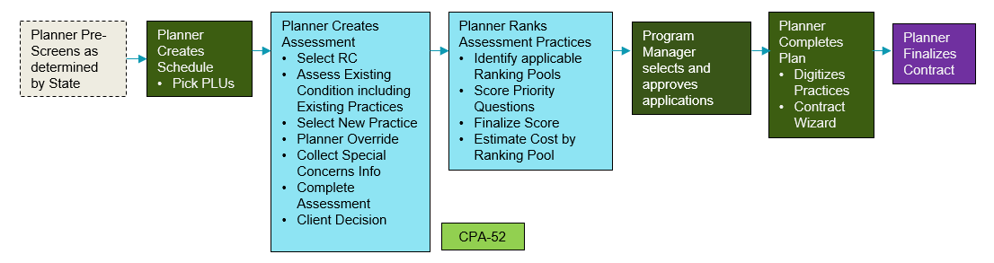
How does CART Work? – Planning Steps
Questions like
“is there cover out there”, percentage?
Steps
1 & 2
Steps3 & 4
Steps5 & 6
Notes:
Explain the workflow at the bottom of the page
This is the Assessment Summary page in CART. This is the user interface that the field staff will use to work through steps 1-6 of the Planning Process, CART Captures existing practices
Whether it was done with NRCS or District or other entity,
I will be demoing CART assessment tomorrow during the break out sessions. Today, I wanted to show you all under the hood of CART. The next portion of my presentation goes through how the Assessment Methodology contained in the Resource Concern Assessment Document and the Planned Practices Points in CPDES function and feed into CART.
Identify Problems and Opportunities
Determine Objectives
Inventory Resources
Analyze Resource Data
Formulate Alternatives
Evaluate Alternatives ----- Based on the Results Tab client’s can make decisions which is Step 7

Slide 5
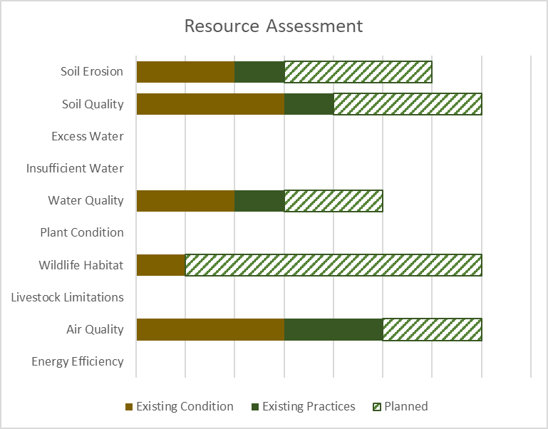
How does CART work? – Threshold (Steps 3-6)
Are we meeting Planning criteria or are there more opportunities out there, it may be shy of meeting one of the resource concerns
CART assists planners illustrate various alternative planned practices and their effect on the resource concern.
Threshold
Planned
BONUS: Ranking taking place
in background
Existing Condition & Practices
Notes:
This will help shows producers on how those resources that are being addressed with our assistance by implementing technical , financial assistance/practices and does it meet threshold for that component, It does take all these into consideration ( Existing Conditions, Existing Practices, and Planned Practices)
BONUS –Ranking Taking Place in the Background!!!

Slide 6
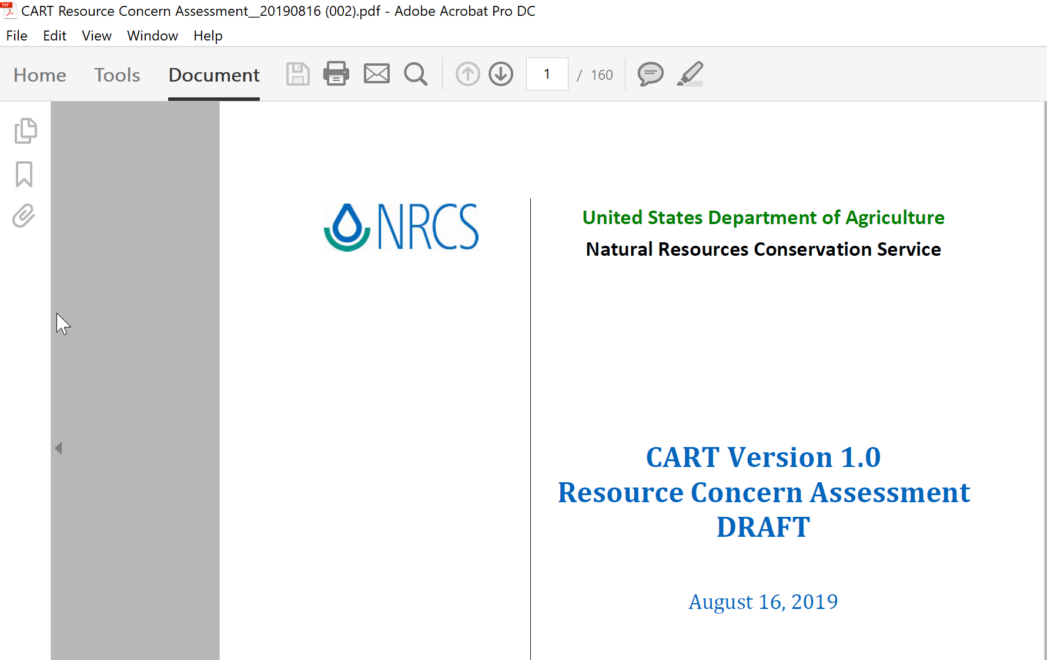
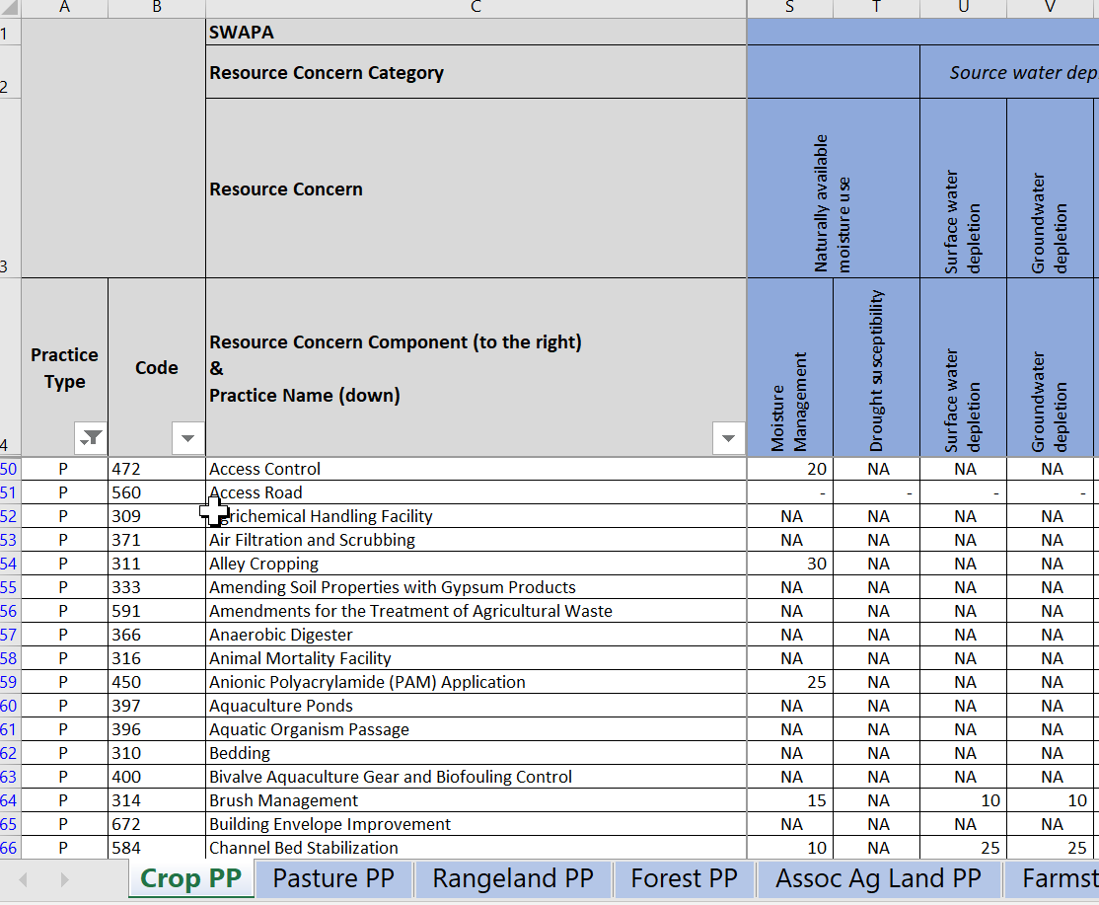
Resource Concern Assessment & Inventory Tool
Notes:
Resources for planners exist, Planning Criteria tools for the assessments on how each resource concern is applicable, assessed for that operation, we have planning criteria (so for example we want to address erosion) and we have a Tolerable soil loss value (a T value) and will compare it against that value

Slide 7
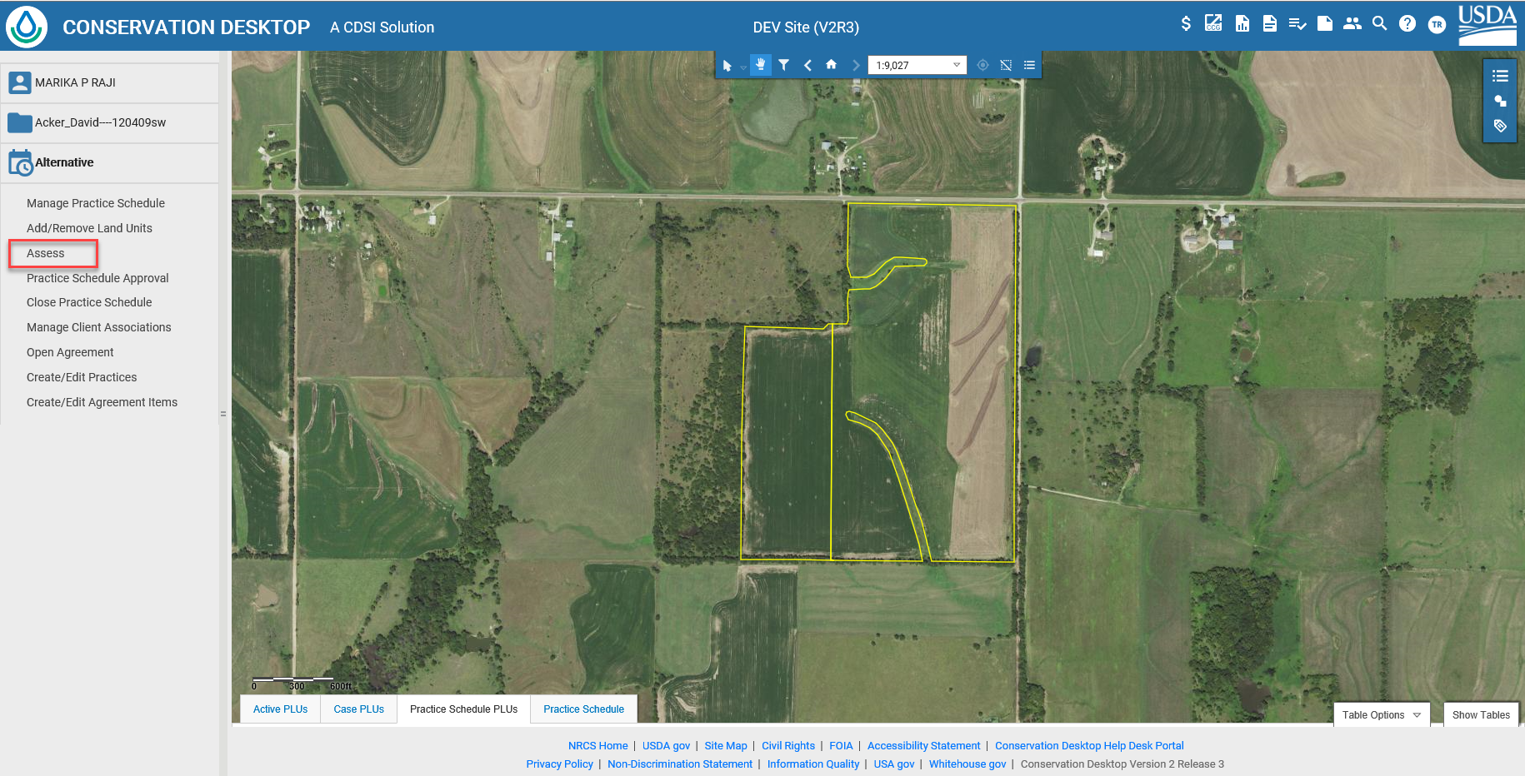
How does CART Work?
Notes:
Integration in CD! Not a separate tool. CART Sits on top of the geospatial Mapping from CD and uses that information to feed into an evaluation, to do the assessment and eventually go into the ranking
The step before entering into CART is to digitize at least one land unit into a practice schedule. This is the minimum requirement additional planning can be done on the land units in CD (planning practices) and that information will be carried over to CART. Also existing applied existing conservation practices will be brought over to CART as well.

Slide 8
CART Workflow
Configured Prior to Workflow
Resource Concern, Practices, and Points
Assessment Question Configuration
Geospatial
Questions
Spending Plan and line items
Program Manager Configuration of Ranking Pools
Geospatial
Questions
Key
CPDES
CART
FM
Request For Assistance
Planner Pre-Screens as determined by State
Planner Creates Schedule
Pick PLUs
Planner Creates Assessment
Select RC
Assess Existing Condition including Existing Practices
Select New Practice
Planner Override
Collect Special Concerns Info
Complete Assessment
Client Decision
Planner Ranks Assessment Practices
Identify applicable Ranking Pools
Score Priority Questions
Finalize Score
Estimate Cost by Ranking Pool
Program Manager selects and approves applications
Planner Completes Plan
Digitizes Practices
Contract Wizard
Planner Finalizes
Contract
CPA-52
Client Info and/or Field Visits conducted as appropriate
Key
May Start Application, including eligibility, but must be completed by end of Ranking Process
CART
CPA-52
CD
Protracts
Notes:
All tools are integrated.

Slide 9
Plan Assessment Ranking Points
Ranking pools will evaluate client’s applications for 5 main areas
Plan Assessment: Existing Vulnerability*
Plan Assessment: Planned Practice Effects*
Pool Priorities: Resource - (ex. Geospatial Based Priority Watershed)
Question Based (ex. Do the practices in the application affect sage grouse?
Pool Priorities: Program-Geospatial Based (ex. Risk of conversion)
Question Based (ex. Veteran Farmer)
Efficiency
*Information captured already in the assessment process
NOTE:
Only resource concerns which are identified by the ranking pool will garner plan assessment points
Only practices on land uses which are identified by the ranking pool will garner plan assessment points
Notes:
Refer back to other slides (Aaron’s and Athenas)

Slide 10
Efficiency
Plan Benefits from Applicable Practices
Average Annual Practice Cost
Weighted to result in meaningful score as identified by program

Slide 11
Application Score Weighting
Set by ranking pool with bounds set by program
Old National, State, and local questions would be incorporated into Plan Assessment or Pool Priorities
Pool Weighting
Plan Assessment | Vulnerability | 20%
 | Planned Practice Effects | 30%
Pool Priorities | Resource | 30%
 | Programmatic | 10%
Efficiency Score |  | 10%
Application Score |  | 100%

Slide 13
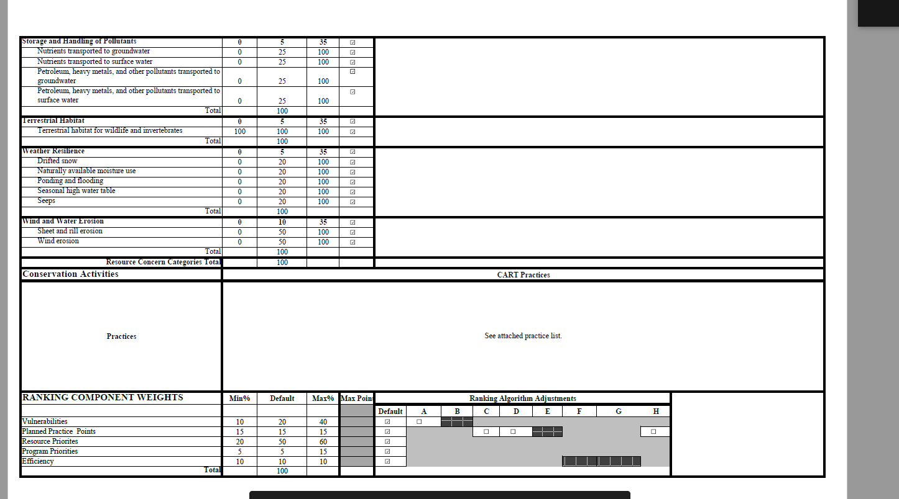

Slide 14
CART & CD Release Highlights
PI 13 April 27-July 19
PI14 July 20-October 11
Mango June 29
Nutmeg Aug 10
CART Ranking: Ranking Templates and pools for EWP, CRP
PLU Layer: 508 symbology updates
SAT: Correct full/partial funding and unlink subaccount from inactive pools
Workload Prioritization Tool
CD-EE (CPA-52): RFO Approval page
“Urban” as a land use modifier
Configuration: State SEC Display Groups
Conservation Products: CPA 1202, CPA 1155 integration with CD Agreements, CUA Plan Maps
Farmers.gov: Automated tasking for contract item certification requests
HELC/WC: Search/Add/Remove CLUs associated to request, Cancel request, Upload Docs
Reports: Full PRS Reports replacement
Reports: CD Applications Report
*All Features are estimated on release timeline

Slide 15
CART & CD Release Highlights
PI14 July 20-October 11
PI15 October 12-January 10
Okra Sept. 21
FY Rollover
Papaya Nov. 2
Assistance Notes: updates for HELC/WC
CART Assessment: Detailed Assessments
Conservation Products: CPA 1245, CPA 1156, AD 1155/56 integration with CD Agreements
Create/Edit Resource Inventory Features
GRAS create Quick Stocking Rates
HELC/WC Request Layer
CD-EE (CPA-52): add SEC survey unique to state
Easement Boundary Creation and Management
Easement CUA Functionality MVP
Bulk archival of assessments
CART Assessment Updates
Practice Points
COMET Climate Tool Integration
CD-EE (CPA-52): complete user inputs, export complete CPA-52
HELC/WC: Appeals Detailed Report and Request Status Report
TSP Registry integration with Practice Schedule
*All Features are estimated on release timeline

Slide 16
CART Advantages
Program Neutral Planning
Streamlined Assessment
Assessment and Resource Concern information by Land Unit
Environmental Assessment completed as part of planning
One Plan Goal
Program Prioritization based on Planning and outcomes
Reduced data duplication

