Slide 1
MN Natural Resources Conservation Service (NRCS)
STAC
Minnesota NRCS State Technical Advisory Committee (STAC)
April 15 2020
9:00 – 11:00am

Slide 2
Todays Agenda
Wednesday April 15, 2020
Time | Discussion Topics | Feedback/Discussion | Topic Leader
9:00 – 9:10 | Welcome and Introductions |  | Troy Daniell NRCS
9:10 – 9:20 | Subcommittee Reports | Forestry and Watershed Subcommittee progress | TBD
9:10 – 9:20 | National Conservation Practice Standards Comment Period | What practices are available for public comment | Ryan Galbreath, NRCS
9:20 – 9:45 | Conservation Application and Ranking Tool (CART) Overview | Comments and what you have heard about CART | Ryan Galbreath, NRCS
9:45 – 10:15 | Environmental Quality Incentives Program (EQIP) Conservation Stewardship Program Regional Conservation Partnership Program Local Work Groups | EQIP and CSP priorities and partner feedback | Keith Kloubec, NRCS
10:15 – 10:30 | Wetland Restoration Criteria and Guidelines | Subcommittee development topic | Lanette Dietrich, NRCS
10:30 – 11:00 | Partner Updates and Announcements and Additional Feedback
11:00 Adjourn

Slide 3
Webinar Housekeeping
Please mute you phones when not talking
Please identify yourself when asking a question or providing a comment.
Please be patient with the system
To protect the health and safety of employees and members of the public during the COVID-19 outbreak in accordance with guidance from federal and state authorities, the MN NRCS State Technical Advisory will perform its committee duties virtually. If possible, please invite a farmer or rancher from your organization to attend also. We look forward to your feedback and ways we can provide better customer service.

Slide 4
Welcome and Introductions
Troy Daniell
State Conservationist
USDA NRCS

Slide 5
STAC Subcommittee Reports
Forestry Subcommittee Report
Celie Borndal, USDA NRCS State Forester
Watershed Subcommittee Report
Shannon Carpenter, USDA NRCS State Water Quality Specialist/TSP Coordinator

Slide 6
Federal Register Notice Comment Period Ends April 23 2020
Treatment of Agricultural Waste (Code 591)
Composting Facility (Code 317)
Conservation Crop Rotation (Code 328)
Dam (Code 402)
Denitrifying Bioreactor (Code 605)
Energy Efficient Building Envelope (Code 672)
Energy Efficient Lighting System (Code 670)
Forage Harvest Management (Code 511)
Grade Stabilization Structure (Code 410)
Grassed Waterway (Code 412)
Heavy Use Area Protection (Code 561)
Herbaceous Weed Treatment (Code 315)
Irrigation Water Management (Code 449)
Lined Waterway or Outlet (Code 468)
Livestock Pipeline (Code 516)
Livestock Shelter Structure (Code 576)
Pasture and Hay Planting (Code 512)
Prescribed Burning (Code 338)
Pumping Plant (Code 533)
Riparian Forest Buffer (Code 391)
Saturated Buffer (Code 604)
Stormwater Runoff Control (Code 570)
Streambank and Shoreline Protection (Code)
Terrace (Code 600)
Trails and Walkways (Code 575)
Tree/Shrub Site Preparation (Code 490)
Underground Outlet (Code 620)
Vegetative Barrier (Code 601)
Watering Facility (Code 614)
Water Well (Code 642)
Well Decommissioning (Code 351).

Slide 7
Conservation Assessment Ranking Tool
A program-neutral assessment with an integrated and efficient ranking tool to facilitate conservation delivery.
Streamline, Efficiency & Customer Service
Streamline Using Geospatial Data
Efficient Conservation Planning and Ranking
Improve Services and Time to Interact with the Client
OUTCOMES!
EVOLVE
GROW
ADAPTIVE
IMPROVE
INNOVATION
ALIGNMENT

Slide 8
CART Advantages
Program Neutral Planning
Streamlined Assessment
Assessment and Resource Concern information by Land Unit
Program Prioritization based on Planning and Outcomes
Reduced data duplication
OUTCOMES!
EVOLVE
GROW
ADAPTIVE
IMPROVE
INNOVATION
ALIGNMENT

Slide 9
Conservation Planning Process
Phase I
Collect & Analyze
Identify Problem
Determine Objective
Inventory Resources
Analyze Resource Data
Phase II
Decision Support
Formulate Alternatives
Evaluate Alternatives
Make Decision
Phase III
Implementation & Evaluation
Implementation Requirements
Implement the Plan
Evaluate the Plan
Conservation Desktop
Future
Conservation Assessment Ranking Tool
Contract
Environmental Assessment
Resource Concerns
Planning Criteria
Existing Condition
Conservation Plan
CAPS
Designs
Checkout
Conservation Practices
Economics

Slide 10
CART Enhanced Program Workflow
Planner Creates Assessment
Select RC
Assess Existing Condition including Existing Practices
Select New Practice
Planner Override
Collect Special Concerns Info
Complete Assessment
Planner Pre-Screens as determined by State
Planner Creates Schedule
Pick PLUs
Planner Ranks Assessment Practices
Identify applicable Ranking Pools
Score Priority Questions
Finalize Score
Estimate Cost by Ranking Pool
Program Manager Selects Assessment and associated Practices by Ranking
Planner Completes Plan
Digitizes Practices
Contract Wizard
Planner Finalizes
Contract
Client Info and/or Field Visits conducted as appropriate
May Start Application, including eligibility, but must be completed by end of Ranking Process
Protracts
CD
CART
CPDES
FM
Configured Prior to Workflow
Resource Concern, Practices, and Points
Assessment Question Configuration
Geospatial
Questions
Spending Plan and line items
Program Manager Configuration of Ranking Pools
Geospatial
Questions

Slide 11
Ranking Pool Use
Within CART each FY 2020 program Spending Plan (funding pools, subaccounts, and/or initiatives) will have a CART ranking pool.
Ranking pools will evaluate client’s applications for 5 main areas
Plan Assessment: Existing Vulnerability
Plan Assessment: Planned Practice Effects
Pool Priorities: Resource
Pool Priorities: Programmatic
Efficiency
Information captured in the planning & assessment process
Pool Weighting
Plan Assessment | Vulnerability
 | Planned Practice Effects
Pool Priorities | Resource
 | Programmatic
Efficiency Score
Application Score
Existing Condition & Practices
Threshold
-
Vulnerability
Notes:
subaccounts

Slide 12
One Plan/Practice Schedule - Multi-Ranking Pool Evaluations
A Plan Assessment is made up of multiple practices which may be eligible under multiple ranking pools.
CART will allow consideration for funding under all applicable ranking pools
Plans may receive funding from multiple ranking pools
CART will assure a practice is not funded twice on the same land unit by separate funding sources
Notes:
More examples

Slide 13
Ranking Pool (Applicability)
A ranking pool will start to garner points if:
At least one resource concern is checked to assess for a resource concern identified as positively weighted for the ranking pool
Applicable Practices are in the Plan for the ranking pool
Applicability Question is passed

Slide 14
Application Score Weighting
Set by Ranking Pool by Program
Pool Weighting
Plan Assessment | Vulnerability | 20%
 | Planned Practice Effects | 30%
Pool Priorities | Resource | 30%
 | Programmatic | 10%
Efficiency Score |  | 10%
Application Score |  | 100%

Slide 15
CART
Assessment

Slide 16
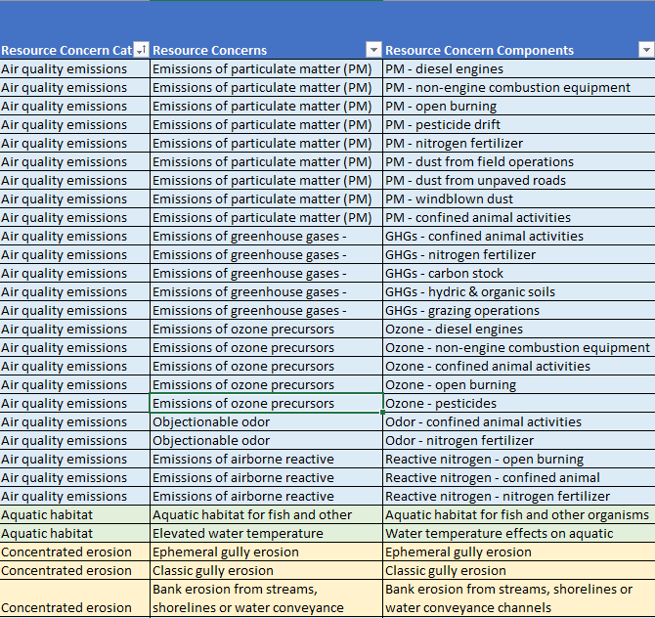
Resource Concerns
CART provides an assessment for all 47 Resource Concerns
Some Concerns are broken into components to prevent apples to oranges comparisons
Concerns are grouped to allow streamlined selection and assignment to land units
This will initially be challenging as it is a new way of thinking.
Geospatial information can be used to identify areas of heightened concern
16

Slide 17
Thresholds
CART sets a threshold of conservation points necessary to achieve the planning criteria for each resource concern selected.
Static Thresholds: Resource concerns have a set threshold of 50. This concerns primarily do not vary by soils or other site characteristic.
Example: Classic Gully Erosion
Example: Terestrial Habitat
Variable Thresholds: Resource concerns have a variable threshold. The level of conservation effort needed to achieve planning criteria vary by site specific criteria.

Slide 18
Existing Condition Inventory
Questions will be based on the resource concerns selected existing condition questions will be asked
Questions will be curated to allow dependencies in a question tree
Questions will be multi-choice and allocate conservation points toward achieving threshold
Some may be answered by geospatial information
Questions may garner points for multiple resource concerns
Existing Practices will be pulled from previous contracts and additional observed practices can be attributed to a land unit

Slide 19
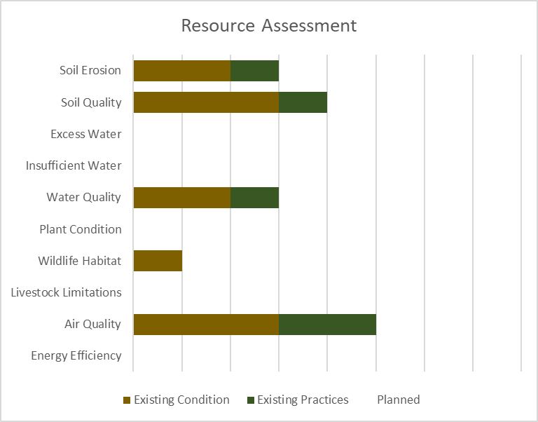
Analyze Resource Data
CART assists planners to analyze resource data captured in the inventory and compare against the threshold to determine if planning criteria is met. Planner override will be allowed.
+
+
+
+
+
+
+
+
+
+
Threshold
Existing Practices
Existing Condition

Slide 20
Phase II Decision Support
Planners compare alternative practices and systems to address resource concerns
CART will allow both primary and supporting practices
Practices garner conservation points toward meeting thresholds for all resource concerns which are relevant
Planners will have the ability to override the CART planned result (meet or not meet) for each resource concern
20

Slide 21
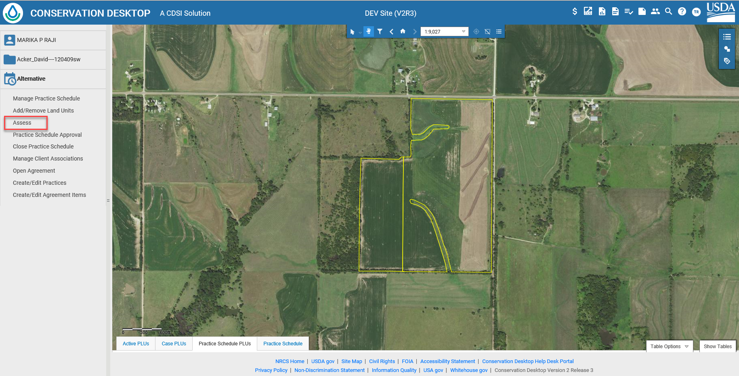
How does CART Work?
Notes:
Integration in CD! Not a separate tool. Streamlined!
The step before entering into CART is to digitize at least one land unit into a practice schedule. This is the minimum requirement additional planning can be done on the land units in CD (planning practices) and that information will be carried over to CART. Also existing applied existing conservation practices will be brought over to CART as well.

Slide 22
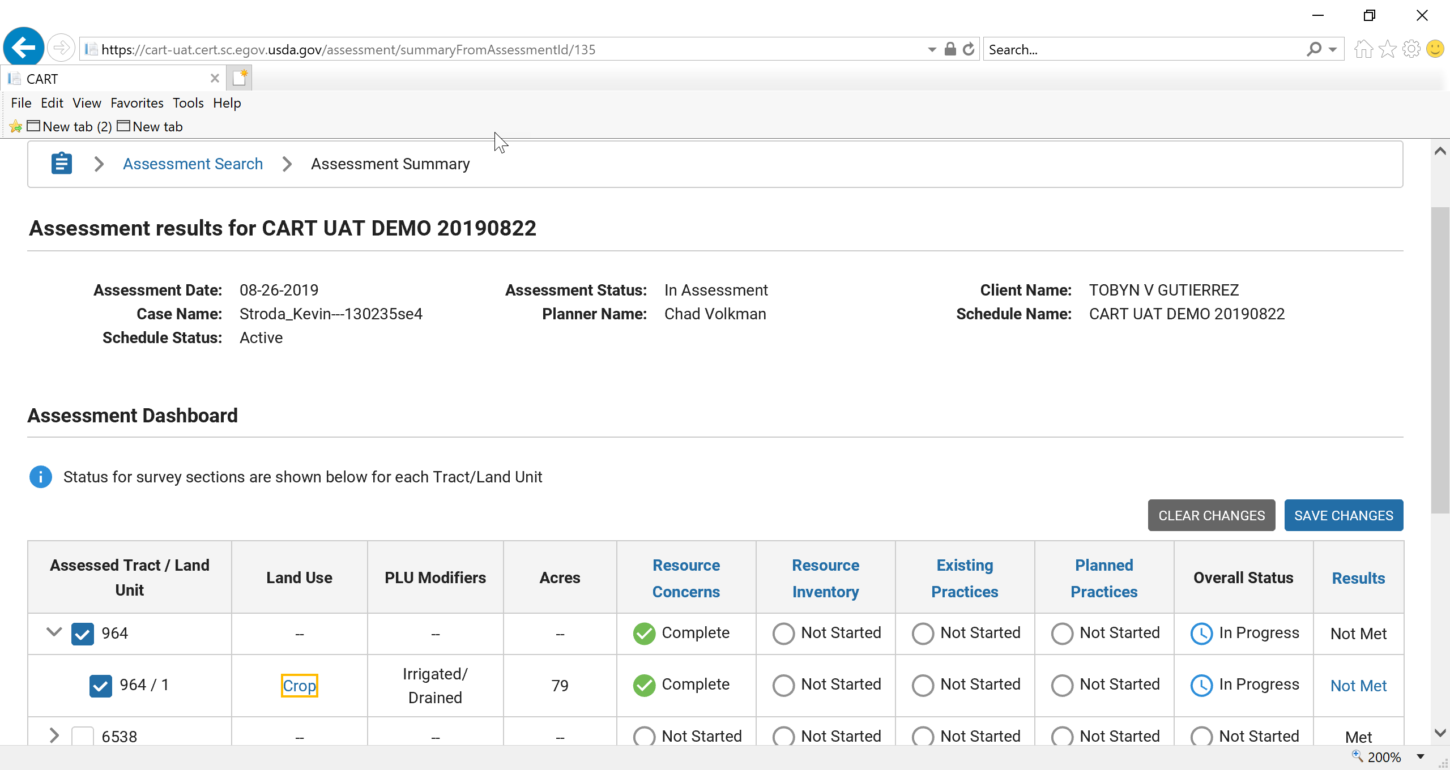
How does CART Work? – Planning Steps
Steps
1 & 2
Steps3 & 4
Steps5 & 6
Notes:
Explain the workflow at the bottom of the page
This is the Assessment Summary page in CART. This is the user interface that the field staff will use to work through steps 1-6 of the Planning Process
Identify Problems and Opportunities
Determine Objectives
Inventory Resources
Analyze Resource Data
Formulate Alternatives
Evaluate Alternatives ----- Based on the Results Tab client’s can make decisions which is Step 7

Slide 23
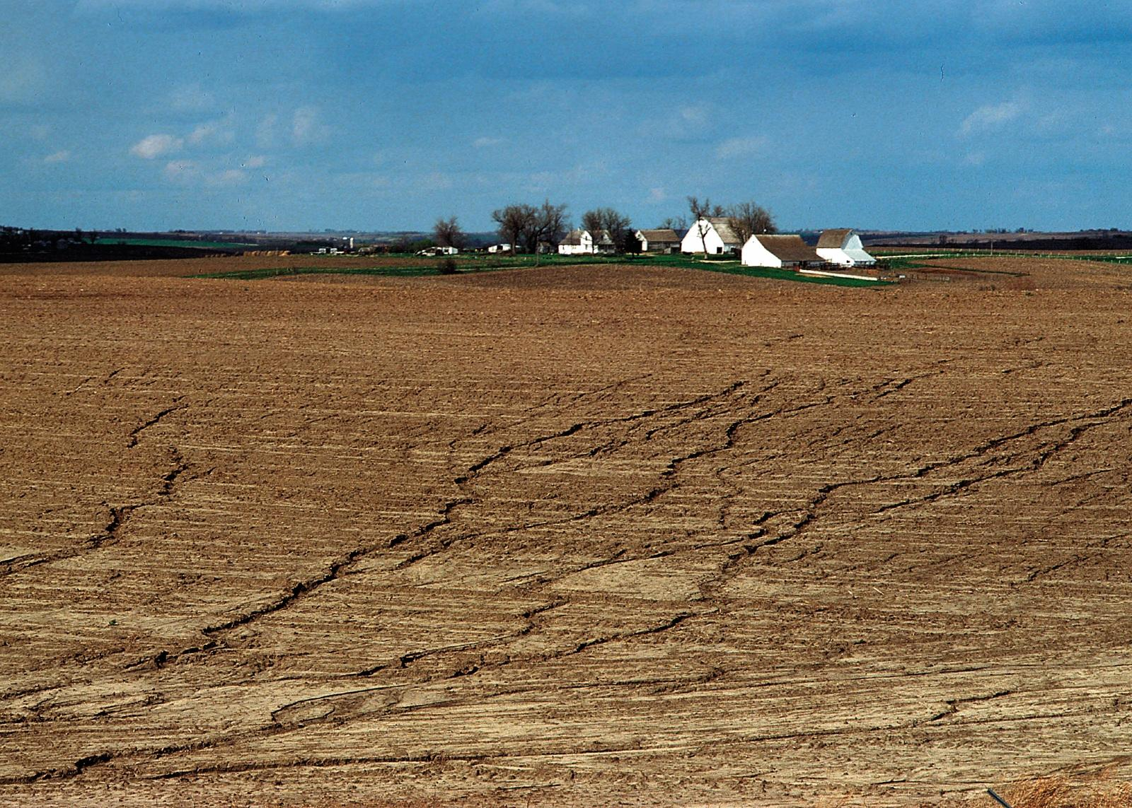
How does CART work? => Steps 1 and 2
Soil Erosion – Sheet and Rill – Threshold
Geospatially Calculated Threshold
40
23
Notes:
State the Resource concern
Explain the Results of the Land Unit table comes from
Geospatially calculated Threshold - Not a set threshold. The threshold will be dynamic based on Erodibility Potential and the R factor. Determined geospatially base on the location of the land unit that was digitized in CD.

Slide 24
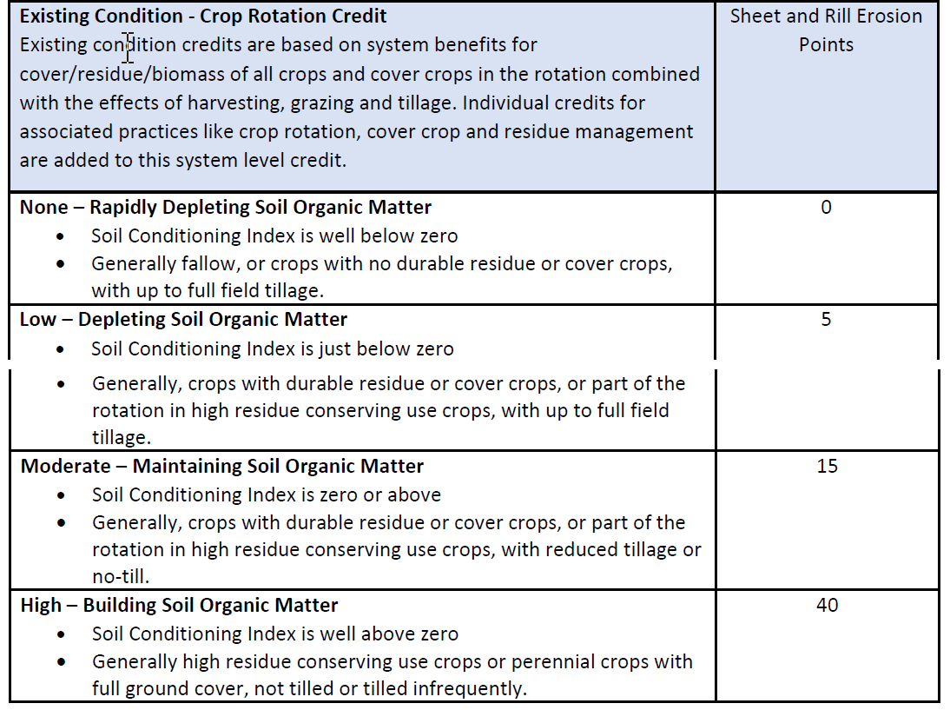
How does CART work? => Steps 3 and 4
Soil Erosion – Sheet and Rill – Existing Conditions
5
5
5
40
24
Notes:
SCI only meant as guidance not requiring that RUSLE II needs to be run. Planner override reference guidance.

Slide 25
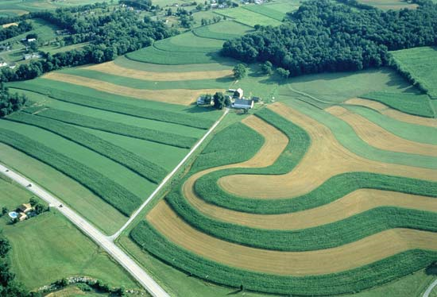
How does CART work? => Steps 3 and 4
Soil Erosion – Sheet and Rill – Existing Practices
Conservation Practices | Conservation Practice Points
Conservation Crop Rotation (328) | 10
Contour Farming (330) | 5
Cover Crop (340) | 15
Residue and Tillage Management, No-Till (329) | 20
Residue and Tillage Management, Reduced Till (345) | 15
Stripcropping (585) | 5
Terrace (600) | 15
5
15
20
20
40
25
Notes:
In CART there are two types of Existing practices that can be shown. The first is going to be Historical Practices pulled from NPAD. These historical practices will be applied practices and funded practices. The second will be Observed Practices. Observed practices will be those conservation practices up and above the Historical Practices. These will be noted when field observations are made.

Slide 26
How does CART work? => Steps 5 and 6
Soil Erosion – Sheet and Rill – Planned Practice
Conservation Practices | Conservation Practice Points
Conservation Crop Rotation (328) | 10
Contour Farming (330) | 5
Cover Crop (340) | 15
Residue and Tillage Management, No-Till (329) | 20
Residue and Tillage Management, Reduced Till (345) | 15
Stripcropping (585) | 5
Terrace (600) | 15
5
15
20
30
50
40
26
Notes:
Planned Practice Points are viewable in the excel document that was sent out with the 2nd updated version of the CART Resource Concern Document.
Housed in CPDES.
Planned Practices could come from CD planning or CART planning. When planned in CART the practices will feed back in to CD as Draft practices.

Slide 27
Plan Assessment Ranking Points
Existing Condition & Practices
Planned Practice
Effects
Threshold
-
+
Vulnerability
5
15
20
30
50
40
40
-
20
+
30
Vulnerability
20
Vulnerability Pts
30
Planned Practices Pts

Slide 28
Conservation Program Application Score Weighting
Set by Ranking Pool by Program
Pool Weighting
Plan Assessment | Vulnerability | 20%
 | Planned Practice Effects | 30%
Pool Priorities | Resource | 30%
 | Programmatic | 10%
Efficiency Score |  | 10%
Application Score |  | 100%

Slide 29
Conservation Program Application Score Weighting
Set by Ranking Pool by Program
Support local workgroups, state technical committees, and partners on prioritizing resource concerns for funding consideration
Determine all eligible ranking pools that support the implementation of the planned practices
Use geospatial data for ranking
Pool Weighting
Plan Assessment | Vulnerability | 20%
 | Planned Practice Effects | 30%
Pool Priorities | Resource | 30%
 | Programmatic | 10%
Efficiency Score |  | 10%
Application Score |  | 100%

Slide 30
Questions or Discussions

Slide 31
Minnesota NRCS State Technical Advisory Committee Keith Kloubec- ASTC-Programs
APRIL 2020

Slide 32
High Priority and Source Water Protection Practices
The 2018 Farm Bill and EQIP interim rule authorize increased payments for up to 10 high priority practices & Source Water Protection practices
Increase payment rates up to 90%
MN NRCS 2020 utilized Prioritization and Ranking Points

Slide 33
High Priority Practices (HPP)
HPP criteria:
Address impairments from excess nutrients in ground or surface water;
Address drought mitigation and declining aquifers;
Meet other environmental priorities identified in habitat or area restoration plans;
Geographically targeted to a specific watershed/Area.

Slide 34
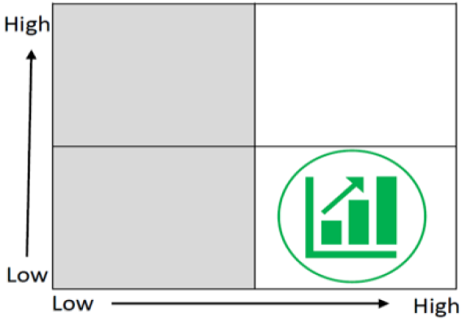
High Priority Practices
Selection of practices should target conservation practices with HIGH potential for conservation benefit but have LOW adoption rates.
Adoption Rate
Conservation Benefits

Slide 35
High Priority Practices
Should not be used to incentivize practices widely used and common unless a specific purpose or geographic region for which the practice is underutilized
For example: Cover Crops- already widely adopted
Cover Crops- used to protect sensitive sandy soils and cycle nutrients in a specific area where it hasn’t been adopted.

Slide 36
Source Water Protection
2020 Priority Areas

Slide 37
Source Water Protection Practices
Increased payment rates apply:
Only within the identified local priority areas and
Meet the objectives of the source water protection assessment
Increased source water protection practice payment rates apply only to EQIP
SWP areas used to prioritize workload in CSP 2020
Additional points for SWP areas several program ranking pools

Slide 38
HPP & SWP considerations
Will an increase of 5-30% in payment rate impact adoption significantly?
Other factors that impact adoption?
Social, practice requirements, technology, other
Promote, Prioritize, Points

Slide 39
HPP & SWP considerations
Nutrient Management (590)
Conservation Crop Rotation (328)
Addition of a small grain into a rotation or
Addition of a perennial crop into the rotation
Drainage Water Management (554)
Saturated Buffer (604)
Denitrifying Bioreactor (605)
Prescribed Grazing (528)
Forage and Biomass Planting (512)
Irrigation Water Management (449)
Residue and Tillage Management, No-Till (329)
Conservation Cover (327)
Cover Crops (340)
Windbreak/Shelterbelt Establishment (380)
Irrigation Water Management (449)
Discussion: practices, locations, other?

Slide 40
Regional Conservation Partnership Program (RCPP)
Mission Support Services
Operations Associate Chief Area

Slide 41
RCPP Interim Rule
Comment period extended to May 12th
https://www.regulations.gov/
Search: NRCS RCPP

Slide 42
RCPP Proposals
2019 Renewal: MDA- MAWQCP Awarded
2019 Classic: Announcement to be issued tomorrow on Awardees
Alternative Funding Arrangements (AFA): March 17-May 18
RCPP 2020 DATES-TBD

Slide 43
What is an Alternative Funding Arrangement (AFA) in RCPP ?
First included in the 2014 Farm Bill, expanded in the 2018 Farm Bill.
Provides for alternative project structures, compared to RCPP Classic’s use of more traditional NRCS program approach.

Slide 44
RCPP Classic Approach
RCPP Project
TA & FA
TA
NRCS
State Office
Partner/ Sponsor
FA
Contracts Easements
Producers/ Landowners

Slide 45
RCPP AFA Approach
LimitedTA
RCPP Project
NRCS
State Office
Inherently Governmental Activities
Lead Partner
FA
Easements Contracts Watersheds
TA
Producers/ Landowners/ Partners/ Contractors

Slide 46
AFA funding announcement
Up to $50 million available
Statutory restriction--a maximum of 15 projects awarded through this announcement

Slide 47
Many requirements similar to Classic
Funding must be split 50/50 with Critical Conservation Areas and State/Multistate pools
Conservation benefits/resource concerns
Partner contributions are critical and goal is at least 1:1
Funding min ($250k) and max ($10M) are the same
70/30 FA/ Max TA split is the same
Eligible lead partners are the same

Slide 48
RCPP Principles- Classic and AFA

Slide 49
AFA is designed for projects…
That are innovative and do not rely on existing NRCS program operations.
That cannot be effectively carried out using RCPP Classic approach.
That can be entirely managed and implemented by the lead partner (in collaboration with other partners), with the exception of inherently governmental activities, in a more grant-like fashion.

Slide 50
How to Apply
Deadline is 11:59 p.m. on May 18, 2020.
Contact your State RCPP Coordinator(s) to discuss your project proposal.
Review the RCPP AFA Proposal Guide (found on the RCPP How to Apply webpage).
Apply for Level 2 eAuthentication permissions (if needed).

Slide 51
Local Work Groups –Locally Led
2020 LWG schedule (MN NRCS Website)- many postponed due to COVID19.
LWG summaries used to develop priorities and ranking points for 2020.
CSP- Priority Resource Concerns
EQIP- Workload Prioritization and Ranking

Slide 52
Questions/Discussion
The USDA is an equal opportunity employer, provider and lender.

Slide 53
Wetland Restoration Criteria and Guidelines
Wetland Restoration Criteria and Guidelines Handout: StateTechApril_2020 WRCG
MN AWMA Boundary
Handout: MN_DRAFT_AWMA Boundary.pdf
Conservation Easements Subcommittee

Slide 54
Partner Updates and Announcements
Next STAC Meeting (July – August)
Feedback on USDA NRCS Programs
Feedback on NRCS Technical Materials
Today’s Challenges Facing MN Farmers, Ranchers and USDA Program Participants.

