Slide 1
ECS Practice Standard Update
Ryan Galbreath
State Resource Conservationist
NRCS State Technical Committee
September 14, 2021

Slide 2
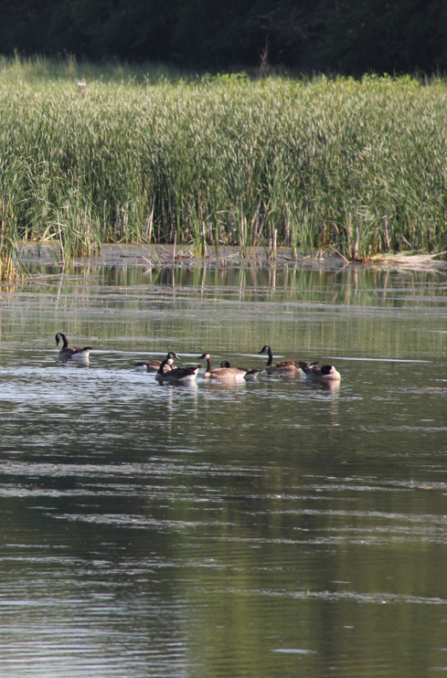
Ecological Sciences (ECS)
23 practices will be updated
All Disciplines are involved:
Agronomy
Forestry
Grazing
Water Quality
Wildlife

Slide 3
Ecological Sciences Practices

Slide 4
October Release
Access Control (472)
Alley Cropping (311)
Contour Farming (330)
Cross Wind Ridges (588)
Fence (382)
Forage Harvest Management (511)
Forest Trails and Landings (655)
Herbaceous Weed Treatment (315)
Mulching (484)

Slide 5
October Release
Nutrient Management (590)
Pasture and Hay Planting (512)
Pest Management Conservation System (595)
Prescribed Burning (338)
Residue and Tillage Management, No-Till (329)
Riparian Forest Buffer (391)
Stream Habitat Improvement and Management (395)
Stripcropping (585)

Slide 6
October Release
Surface Roughening (609)
Tree/Shrub Site Preparation (490)
Vegetative Barrier (601)
Wildlife Habitat Planting (420)
Windbreak/Shelterbelt Establishment (380)
Woody Residue Treatment (384)

Slide 7
Questions?

Slide 8
Agronomy Practices

Slide 9
October Release
Contour Farming (330)
Cross Wind Ridges (588)
Mulching (484)
Nutrient Management (590)
Pest Management Conservation System (595)
Residue and Tillage Management, No-Till (329)
Surface Roughening (609)
Stripcropping (585)
Vegetative Barrier (601)

Slide 10
Forestry Practices

Slide 11
October Release
Access Control (472)
Alley Cropping (311)
Forest Trails and Landings (655)
Tree/Shrub Site Preparation (490)
Windbreak/Shelterbelt Establishment (380)
Woody Residue Treatment (384)

Slide 12
Grazing Practices

Slide 13
October Release
Fence (382)
Forage Harvest Management (511)
Herbaceous Weed Treatment (315)
Pasture and Hay Planting (512)

Slide 14
Water Quality Practices

Slide 15
October Release
Riparian Forest Buffer (391)

Slide 16
Wildlife Practices

Slide 17
October Release
Prescribed Burning (338)
Stream Habitat Improvement and Management (395)
Wildlife Habitat Planting (420)

